Slide 1
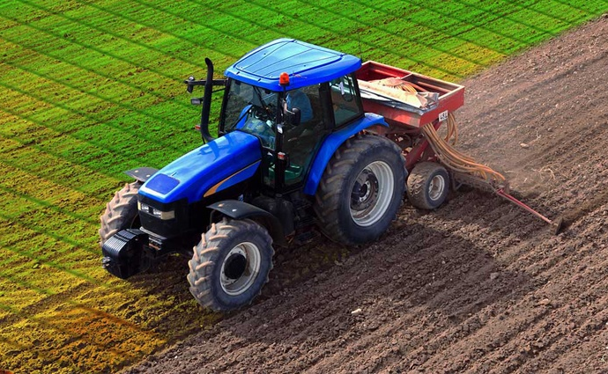
Science of Farming
Farm practices and technology are constantly evolving.
Conservation practices (4R Nutrient Stewardship System, contour plowing, terracing, windbreaks, cover crops, crop rotation, no-till farming, etc.)
Cultural controls (varied planting seasons, etc.)
New farm equipment
New technology (Global Positioning System, weather monitoring system, soil PH and temperature analysis, new seed varieties, etc.)
Biological controls (ladybugs, etc.)
Chemical controls (pesticides and herbicides)
Notes:
Optional Slide

Slide 2
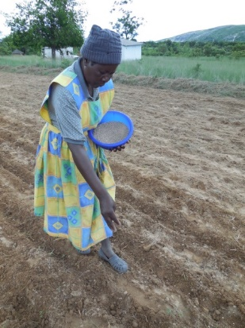
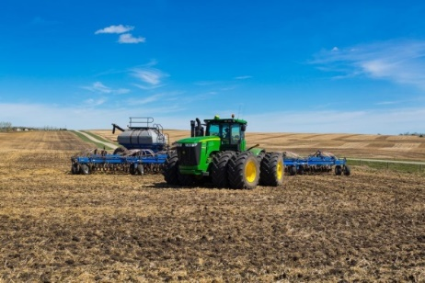
Science of Farming
Goal: Grow a healthy crop and raise healthy livestock while balancing a budget and environmental footprint
Reality: Farmers must use the resources they have to make informed decisions
Does a Kenyan farmer have the same equipment as a North American farmer?
How does an organic farmer vs a conventional farmer respond to a problem with nutrients, pests or diseases?
There is no one-size-fits-all solution. Every farmer grows the healthiest plants and animals they can.
A farmer’s livelihood depends on sustainable practices.
Notes:
Optional Slide

