Slide 1
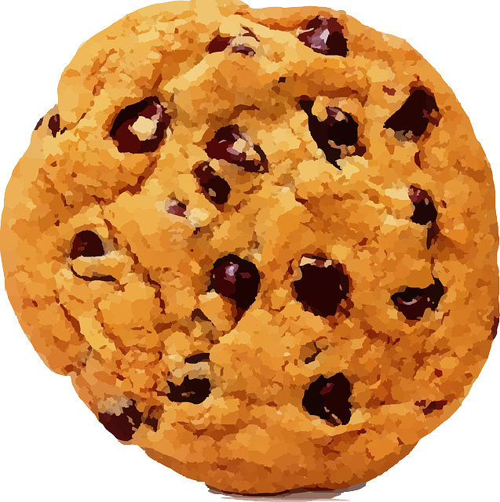
Enriching activities
The Sustainability Cookie
Please Do Not Touch or Eat Your Cookie Without My Permission
Notes:
Use this exercise to help reinforce the principles of sustainability and food waste
Supplies: Cookies (1 per student), napkins, the ingredients needed to make a chocolate chip cookie (flour, sugar, butter, eggs, vanilla, baking soda, chocolate chips, salt)
• Pass out a cookie to each student on a napkin, do not let them eat or touch the cookie without your permission.
• Display all ingredients, explain that each symbolizes a piece of the sustainability barrel. Each is necessary to make a cookie, just as it is necessary to consider all social, economic and environmental factors to attain sustainability.
BUT, what if food security is an issue in the classroom? Have 1/3 of the classroom take their cookie off their desk and place it on another student’s desk.
Ask both groups of students (those with cookies and those without) to describe how they feel about their access to food.
• Go around to the students who have multiple cookies and cover one with a napkin. Explain this symbolizes food waste has occurred, the food was disposed of without being consumed.
Remind the class that 1/3 of our food supply is wasted, this includes developed and developing countries. Ask the class what is wasted beside the food itself when thrown away? (i.e. environmental resources, commodities, fuel, labor)
• Ask the students who don’t have a cookie to get theirs back so each student has one. Let them eat their treat!
• Remind the class of the value of access to a stable food supply and the conscious decisions we can make to ensure that continues.

