Slide 1
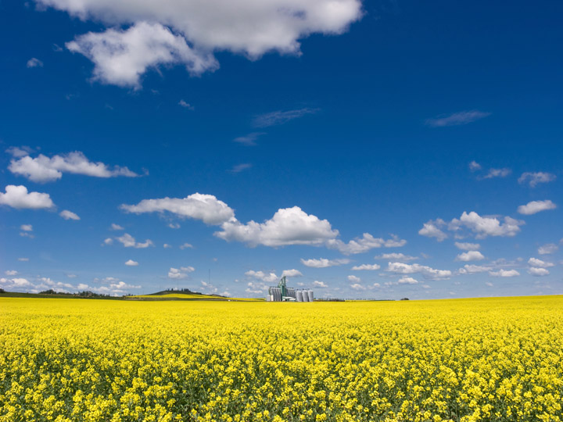
Sustainable Agriculture
Lesson 1
V6.0
Notes:
Time
90 minutes
Activity Expectations
Students will be able to:
Understand the core question, “How will we sustainably feed nearly 10 billion people by the year 2050?” and begin to think about the challenges and opportunities presented by this question;
Describe the expected population growth between now and the year 2050;
Identify agricultural products that must be provided by agriculture in order to accommodate a growing population;
Explain what sustainable agriculture is using the sustainability barrel;
Discover how the ripple effect can relate to sustainable agriculture and have a positive impact in our society; and
Understand the role food waste plays in our world.
Materials
Introduction to Sustainable Agriculture PowerPoint
Journey 2050 Introduction video (https://youtu.be/zYecU_gJdxA)
Sustainability Farming Game Level 1 Demo
Computer or tablet device for each student
Optional: Student Handout 1: World Population Growth
Key Terms
Sustainability, Agriculture, Sustainable Agriculture, Social, Economic, Environment

Slide 2
How much is 1 Million?
If I spend $1000 every day, how many days would it take to spend 1 million dollars?
2.7 years or 1,000 days
Notes:
Allow students to offer their answers as they begin visualizing the quantity and value of 1 million. Then ask, “If I spent $1000 every day, how long would it take me to spend 1 million dollars?” (2.7 years, or 1,000 days)

Slide 3
How much is 1 Billion?
If I spend $1000 every day, how many days would it take to spend 1 billion dollars?
1,000,000 days or 2,740 years!
What is the current world population?
Over 7 billion
What is the world population projected to be in 2050?
Nearly 10 billion
Notes:
If I spend $1,000 every day, how many days would it take to spend 1 billion dollars?” (1,000,000 days or 2,740 years)
What is the current world population right now?(over 7 billion).
Do you know what the world population is projected to be in the year 2050?(nearly 10 billion).
Optional:
If time allows, use one of the following activities to help students further visualize and understand the growth trends in world population:
Show the World Population video/animation (https://youtu.be/khFjdmp9sZk, 5:46 min)
Show the 7 Billion: How Did We Get So Big So Fast? Video (https://www.youtube.com/watch?v=VcSX4ytEfcE, 2:33 min)
Have students complete Student Handout 1: World Population Growth.

Slide 4
Introduction to Sustainable Agriculture
Watch the Journey 2050 Introduction Video
As you watch, discover:
Why 2050?
What is the sustainability barrel?
What is the ripple effect?
Notes:
https://youtu.be/zYecU_gJdxA
Prepare students for the video by asking them to discover three things:
Why is 2050 a significant year?
What is the sustainability barrel? and
What is the ripple effect? (Background and discussion prompts are outlined in the steps below and in the PowerPoint notes.)

Slide 5
Why 2050?
How many years until we reach the year 2050?
How old will you be in 2050?
Notes:
Ask students, “If it is [insert current year] right now, how many years until we reach the year 2050?”
Then ask, “How old will you be in the year 2050?”

Slide 6
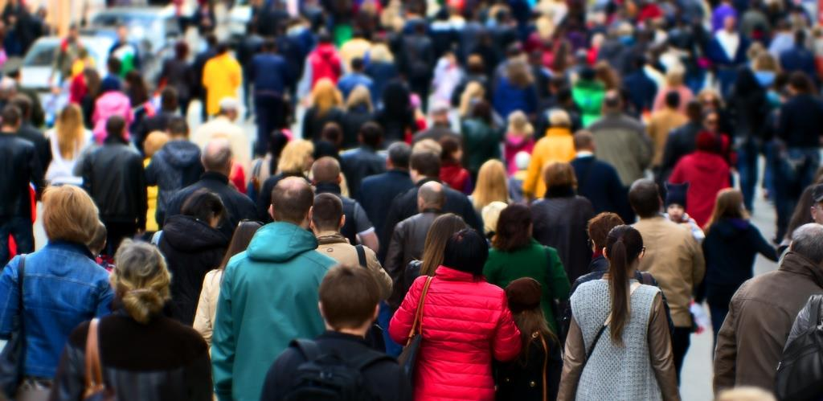
Why 2050?
Over 7 billion Nearly 10 billion
people today by the year 2050
Notes:
Explain that scientists and world leaders have identified 2050 as a key moment in time when the world’s population will be nearly 10 billion – that is over 2 billion more than today. Point out to students that they will be adults! They will have an influence on the decisions that impact everything from what is taught in schools to what they buy at the grocery store.

Slide 7
Why 2050?
What will we need more of in order to feed 2 billion additional people?
Water
Jobs
Food
Homes
Medicines
Who provides these resources?
Farmers and natural resources from the Earth
Notes:
Ask students to identify some of the resources that we will need more of in order to provide for over 2 billion additional people on the earth. Brainstorm and list several items on the board. Use questioning to help students identify items such as food, clothing, shelter, fuel, jobs, medicine, etc. Remind students about all the products they get from agriculture (food, fiber, fuel, timber, medicines and by-products that are used in manufacturing or end up in items such as lipstick, paint and batteries). Explain that farmers and many other agricultural professionals are responsible for producing each of these daily necessities.

Slide 8
Why 2050?
It is predicted we will need to grow 60-70% more food than we currently grow today, on the same amount of land or less.
To accomplish this goal, will there be increased or decreased pressure on Earth’s natural resources?
Notes:
Explain that in order to feed over 2 billion additional people, it is predicted that farmers will need to produce 60 to 70% more food than we currently produce today on the same amount or even less land.
Ask, “Will this goal of sustainable agriculture be easy to accomplish? Will the pressure on farmers increase, decrease, or stay the same?”
As students are thinking and offering answers, draw their attention back to the Interest Approach at the beginning of the lesson, picturing an additional 2 billion people that agriculture must feed. Students should conclude that farmers will have increased pressure to produce more food and fiber for a growing population.

Slide 9
What is the sustainability Barrel?

Slide 10
Sustainability Barrel
It is estimated that by 2050, our growing population will require the equivalent of all the food grown in the last 500 years put together.
Can a farmer take their same land, soil, seeds, water, and tractors and double their crop from one year to the next?
No! There are limitations
Notes:
Tomorrow’s farmer will have to feed even more people.
It is estimated that by 2050, our growing population will require the equivalent of all the food grown in the last 500 years. That’s a lot of food!
Ask, “Do farmers have limitations to how much they can produce?”
As students think about the answer to this question, give an example of a farmer. Can this farmer take their same land, soil, seeds, water and tractors and double their crop from one year to the next? No, there are limitations if a farmer wants to produce agricultural goods in a sustainable manner.

Slide 11
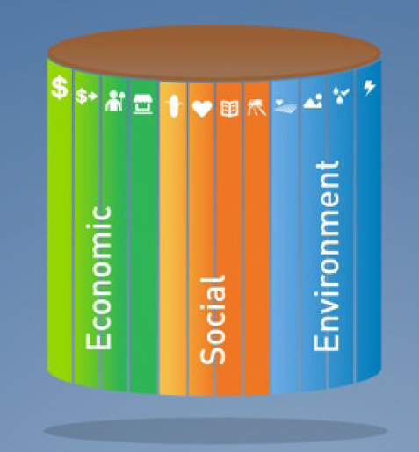
Sustainability Barrel
ECONOMIC FACTORS: profits, jobs, incomes, community
SOCIAL FACTORS: food, education, health, infrastructure
ENVIRONMENTAL FACTORS: soil health, habitats, water, greenhouse gases
Notes:
Ask students to picture a wooden barrel made up of several wooden slats.
Explain that we are going to call it a “sustainability barrel.”
Each wooden slat of the barrel represents a factor influencing sustainable agricultural production. Each factor can be placed into one of three challenges to sustainable agriculture--producing sustainably while maintaining economic, social and environmental systems.
For example, in order to be able to grow enough food to feed the world sustainably, we have to make sure that the soil stays healthy, that we have enough water to grow the food, that we don’t destroy habitats and that farmers are able to earn a profit.

Slide 12
Sustainability Barrel
A community is only as successful as the least developed factor.
We must continually try to improve the weakest one.
What are some examples of limiting factors?
Notes:
Ask students, “What are some examples of limiting factors?” (water, available land, soil health, climate, economy, education, etc.)
Ask students to explain how each factor influences our ability to produce our food.
Remind students that we must continually improve the weakest part of our sustainability – whether it is education or soil health – they all impact our ability to feed the world. A community or program is only as successful its the least developed sustainability factor.

Slide 13
What is the Ripple Effect?

Slide 14
Ripple Effect
Can one single drop of water impact an entire body of water?
Yes. Even a small drop of water creates a ripple
Notes:
Ask, “Can a single drop of water impact an entire body of water?” (Yes, it creates a ripple)

Slide 15
Ripple Effect
If a farmer harvests a successful crop? What “ripples” could this create?
Financial investments improve local economy and provide more jobs
Earn enough money to invest in better farming technology Opportunity to send children to school and access medicines
Provides our food supply
Notes:
Use this slide to illustrate how sustainable practices in agriculture can create a positive ripple effect.

Slide 16
Ripple Effect
What if a farmer invests in a new drip irrigation system? What “ripples” could this create?
More food could potentially be grown with the additional available water
The local business where it was purchased would benefit
Water will be conserved
Notes:
Use this slide to illustrate how sustainable agriculture practices can create a positive ripple effect.

Slide 17
Sustainability Farming Game Level 1 Demo

Slide 18
Sustainability Farming Game Level 1 demo
Play the game!
Stop after round one
Introduction
Nutrients
Water
Economy
Land Use
World
(Optional)
Careers
Technology
Journey2050.com
Notes:
Level 1 takes 5 minutes to play
Inform students that they will experience the lives of three actual farm families in Kenya, India and Canada.
As they interact with each family, they should pay attention to the farming practices they choose, the technology they use and the community investments they make.
Remember, agriculture is the foundation for life, and its success creates ripples locally and globally that will determine whether we meet the challenge of feeding the world.
Explain that the sustainability barrel will determine their score, and help students understand the significance of balancing the social, economic and environmental pillars of the sustainability barrel throughout the game (e.g., investments in soil health produce better crops, earning more money; investments in roads allow products and people to travel easier, improving access to markets and labor).
Explain to the students that it is very important that they listen to you as they will have to stop and wait every time they finish a level. Every student must start and end the game (roughly) at the same time to ensure your class time flows smoothly.

Slide 19
Follow-Up Discussion

Slide 20
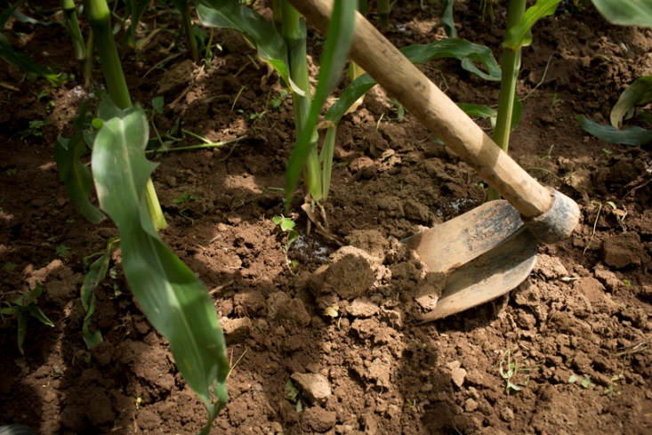
Follow-Up Discussion
After growing your first crop, did you invest some of your money to purchase additional land? Why or why not?
What was your limiting factor in your sustainability barrel? What did this mean?
What were some of the ripple effects of your farming choices?
Notes:
Once students have completed the game, use the following questions to help students synthesize what they have learned:
After growing your first crop, did you invest some of your money to purchase additional land? Why or why not?
What was the limiting factor in your sustainability barrel? What did this mean? (Answers will vary)
What were some of the ripple effects of your farming choices?

Slide 21
Do people waste food?
Notes:
Option to teach as an independent lesson another day: Slides 21-25

Slide 22
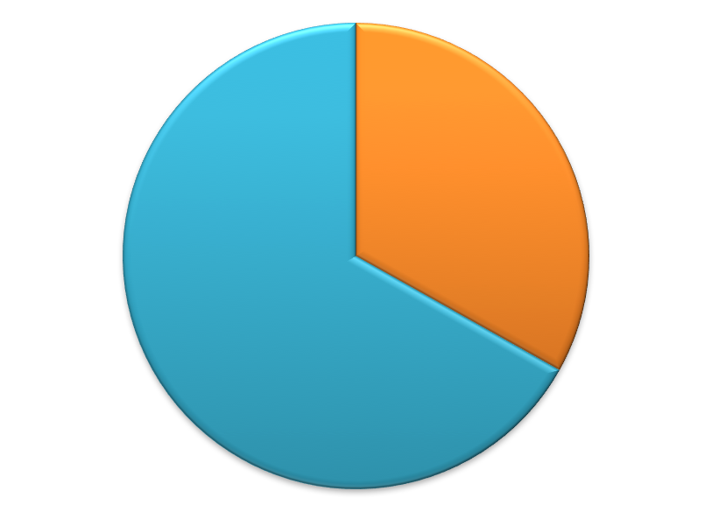
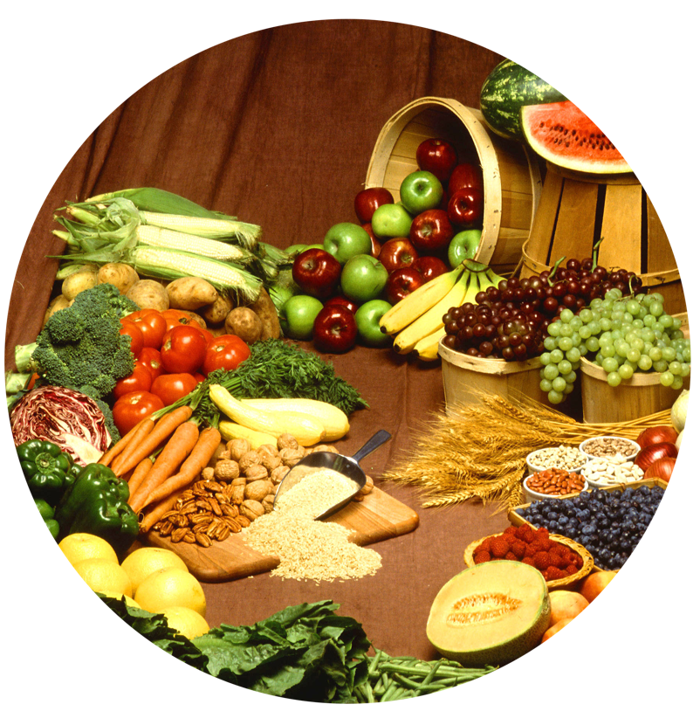
Food security risk
There are an estimated 1.4 billion people living in extreme poverty and around 870 million people that are hungry, malnourished and food insecure (have difficulty acquiring food).
Developed countries food is thrown out and overconsumed
Developing countries food is lost to unreliable storage and transportation.
Of all the food produced on our planet…
1/3 of our total food supply is wasted
Hunger is often caused by food waste and inequality of distribution, not scarcity.
Notes:
Take some time with your students to discuss the risks of food security. There are food security risks in all parts of the world, and unfortunately there is one prominent threat that we all contribute to: food waste. Unfortunately, about one-third of our current global food supply is wasted. There are an estimated 1.4 billion people living in extreme poverty, and about 870 million people that are hungry, malnourished and food insecure (have difficulty acquiring food). In developed countries food is thrown out and overconsumed, and in developing countries food is lost to unreliable storage and transportation.
Hunger is often caused by food waste and inequality of distribution, not scarcity.
Ask your students this question, “How often do you throw food out and what else could you do with that uneaten food?” Discuss ways the students can reduce their personal food waste, such as making or ordering only what you NEED to eat, composting, saving food for leftovers to eat later, etc.
Sustainable agriculture is critical in the global effort to eradicate hunger and poverty, and reducing waste can improve the sustainability of agriculture.

Slide 23
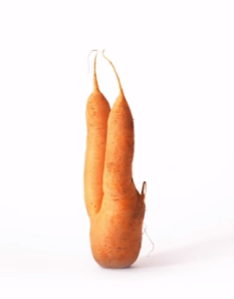
How does food waste impact sustainability & hUNGER
Watch The Ugly Carrot Video
Have you ever seen a carrot or other similarly misshaped produce item at a grocery store?
If you did see this carrot (or another similar produce item), would you buy it?
Why or why not?
Would you pay the same price as if it was perfectly shaped?
Notes:
Play the video clip, The Ugly Carrot (https://www.youtube.com/watch?v=EswyKGgk_Dc). Then ask the following questions:
Have you ever seen a carrot or other similarly misshaped produce item at a grocery store?
If you did see this carrot (or another similarly misshaped produce item), would you buy it? Why or why not? Would you pay the same price as if it was perfectly shaped?

Slide 24
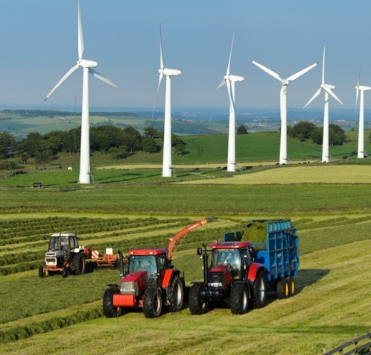
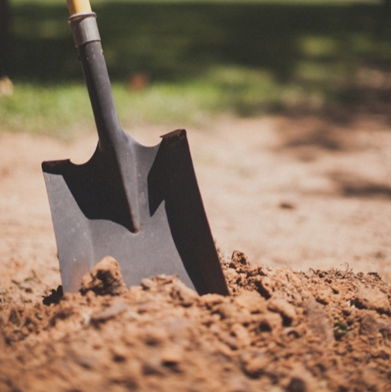
How does food waste impact sustainability & hUNGER
An estimated 1.3 billion tons of food never reaches a table.
What does it cost our environment to produce the food that we throw away?
Water
Land & Soil
Soil Nutrients
Fuel & Energy
Notes:
Ask students, “How does food waste impact sustainability and hunger?”
Students will likely associate food waste with hunger and recognize the moral, economic and social implications. Provide guiding questions to help students also recognize the impact to our environment and natural resources that food waste has.
Ask, “Besides the food itself, what else is wasted?”

Slide 25
BRAINSTORM CHALLENGES
When a country is hungry…
When a country has an overabundance of food...
Malnutrition and health care risks
Violence and thievery
Vulnerability to markets and storage
Decline in education attendance
Political distress and corruption
Decline in infrastructure, investment in technology and innovation
Risk of unsustainable practices across industries
Quality food is thrown out
Obesity - Increasing calorie-intake (eating more per meal)
Rise in Western-style diets and desire for food from other places (increased markets, infrastructure)
Shift to more urban population which can result in disconnect with life on the farm
Consumer demands and perspectives influence food value chain (genetically modified, organic, free range vs barn raised animals, herbicides, pesticides, food labels, country of origin traceability, animal care, food preparation, sanitation, packaging, preservatives...)
Notes:
On the board, brainstorm potential challenges that could arise when the people of country are hungry (malnutrition and health care risks, violence and thievery, vulnerability to markets and storage, decline in education attendance, political distress/corruption, decline in infrastructure, decline in investment in technology and innovation and risk of unsustainable practices across industries). On the board, brainstorm potential challenges that could arise when a country has an overabundance of cheap food (quality food is thrown out, obesity, increasing calorie-intake (eating more per meal), rise in Western-style diets, desire for food from other places (increased markets, infrastructure), shift to more urban population which can result in disconnect with life on the farm, consumer demands and perspectives influence food value chain (genetically modified foods, organic, free range animals, herbicides, pesticides, food labels, country of origin traceability, animal care, food preparation, sanitation, packaging, preservatives, etc.).
Optional questions for higher grades: How can governments be involved in food security? (Governments can provide regulations, policies, education programs, low interest loans, investment in research and development, and share practices with other countries.) What happens when there is corruption in government or a huge gap between the rich and poor?

Slide 26
Wrap-Up
By 2050, it is expected that our world will grow from over 7 billion to nearly 10 billion people.
Sustainable agriculture is the practice of producing our food, fiber and fuel in a way that is profitable to the farmer, supports a healthy quality of life and protects our natural resources (land, air and water).
Many factors can limit our ability to produce food for a growing population. These limiting factors are depicted in the sustainability barrel.
Using sustainable agricultural practices can improve our society through the ripple effect.

Slide 27
Wrap-Up
Over one-third of our food is wasted in both developing and developed countries.
Hunger is often caused by food waste and inequality of distribution, not scarcity.
Food waste decreases sustainability due to the inefficient use of natural resources, such as arable land, soil nutrients, water and energy.
Food waste can negatively affect our quality of life and create undesirable outcomes in a country.

Slide 28
Questions?
Programs@naitco.org

Slide 29
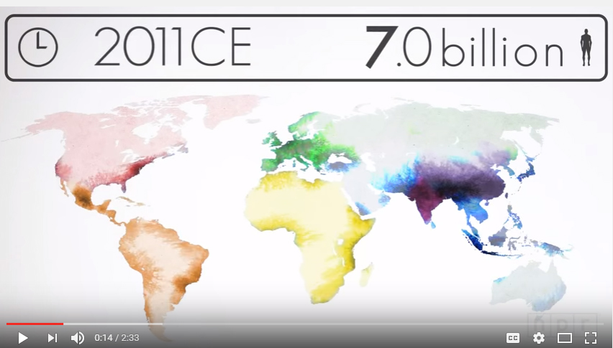
Enriching activities
WHY DID OUR POPULATION GROW SO FAST?
Notes:
https://www.youtube.com/watch?v=VcSX4ytEfcE
Very cool animated video to show students why and how our population grew to reach over 7billion today.
“It was just over two centuries ago that the global population was 1 billion — in 1804. But better medicine and improved agriculture resulted in higher life expectancy for children, dramatically increasing the world population, especially in the West.
As higher standards of living and better health care are reaching more parts of the world, the rates of fertility — and population growth — have started to slow down, though the population will continue to grow for the foreseeable future.
U.N. forecasts suggest the world population could hit a peak of 10.1 billion by 2100 before beginning to decline. But exact numbers are hard to come by — just small variations in fertility rates could mean a population of 15 billion by the end of the century”.

Slide 30
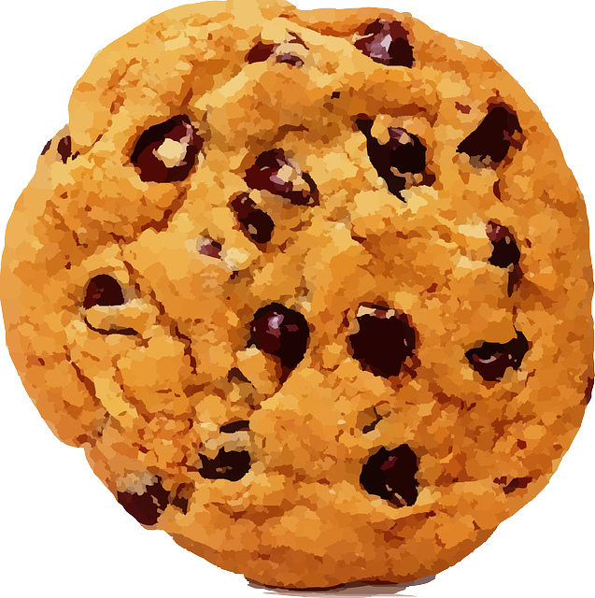
Enriching activities
The Sustainability Cookie
Please Do Not Touch or Eat Your Cookie Without My Permission
Notes:
Use this exercise to help reinforce the principles of sustainability and food waste
Supplies: Cookies (1 per student), napkins, the ingredients needed to make a chocolate chip cookie (flour, sugar, butter, eggs, vanilla, baking soda, chocolate chips, salt)
• Pass out a cookie to each student on a napkin, do not let them eat or touch the cookie without your permission.
• Display all ingredients, explain that each symbolizes a piece of the sustainability barrel. Each is necessary to make a cookie, just as it is necessary to consider all social, economic and environmental factors to attain sustainability.
BUT, what if food security is an issue in the classroom? Have 1/3 of the classroom take their cookie off their desk and place it on another student’s desk.
Ask both groups of students (those with cookies and those without) to describe how they feel about their access to food.
• Go around to the students who have multiple cookies and cover one with a napkin. Explain this symbolizes food waste has occurred, the food was disposed of without being consumed. Remind the class that 1/3 of our food supply is wasted, this includes developed and developing countries. Ask the class what is wasted beside the food itself when thrown away? (i.e. environmental resources, commodities, fuel, labor)
• Ask the students who don’t have a cookie to get theirs back so each student has one. Let them eat their treat!
• Remind the class of the value of access to a stable food supply and the conscious decisions we can make to ensure that continues.

Slide 31
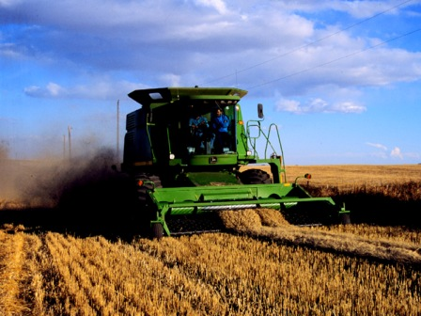
Enriching activities
Research the definitions of:
Sustainability
Agriculture
Sustainable agriculture
Supplementary videos (60 seconds):
Sustainability - https://youtu.be/nTAxPO-YDF8
Best Management Practices - https://youtu.be/bLQ5QWN0NIg
Ripple Effect - https://youtu.be/MzF8LPlaIcY
Did you Know?
A North American farmer in the 1900s produced enough food for 10 people. Today’s farmer feeds over 120 people.
Why can farmers produce more food today than they could in the early 1900s?
Notes:
Optional Slide Research the definitions of:
Sustainability
Agriculture
Sustainable agriculture
Supplementary videos (60 seconds):
Sustainability - https://youtu.be/nTAxPO-YDF8
Best Management Practices - https://youtu.be/bLQ5QWN0NIg
Ripple Effect - https://youtu.be/MzF8LPlaIcY

Slide 32
Enriching activities
Read National Geographic’s How Reducing Food Waste Could Ease Climate Change
Watch the DNews segment Why Do We Waste $1 Trillion of Food A Year?
Develop a marketing plan to decrease wasted food by marketing produce that is safe and healthy, but imperfect in size or shape. Show the video clip Inglorious Fruits and Vegetables as an example.
Students will understand the importance of taking action through service-learning using the WE Service Learning in Action: Introduction to Sustainable Agriculture lesson plan.
Notes:
Optional Slide
As an example to illustrate growth and improvement in agriculture, explain that a North American farmer in the 1900s produced enough food for 10 people. Today’s farmer feeds over 120 people. Ask students, “Why can farmers produce more food today than they could in the early 1900s?” (increased knowledge and skills about plants and animals, technology, machinery, improved breeding and genetics, etc.)
As a class or part of an additional assignment, read National Geographic’s How Reducing Food Waste Could Ease Climate Change.
Watch the DNews segment Why Do We Waste $1 Trillion of Food A Year? (https://www.youtube.com/watch?v=zjNqr4VltAc, 4:28 min). As a class, discuss why consumers are attracted to food meeting specific cosmetic standards and the impacts of the behavioral trend.
Assign students a marketing project. Instruct them that they are to develop a marketing plan to decrease wasted food by marketing produce that is safe and healthy, but imperfect in size or shape. Show the video clip Inglorious Fruits and Vegetables (https://www.youtube.com/watch?v=qQQMygivn0g, 0:15 min) as an example.

Slide 33
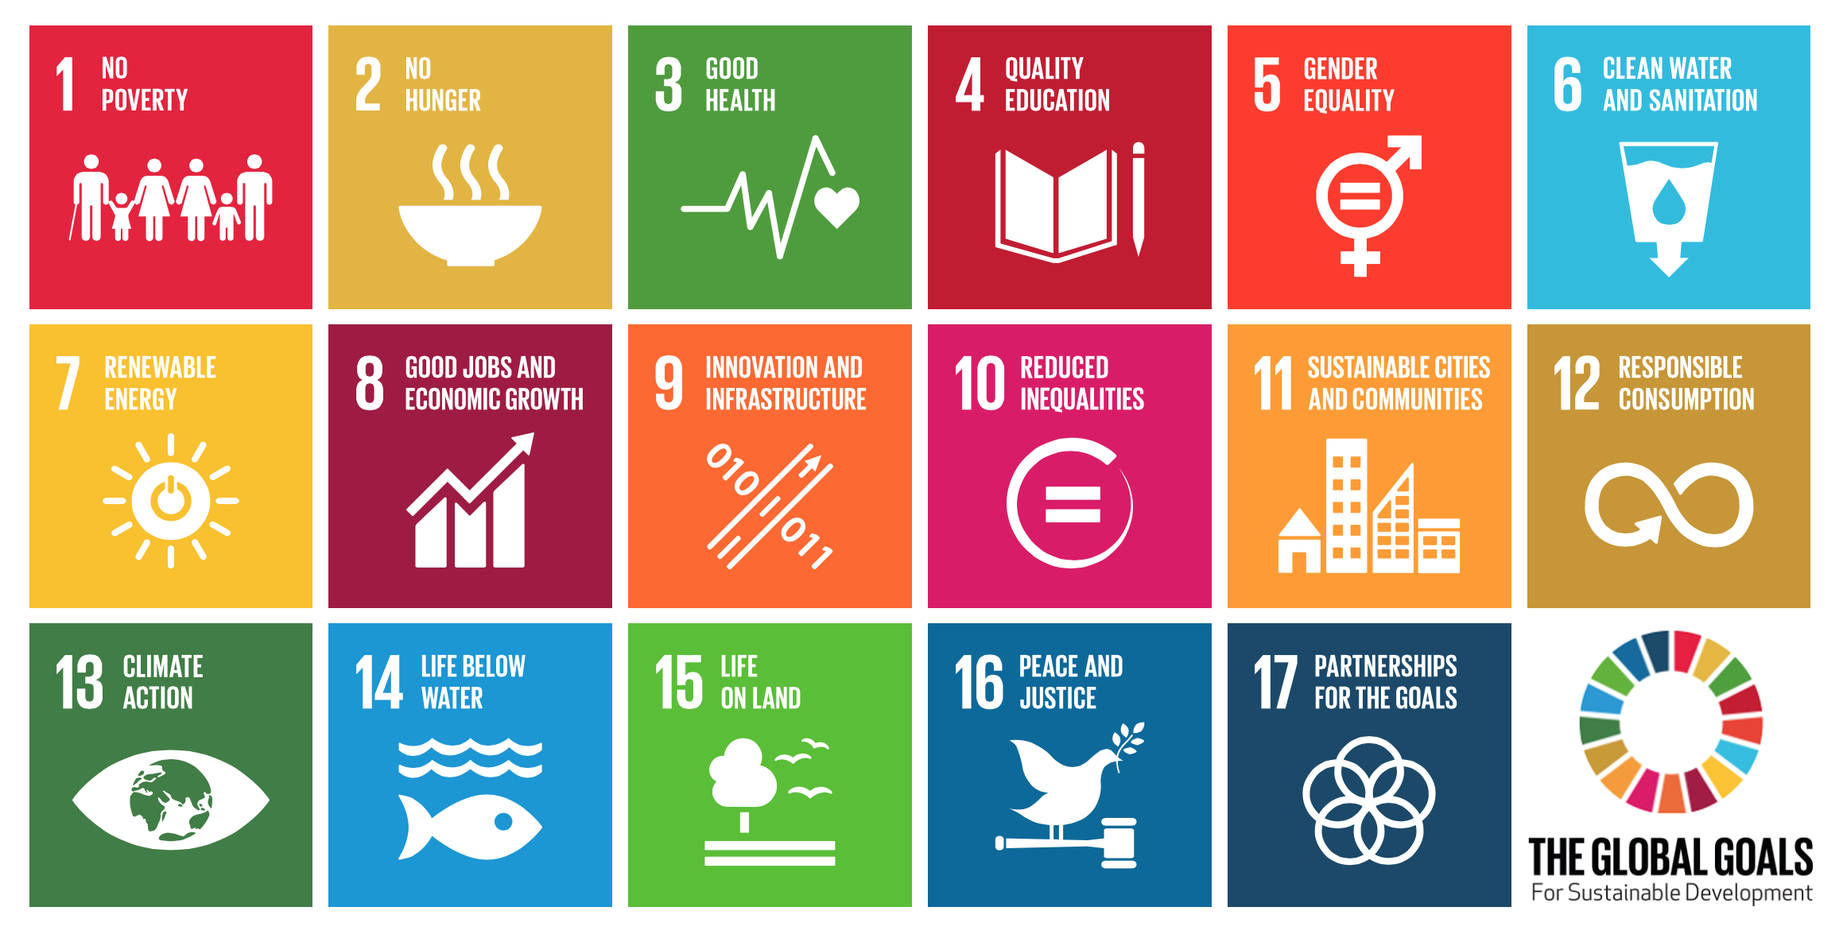
World leaders are working on solutions too
Notes:
Optional Slide
World leaders are working on solutions to global sustainability. The United Nations has released 17 goals that we all need to work towards. There is a free App called Global Hero that highlights each goal in 30-second mini-games. There are no in-app purchases to play the games. Learn more about each goal here: http://www.globalgoals.org/

Slide 34
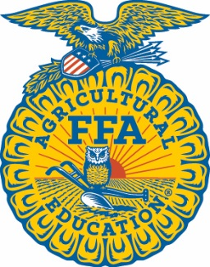
Brought to you in collaboration
www.Journey2050.com
Notes:
Brought to you by community partners around the world.

