Slide 1
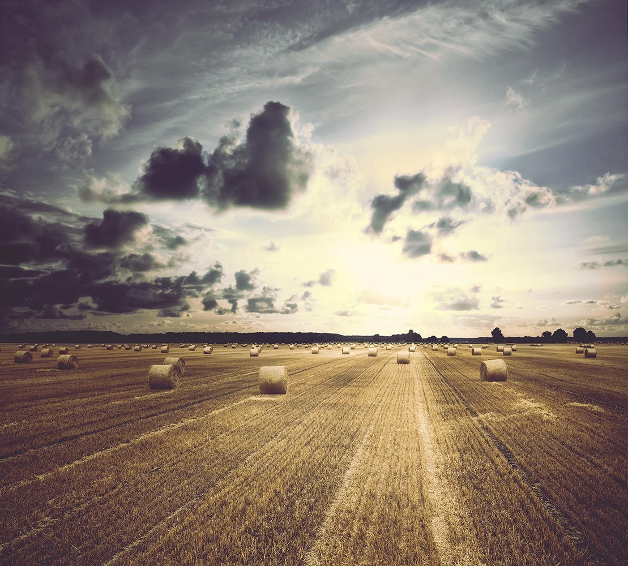

Land Use
Lesson 5
V6.0
Notes:
Time
30 - 45 minutes
Activity Expectations
Students will be able to:
Recognize that arable land is a limited resource;
Identify best management practices that can be applied to every stakeholder’s land-use decisions; and
Analyze and discuss the impacts of food waste on our environment.
Materials
Apple, knife and cutting board
Land Use PowerPoint
Land Use video (https://youtu.be/RMu7NtScdhU)
Key Terms
Currency, Population Density, Habitat, Best Management Practices, Agriculture, Stakeholder

Slide 2
How much of the Earth’s surface is ideal for
GROWING CROPS?
Notes:
Ask students, “How can we feed over 2 billion more people in 2050?” Students will likely say that we need to grow/produce more food. Before you offer any additional information conduct the following demonstration:
Hold up an apple and explain that it represents the Earth. Ask, “How much of the Earth’s surface do you think is ideal for growing crops?”
Ask, “If you look at a globe or map, what is the main color you see?” (Blue) Cut the apple into four equal-sized wedges. Nearly three of these quarters represent land covered in water. Set these aside.
The remaining quarter represents land area, which occupies 25% of Earth’s surface. Take this quarter, and cut it in half, so you have two, one-eighth sections.
One of these sections represents deserts, swamps, mountains, and polar regions; this half of our land, or one-eighth (12.5%) of Earth’s surface, is not suitable for people to live or grow crops on. Set this section aside.
The other eighth represents land where people can live. There are some places where people can live, but crops can’t be grown. Slice this section lengthwise into four equal parts. Now you have four 1/32nd pieces of an apple, each representing 3.1% of Earth’s surface.
The first section represents the areas of the world with rocky soils that are too poor for any type of food production. Set this section aside.
The next two sections represent land that is too wet or too hot for food production. Set these sections aside also.
The fourth section represents the area of the world that is most suitable for development and agricultural cultivation. The best lands for agriculture are often desirable places to build homes and towns as well.
Carefully remove the peel of the last 1/32nd section. This small bit of peel represents all the soil of our earth upon which humans depend for food production. Display slide 3 of the PowerPoint for further illustration.

Slide 3
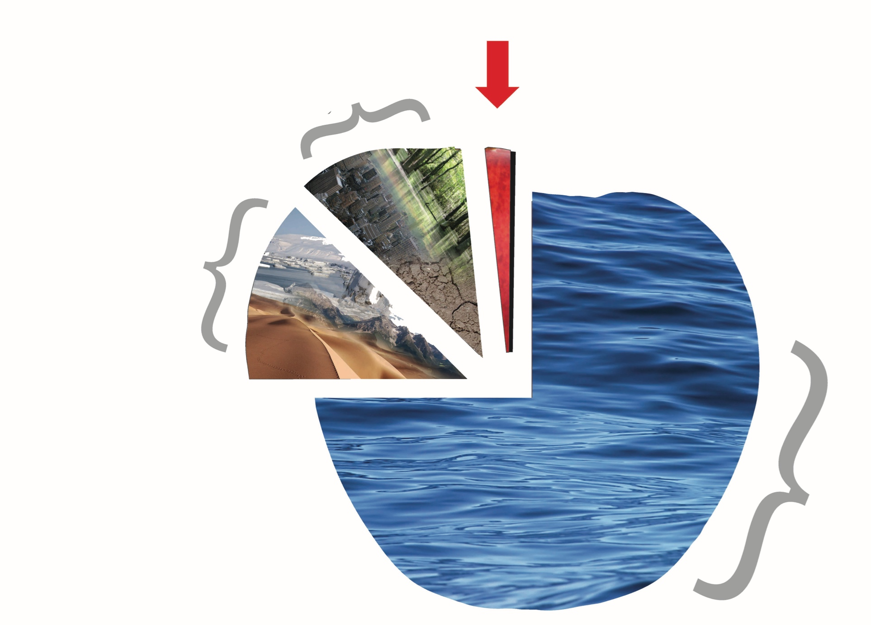
Why is land a precious resource?
Cities and Land Too Wet, Dry, Rocky
Roughly 3% of the Earth
(or 10% of Earth’s land) has ideal conditions for growing crops
Mountains,
Arctic,
Antarctic,
Desert
Oceans,
Ice,
Lakes,
Rivers
Notes:
Return to the original question. Can farmers simply plant more acres of crops to feed a growing population? (No) Point out that the population may increase, but the amount of arable farmland will stay the same.
Explain that to feed 9 billion people farmers will need to use best practices including preserving soil nutrients, improving water conservation and using arable land efficiently to grow the things we use every day; food, clothing and shelter. This will need to be done in a sustainable way to minimize environmental impacts and maintain our quality of life.

Slide 4

Watch the Journey 2050
Land Use Video
As you watch, discover:
Why is land a precious resource?
How are best management practices applied to land use choices?
Notes:
Play the Land Use video (https://youtu.be/RMu7NtScdhU)
Prepare students for the video by asking them to discover two things: 1) Why is land a precious resource? 2) How are best management practices applied to land use?

Slide 5
Why is land a precious resource?

Slide 6
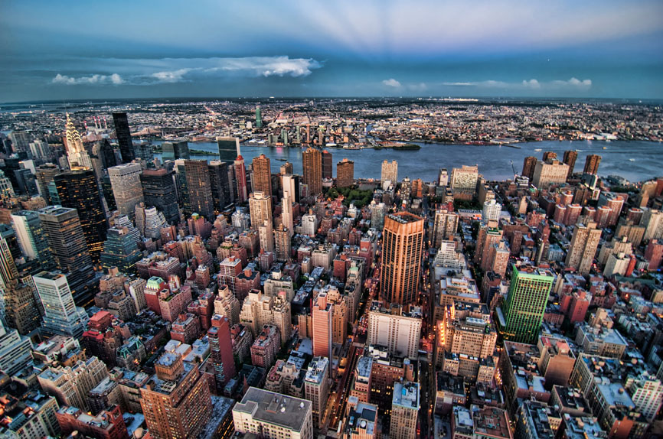
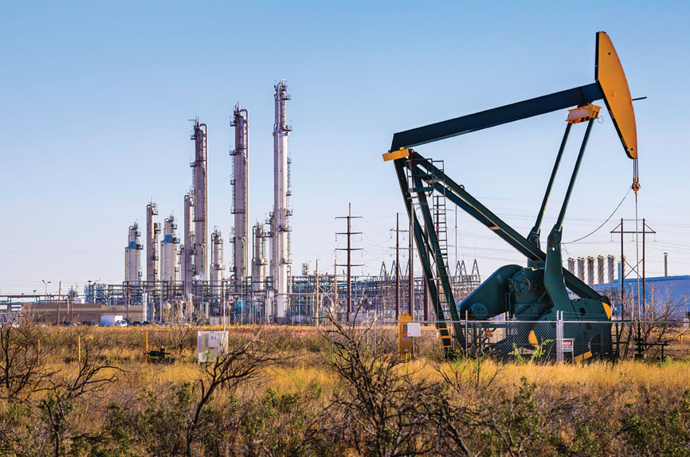
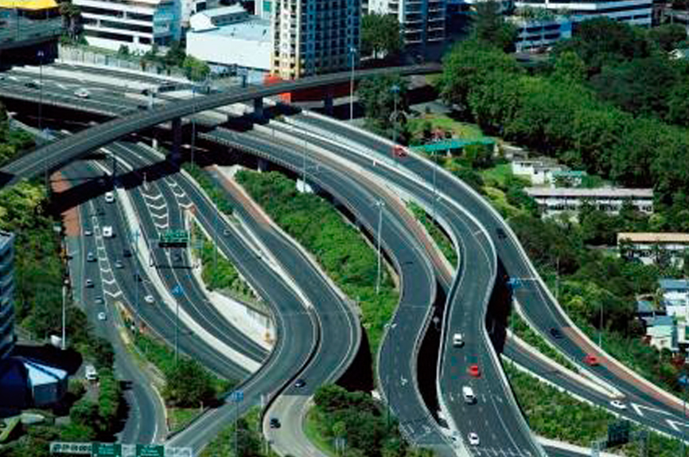
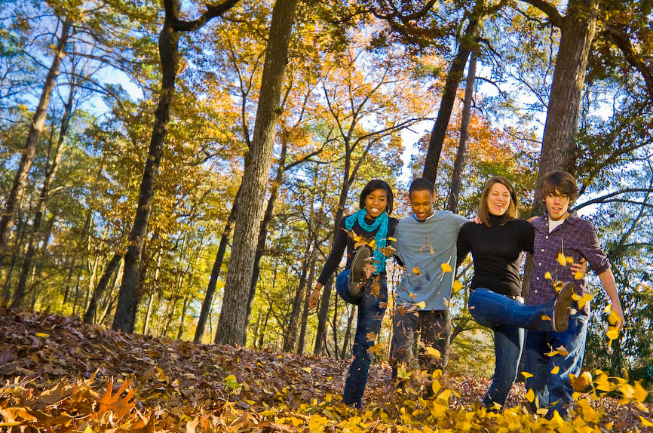
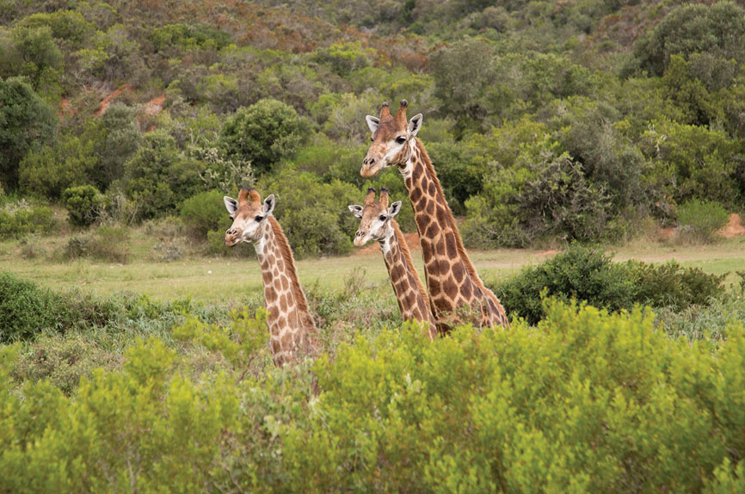
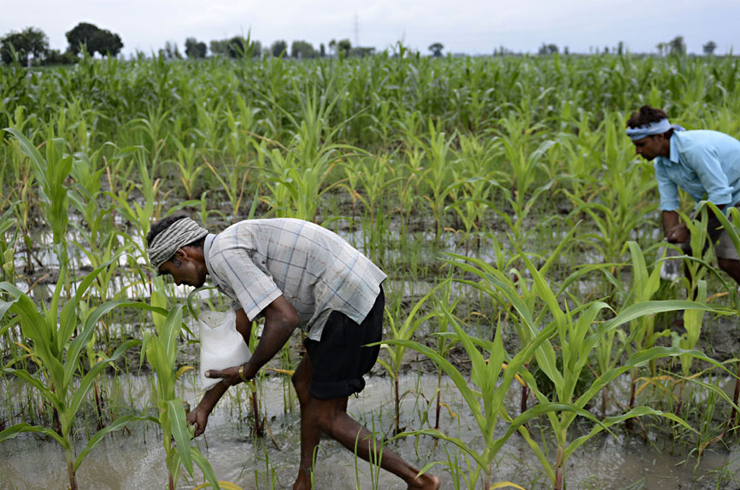
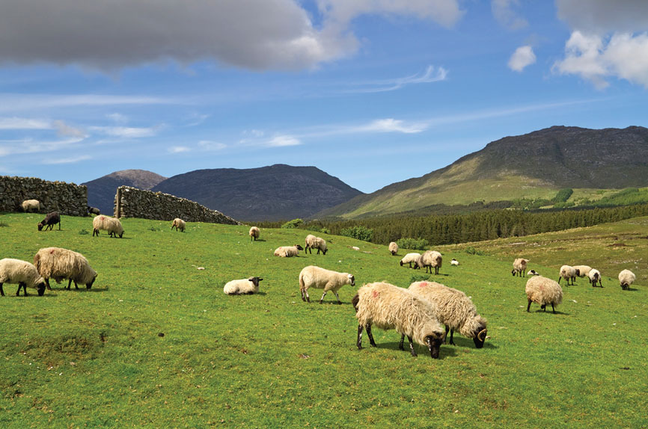
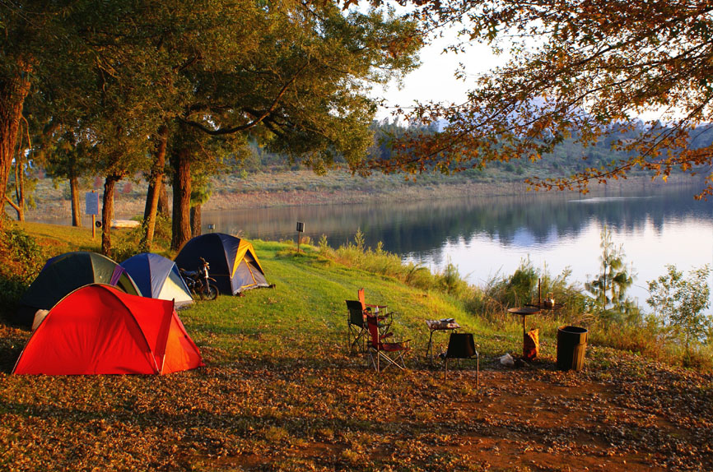
Why is land a precious resource?
What is our land used for?
Businesses & Industries
Habitats
Food
Recreation
Homes & Roads…
Notes:
Ask, “What is our land used for?” (habitat, recreation, homes, industries, agriculture, etc.) Explain that land is a precious resource. There are many things that influence how land is used and what it is used for.

Slide 7
Why is land a precious resource?
Population Statistics by Country:
Worldometers
Notes:
Display the Worldometers website to show your class the live population statistics for the 20 largest countries in the world.
Optional: If time allows, challenge students to discover which of these countries has the highest and the lowest population density. (Russia has only 9 people per km2, and India has 452 people per km2.) Make it a race with a prize to see who can figure it out first. This statistic can be found on the Worldometers website by clicking on each individual country in the list of Top 20 Largest Countries by Population.

Slide 8
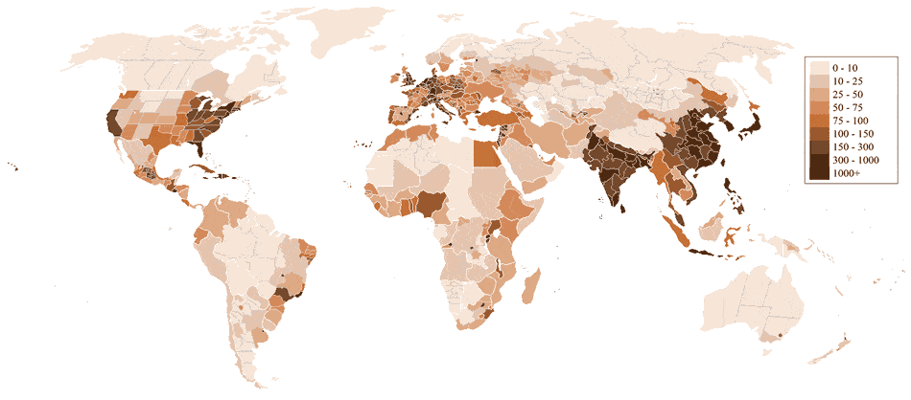
Why is land a precious resource?
Population Statistics by Country:
China
India
Notes:
Ask students if they can see a relationship between human population and agricultural land (map on next slide). Students should recognize that we are building our homes and businesses in the areas that have the best climate and soil for growing crops! Historically, people have settled near water and fertile land in order to grow crops. As cities grow the urban footprint expands into areas that are habitat and farmland.
India and China have nearly 40% of the population between the two countries (As of 2018, China has 1.415 billion people + India has 1.354 billion people = 2.769 billion or 36.28% of the world share (compared to the next largest population: USA is in 3rd place with 326,766748 people; Canada is 38th with 36,953,765).
http://www.worldometers.info/world-population/population-by-country/
Compare China and India’s footprint to arable land in the next slide.
Image attributed to: http://www.worldometers.info/world-population/

Slide 9
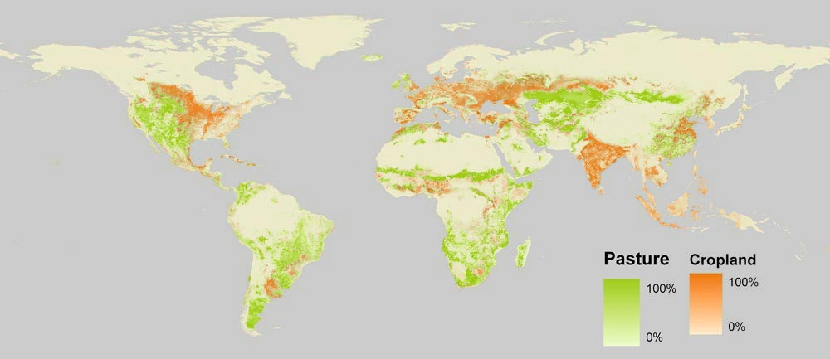
Why is land a precious resource?
Agricultural Land:
3% of Earth (10% of the Earth’s land) has ideal crop growing conditions (arable land = cropland).
With best management practices, innovation and technology we can use nearly 40% of the total land to grow food or provide grazing for livestock.
China
India
Notes:
Explain that farmers have increased yields (food production) by using improved practices, science and technology. For example, plant scientists have developed plants that are resistant to insects, disease and drought; soil scientists and land managers have developed soil conservation practices; and irrigation engineers have developed systems and delivery mechanisms to minimize water use and still grow a bountiful crop.
Image attributed to: https://ourworldindata.org/land-use-in-agriculture/

Slide 10
How are Best Management Practices applied to land use?
Notes:
Explain that farmers have increased yields (food production) by using improved practices, science and technology. For example, plant scientists have developed plants that are resistant to insects, disease and drought; soil scientists and land managers have developed soil conservation practices; and irrigation engineers have developed systems and delivery mechanisms to minimize water use and still grow a bountiful crop. Yields have constantly gone up. Compared to 50 years ago, the world uses 68% less land to produce the same amount of food.
https://ourworldindata.org/land-use-in-agriculture/

Slide 11
How do we improve our land-use choices so
we can feed a growing world and
still have a high quality life
and environment?
Notes:
Ask, “How do we improve our land-use choices so that we can feed a growing world and still have a high quality life and environment?” We need to use best management practices (these are discussed in the Best Management Practices video (https://youtu.be/bLQ5QWN0NIg, 1:06). Best practices are simply the best way to do something. For example, in school, if you attend class, engage in the content, and study, you will do well in the course. Similarly, we can also think about the best ways to use our land sustainably by considering natural habitats, agricultural best management practices and urban growth.

Slide 12
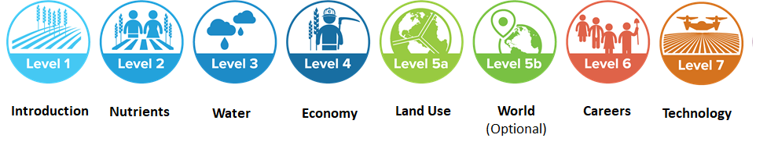
Land use Game
Level 5a
Play the game!
Notes:
Open Level 5a on each student’s computer or device. Explain the following:
In this level, you will make predictions for the percentage of land used by nature, urban and agriculture in the 1900s compared to the year 2000.
Next, explore best management practices that each stakeholder should employ in our journey and come up with your own ideas that each could be implemented to make better land-use choices.

Slide 13
Follow-Up Discussion

Slide 14
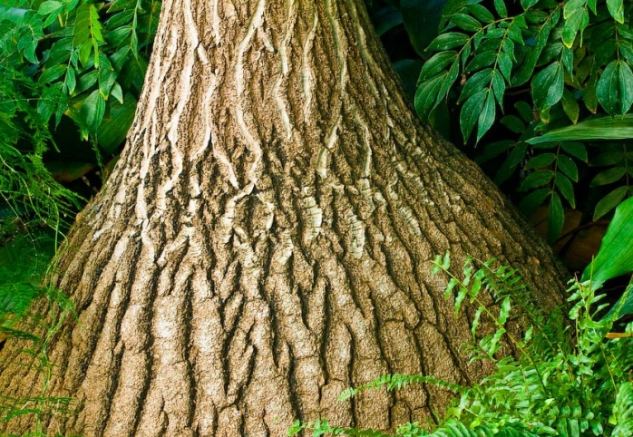
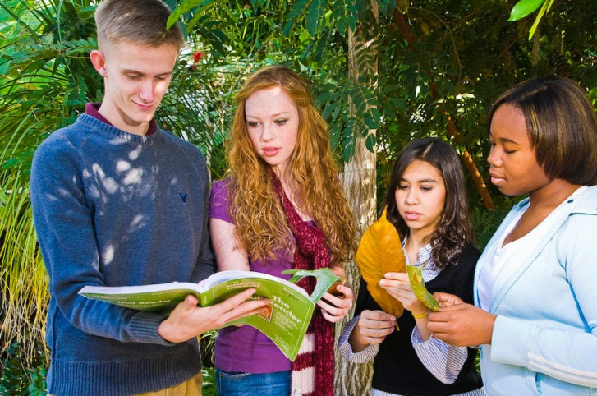
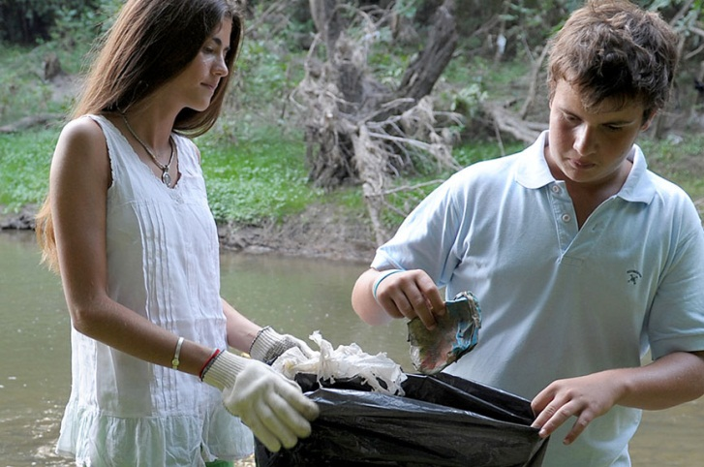
Re-cap: How are Best Management Practices applied to land use?
Improve natural habitats
Replace what you use and clean up the environment.
Plant native species and remove invasive species.
Don’t just talk about stewardship, take action.
What other ideas do you have?
Notes:
Review slides as a class and discuss the noted best management practices.

Slide 15
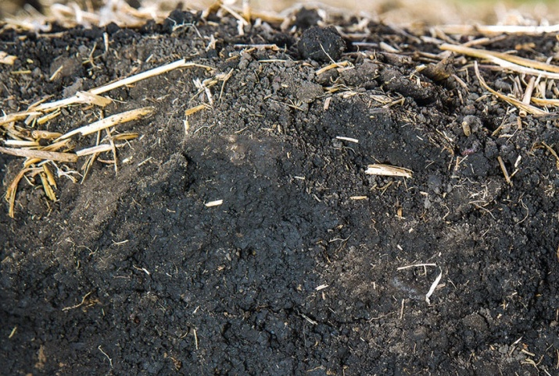
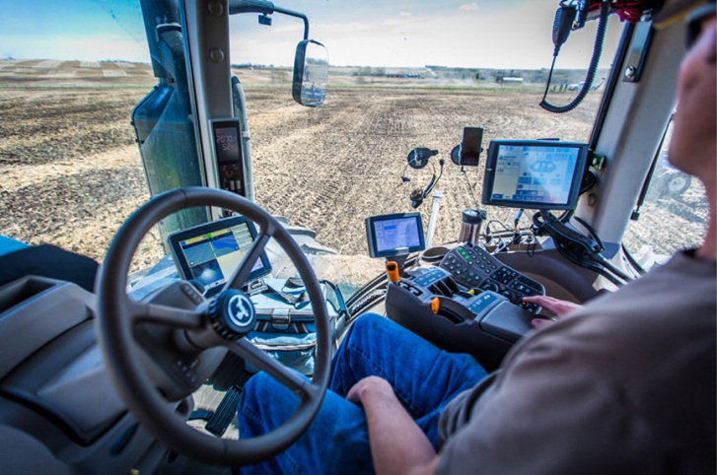
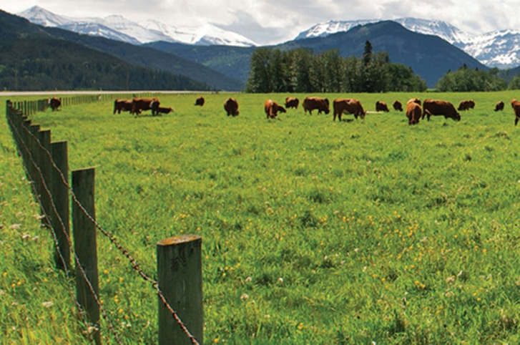
Re-cap: How are Best Management Practices applied to land use?
Agricultural Best Management Practices
Improve soil health to grow more on the same land.
Use technology to make more efficient use of inputs (e.g., fertilizer, water).
Sustainably use land already in production.
What other ideas do you have?
Notes:
Review slides as a class and discuss the noted best management practices.

Slide 16
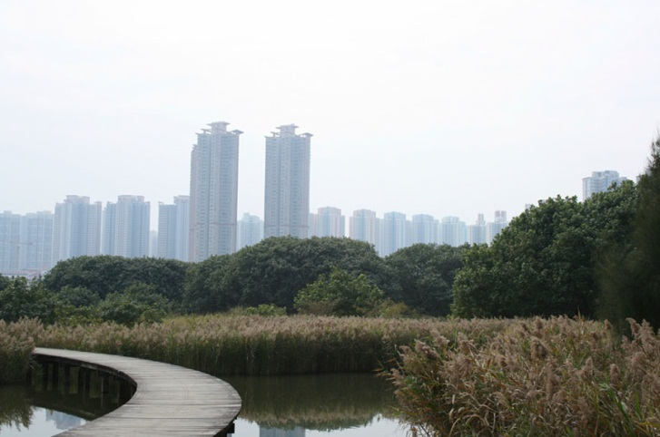
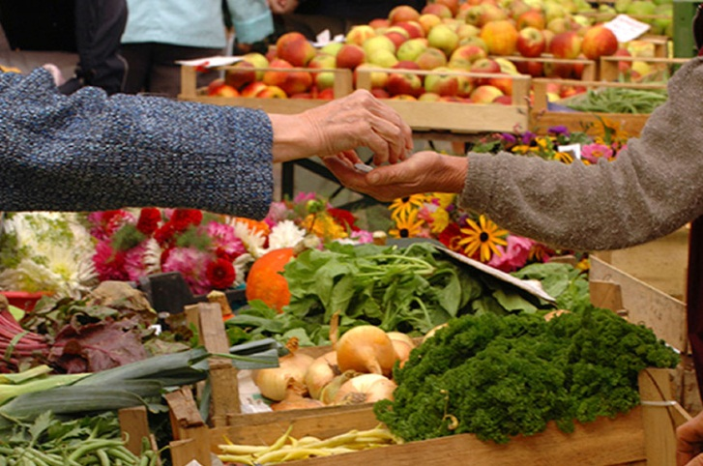
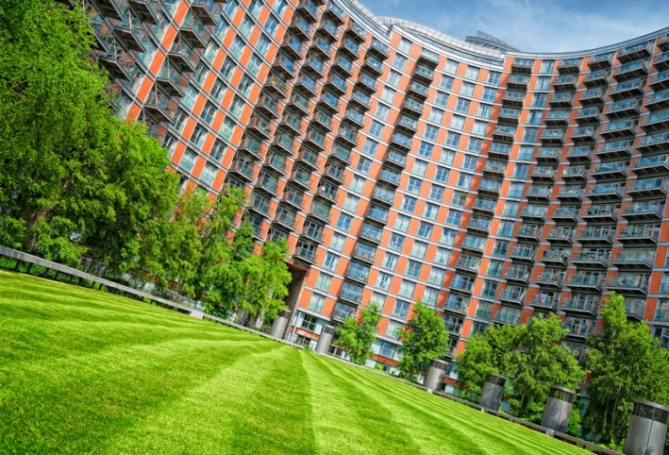
Re-cap: How are Best Management Practices applied to land use?
Manage Urban Growth
Retain urban wetlands and riparian areas.
Reduce food waste. Only buy what you need to eat.
Build businesses and homes up. Not out.
What other ideas do you have?
Notes:
Review slides as a class and discuss the noted best management practices.

Slide 17
wrap-Up
  Three percent of the Earth (ten percent of the Earth’s land) is ideal for growing crops.
  Most of our urban areas were built on ideal crop land. Our ancestors settled where they could grow food and cities grew from there.
  The quality of the soil under our homes and businesses is the real challenge in the journey. The challenge also spreads to our natural areas. Protecting the Earth’s biodiversity and natural resources is vital to our survival.
  Every land use decision we make has a consequence. Best management practices are essential in our journey to sustainably feed the world while balancing social, economic and environmental needs.
Notes:
Review and summarize the following key concepts:
Three percent of the Earth (ten percent of the Earth’s land) is ideal for growing crops.
Most of our urban areas were built on ideal crop land. Our ancestors settled where they could grow food and cities grew from there.
The quality of the soil under our homes and businesses is the real challenge in the journey. The challenge also spreads to our natural areas. Protecting the Earth’s biodiversity and natural resources is vital to our survival.
Every land use decision we make has a consequence. Best management practices are essential in our journey to sustainably feed the world while balancing social, economic and environmental needs.

Slide 18

Questions?
Programs@naitco.org

Slide 19
Enriching activities
Play the game!
Notes:
Watch the Where in the World video (https://youtu.be/ZvdtHNe8zGw, 5.06)
Have students play the Journey 2050 Where in the World Geography Game. This is a Q&A style game that has clues embedded in each question. Print or project the Land Use Map (PowerPoint slide 9) and Country Comparison Map for a quick reference. Before the game begins, ask the students to think of their favorite foods, sports, music and places to travel as well as things that they love about their country. Explore where some of their favorite things come from and how trading goods around the world allows us to enjoy those things. Make sure the students are aware that in the game, spelling counts. The game takes about 15 minutes to complete.

Slide 20
Enriching activities
Distribute the Country Comparison Map Find similarities and differences in climate, topography, culture, and food production across the globe.
Watch – TedTalk by Allan Savory on desertification and cattle: https://youtu.be/vpTHi7O66pI
Students will understand the importance of taking action through service-learning using the WE Service Learning in Action: Land Use lesson plan

Slide 21










Brought to you in collaboration
www.Journey2050.com
Notes:
Brought to you by community partners around the world.

