Slide 1
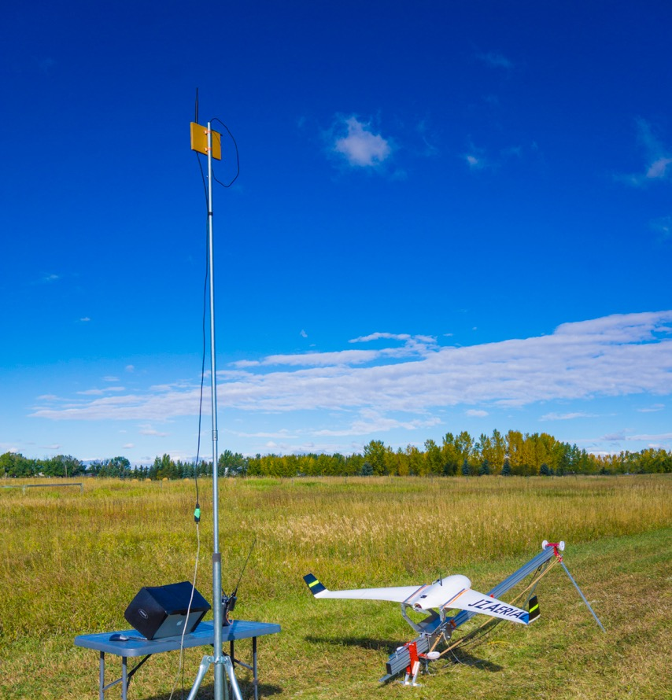

Technology & Innovation
Lesson 7
V1.0
Notes:
Time
60 minutes
Activity Expectations
Students will be able to:
Understand new technologies that will impact the future of farming;
Understand the role of developing countries in food security; and
Explain how consumers influence production.
Materials
Technology & Innovation PowerPoint
TED Talk, A Global Food Crisis May be Less Than a Decade Away (https://www.ted.com/talks/sara_menker_a_global_food_crisis_may_be_only_a_decade_away?utm_campaign=tedspread&utm_medium=referral&utm_source=tedcomshare, 17.34 min) by Sara Menker
Future of Agriculture: Technology and Innovation Handout
Journey 2050 Technology & Innovations video (https://youtu.be/qexChWNFY5E, 4.57 min)
Based on The Future of Farming & Agriculture video (https://www.youtube.com/watch?v=Qmla9NLFBvU, 12.28 min)
SnapAG Information Sheets (https://aitc-canada.ca/en-ca/learn-about-agriculture)
Technology & Innovations Find Someone Who Handout (Enriching Activity)
Key Terms
Technology, innovation, precision agriculture, innovations, autonomous, drone, aquaponics, entomophagy, developing nation, developed nation

Slide 2

Watch the TED Talk Video (stop at 2.29min):
A Global Food Crisis May be Less Than a Decade Away
by Sara Menker
As you watch, discover:
  The concepts of supply and demand as well as a “capacity” to produce food
Notes:
Show students the TED Talk, A Global Food Crisis May be Less Than a Decade Away by Sara Menker.
Pause the talk at 2:29 (15:04 remaining) and discuss Sara’s statement, “We could have a tipping point in global food and agriculture if surging demand surpasses the agricultural system’s structural capacity to produce food.” Discuss the concepts of supply and demand as well as a “capacity” to produce food. As demand (population) rises, what limits our capacity to produce food? (arable land, water, soil nutrients, etc.)
Next ask, “What are some things that can increase our capacity to produce food? Allow students to brainstorm their own ideas.
Explain that we will be exploring three ways to expand our capacity to produce food:
Developing and implementing new technologies,
Helping developing countries improve farming efficiency, and
Learning how consumer choices can either support or challenge food sustainability.

Slide 3
Watch the Journey 2050
Technology & Innovation Video
As you watch, discover:
Technologies and innovations being developed around the world
Notes:
Life on the farm 100 years ago looked vastly different compared to today and it will continue to change to meet the needs of the world. Cutting-edge technology and innovations are being used in agriculture. These new technologies are being developed with a purpose to overcome the challenges we face in providing food, fuel, and fiber for a growing population.
The use of technology can be found in nearly every aspect of our daily lives and has revolutionized farming with more innovation on the horizon! Some technologies are emerging while others have been adopted globally.
Prepare students for the video clip by letting them know they will be introduced to several innovations that can be used in agriculture. As they watch, they should also consider the challenge(s) that each innovation could help to overcome.
Watch this video for a few examples. https://www.youtube.com/watch?v=qexChWNFY5E&feature=youtu.be (4.57 min)
Ask the students, “Have you seen any of these innovations in action?”
Optional: If time permits, play the Tech-BINGO game available in the Enriching Activities below

Slide 4
Group discussion
Which innovation do you think could be most impactful and why?
What are some pros and cons of using these technologies?
Notes:
After the video, have students share their thoughts.
Ask questions such as,
“Which innovation do you think could be most impactful and why? Or,
“What are some pros and cons of using these technologies?”

Slide 5
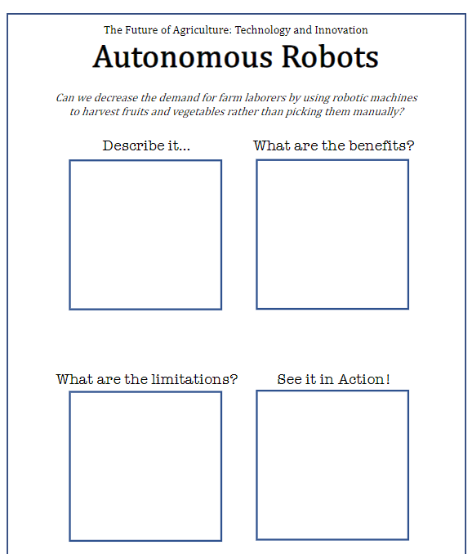
Research project
Research and create a digital presentation about one technology or innovation to share with the class. Include the following:
Describe it. How it is used, where it is used, etc. Include details such as how much it costs and where it is currently being used.
What are the benefits? What obstacle(s) does this innovation overcome?
What are the limitations? Each form of technology has limitations. What are they? Is it the expense of the equipment, accuracy of its use, etc.?
See it in Action! Find images or a demonstration video of the technology in action.
Notes:
Give each pair (or small group) of students one copy of the Future of Agriculture: Technology and Innovation handout.
Note: You should have 1 copy (printed single-sided) of this PDF per group. The sheet they receive represents the specific technology they will be researching. There are 3 blank sheets at the end of the document if your students would like to research an innovation not currently on the list.
Provide time for the students to perform research and create a digital presentation about their technology to share with the class. Students should use the four sections found on their handout to outline their research and presentation:
Describe it. Students should describe the technology, how it is used, where it is used, etc. If possible, include details such as how much it costs and if it is currently being used in agriculture today.
What are the benefits? What obstacle(s) does this innovation overcome?
What are the limitations? Each form of technology has limitations. What are they? Is it the expense of the equipment, accuracy of its use, etc.?
See it in Action! Have students find images or a demonstration video of the technology in action.

Slide 6
Technology & Innovation
Presentations
VOTE
Which are the 3 most promising technologies & innovations that will make a difference in the future of agriculture.
Notes:
As each team presents to the class, have the class consider what changes in society, environment or economy would have to be made for the innovation to be adopted globally.
As a class or as an individual assignment, have students select what they believe are the three most promising innovations that will make a difference in the future of agriculture. Remind students to focus on the goal of providing a sustainable food supply for a growing population.

Slide 7
What’s the difference
Developing Country
vs
Developed Country
Notes:
Discuss, compare, and contrast the terms “developing” nation and “developed” nation with your students. Help students recognize the meaning of these terms in the context of various topics such as economics (access to capital and markets), health, safety & sanitation, education opportunities, etc.

Slide 8
Watch the TED Talk Video (start at 2.29min):
A Global Food Crisis May be Less Than a Decade Away
by Sara Menker
As you watch, evaluate:
What can developed and developing countries do to prevent a famine as we move toward 2050?
What can developed and developing countries learn from each other?
Can technology and innovations be integrated from one country to another?
Notes:
Show students the TED Talk, A Global Food Crisis May be Less Than a Decade Away by Sara Menker.
Once students have a foundational knowledge of developing nations, have students watch the remaining portion of the TED talk that they began during the Interest Approach portion of the lesson. Start at 2:29 (15:04 remaining).
Teacher Note:
At 3:40 (13:40 remaining) Sara makes the statement “…the world lacked an actionable guide for HOW we can avoid a global food crisis…” If you continue to the Summary Level of Journey 2050, students will engage in a Project-Based Learning activity to create their own action plan to improve our world’s sustainability.
After listening to the TED talk, explore which countries in the world have potential to increase crop yields on existing farmland (remember the goal is not to turn more land into farmland but to maximize the land already in production). Make sure at least one group explores India and African countries. Instruct students to consider the growing crop conditions (i.e. arable land, soil health, pests/diseases, water/climate), transportation/storage to get products to markets/market access, technology available, level of education within the country, access to capital to invest in new innovations/best practices and anything else that would contribute to the success or failure of growing food sustainably, then respond to the question, does the country I have selected have the ability to increase crop yields on existing farmland with all the resources required?
Have the student’s share their findings and ask them to evaluate the potential of each country in how stakeholders (producers, consumers, governments, environmentalists, non-profits, educators etc.) can contribute to successful advancements in the countries identified.
Summarize by discussing answers to the following questions:
What can developed and developing countries do to prevent a famine as we move toward 2050?
What can developed and developing countries learn from each other? Can technology and innovations be integrated from one country to another?

Slide 9
How do consumers like yourself influence what producers grow?
Notes:
Direct the attention of the students to themselves. Ask, “How do consumers like yourself influence what producers grow?” As an example, ask students to raise their hand if they would eat insects as a source of protein. If they will eat insects then demand increases. If they won’t then demand decreases. Explain that every time we shop at a grocery store we are sending a message to the agricultural value chain on what preferences we have.
How else do consumers influence growers?
Ask students if they have seen campaigns (“Meatless Mondays” or “Milk: It Does a Body Good) or food labels (organic, Non-GMO, natural, cage-free, antibiotic free, etc.) that could influence someone positively or negatively about food. The following discussion should prompt the students to take a science-based, informed approach when viewing information they may see on social media or in marketing campaigns trying to influence their purchasing behavior.

Slide 10

snapag
What does organic farming look like?
What are GMOs and are they okay to eat?
How are
chickens raised?
Are your perceptions different or
the same as the industry?
Notes:
Separate the classroom into small groups.
Give each group one or two snapAG information sheets, https://aitc-canada.ca/en-ca/learn-about-agriculture (i.e. What are GMOs and are they okay to eat? What does organic farming look like? How are chickens raised?).
SnapAG is a series of resources that help students explore hot topics affecting the agriculture industry.
Each group should answer the following questions: “Are their own perceptions different or the same as the industry?”, “Why do they have the perseptions that they do?”, “Are their views based on science?”, and, then have them once again answer the question, “How do consumer perceptions influence producers growing crops and raising animals”.

Slide 11



Wrap up
Technology and innovation play a critical role in the future of agriculture. Each innovation must be understood for the benefits and limitations it brings as there is no one-size fits all solution.
If supported, developing countries have the greatest potential to make the most improvements.
Consumers have a direct influence on what is grown and how. It’s important that you take a science-based, informed approach when viewing information on social media or in marketing campaigns trying to influence your purchasing behavior.
As we strive to feed a growing population, every stakeholder must act in a way that encourages sustainable solutions.
Notes:
Technology and innovation play a critical role in the future of agriculture. Each innovation must be understood for the benefits and limitations it brings as there is no one-size fits all solution.
If supported, developing countries have the greatest potential to make the most improvements.
Consumers have a direct influence on what is grown and how. It’s important that students take a science-based, informed approach when viewing information they may see on social media or in marketing campaigns trying to influence their purchasing behavior.
As we strive to feed a growing population, every stakeholder must act in a way that encourages sustainable solutions. We need to begin to solve the problems today. Waking-up to address these issues on January 1, 2050 is too late!

Slide 12

Questions?
Programs@naitco.org

Slide 13
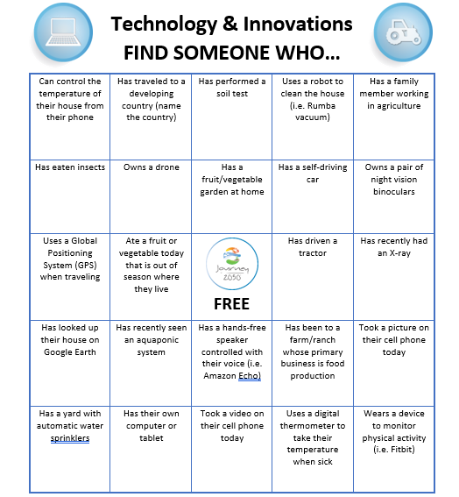
Technology & Innovation
Find Someone Who…
When you find a classmate that can say YES to a statement, write their name in the square.
Can you get 5 in a row or fill in all the squares?
Notes:
This game can be used at the beginning of the lesson or end to engage your students in discussions around technology and innovations they may use every day in their own life – which are also used in agricultuer. The game is based on BINGO.
Print one copy per student of the Technology & Innovation Find Someone Who Handout.

Slide 14
Enriching activities
Will tech take over the farm? https://www.youtube.com/watch?v=JPvjucZPZLM
Future of Agriculture Podcast: https://player.fm/series/future-of-agriculture
Hear from an Iowa farmer about the transformation of his family farm from the 1890s until today and moving into the future: https://www.ted.com/talks/mark_jackson_a_personal_story_about_farming_and_the_future_of_agriculture
Notes:
Will tech take over the farm? https://www.youtube.com/watch?v=JPvjucZPZLM
Future of Agriculture Podcast: https://player.fm/series/future-of-agriculture
Hear from an Iowa farmer about the transformation of his family farm from the 1890s until today and moving into the future: https://www.ted.com/talks/mark_jackson_a_personal_story_about_farming_and_the_future_of_agriculture
To explore further into specific technologies on the farm, see the following additional lesson plans:
High-Tech Farming (https://www.agclassroom.org/teacher/matrix/lessonplan.cfm?lpid=691, 2 hours)
Drones in High-Tech Farming (https://www.agclassroom.org/teacher/matrix/lessonplan.cfm?lpid=692, 3 hours)
Robots in High-Tech Farming (https://www.agclassroom.org/teacher/matrix/lessonplan.cfm?lpid=693, 3 hours)
Growing a Nation: Growing Technology (https://www.agclassroom.org/teacher/matrix/lessonplan.cfm?lpid=709), 1 hour
To explore further into consumer choices and food labeling use the lesson, Looking Under the Label.
Watch this video: Growing Today for Tomorrow (https://www.youtube.com/watch?v=ym6biFbr3GQ, 3:30) Discuss how farmers have been able to continually produce more food with fewer resources.
Turning waste into food and livestock feed through innovation (https://www.ceres-ab.com/about-us?wix-vod-video-id=5f23646e1754458f8c6336be4df6ba68&wix-vod-comp-id=comp-j48u0gxt#, 3.01)

Slide 15
Enriching activities
To explore further into specific technologies on the farm, see the following additional lesson plans:
  High-Tech Farming (https://www.agclassroom.org/teacher/matrix/lessonplan.cfm?lpid=691, 2 hours)
  Drones in High-Tech Farming (https://www.agclassroom.org/teacher/matrix/lessonplan.cfm?lpid=692, 3 hours)
  Robots in High-Tech Farming (https://www.agclassroom.org/teacher/matrix/lessonplan.cfm?lpid=693, 3 hours)
  Growing a Nation: Growing Technology (https://www.agclassroom.org/teacher/matrix/lessonplan.cfm?lpid=709), 1 hour
To explore further into consumer choices and food labeling use the lesson, Looking Under the Label.
Watch this video: Growing Today for Tomorrow (https://www.youtube.com/watch?v=ym6biFbr3GQ, 3:30) Discuss how farmers have been able to continually produce more food with fewer resources.
Turning waste into food and livestock feed through innovation (https://www.ceres-ab.com/about-us?wix-vod-video-id=5f23646e1754458f8c6336be4df6ba68&wix-vod-comp-id=comp-j48u0gxt#, 3.01)
Notes:
Tech-BINGO Handout
Will tech take over the farm? https://www.youtube.com/watch?v=JPvjucZPZLM
Future of Agriculture Podcast: https://player.fm/series/future-of-agriculture
Hear from an Iowa farmer about the transformation of his family farm from the 1890s until today and moving into the future: https://www.ted.com/talks/mark_jackson_a_personal_story_about_farming_and_the_future_of_agriculture
To explore further into specific technologies on the farm, see the following additional lesson plans:
High-Tech Farming (https://www.agclassroom.org/teacher/matrix/lessonplan.cfm?lpid=691, 2 hours)
Drones in High-Tech Farming (https://www.agclassroom.org/teacher/matrix/lessonplan.cfm?lpid=692, 3 hours)
Robots in High-Tech Farming (https://www.agclassroom.org/teacher/matrix/lessonplan.cfm?lpid=693, 3 hours)
Growing a Nation: Growing Technology (https://www.agclassroom.org/teacher/matrix/lessonplan.cfm?lpid=709), 1 hour
To explore further into consumer choices and food labeling use the lesson, Looking Under the Label.
Watch this video: Growing Today for Tomorrow (https://www.youtube.com/watch?v=ym6biFbr3GQ, 3:30) Discuss how farmers have been able to continually produce more food with fewer resources.
Turning waste into food and livestock feed through innovation (https://www.ceres-ab.com/about-us?wix-vod-video-id=5f23646e1754458f8c6336be4df6ba68&wix-vod-comp-id=comp-j48u0gxt#, 3.01)

Slide 16
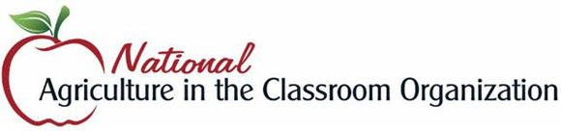









Brought to you in collaboration
www.Journey2050.com
Notes:
Brought to you by community partners around the world.

Slide 17
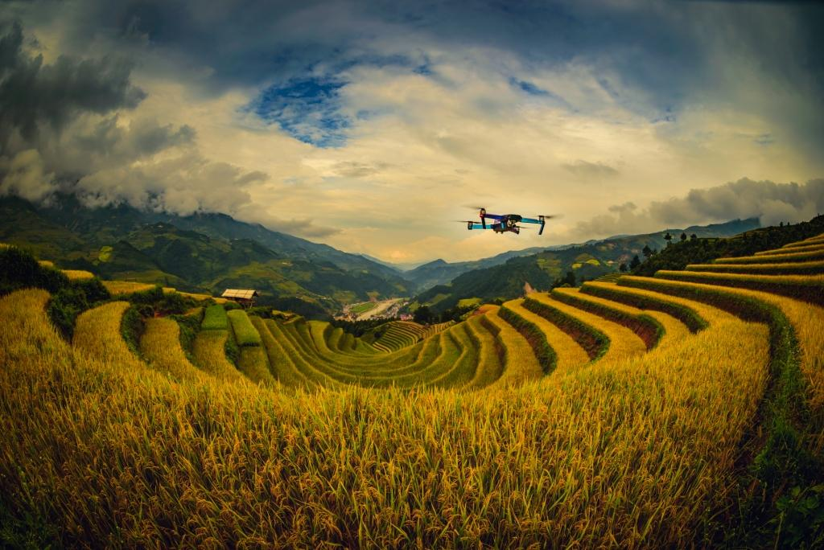
Appendix
Innovation and Technology Examples
Notes:
Some technologies are emerging, while others have been adopted globally. Here are a few examples. Have you seen any of these innovations in action?

Slide 18

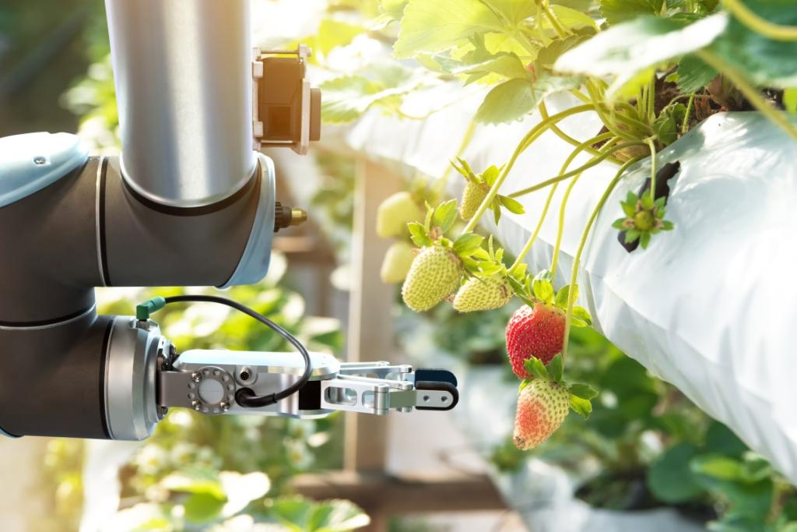
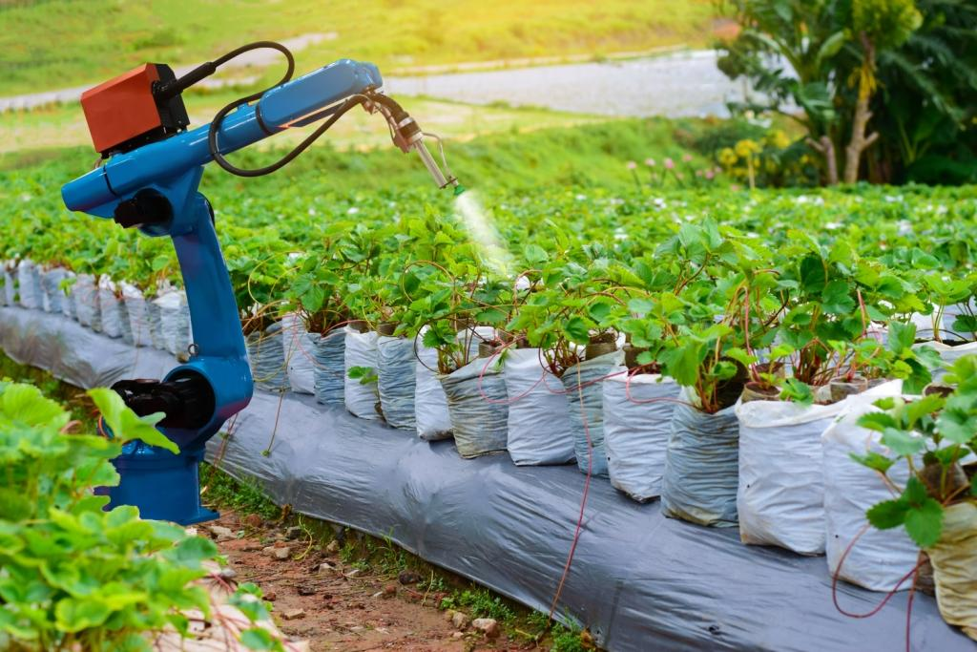
Autonomous robots
Agriculture requires a significant amount of manual labor.
What do you think a robot could do?
Autonomous pickers identify and pick ripe fruits and vegetables. Other specialized robots could also find and eliminate weeds and pests that damage crops.

Slide 19
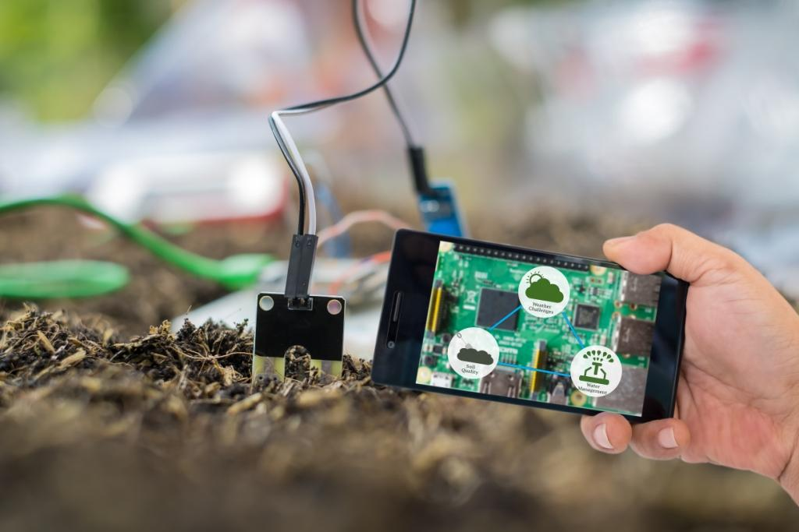
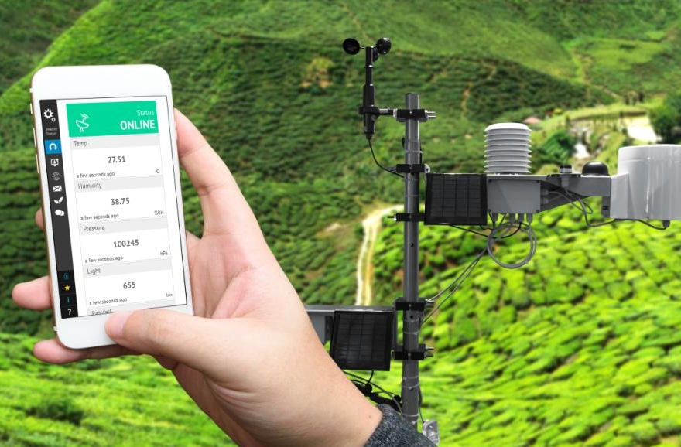
Agriculture sensors
When it comes to nutrient management, watering, pest management, and harvest - too early or too late doesn’t cut it.
When it’s time to take action, high-tech sensors located in fields send alerts to farmers through an app on their phone.

Slide 20
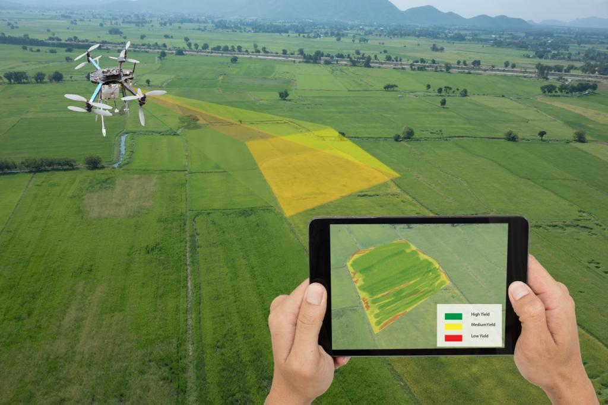
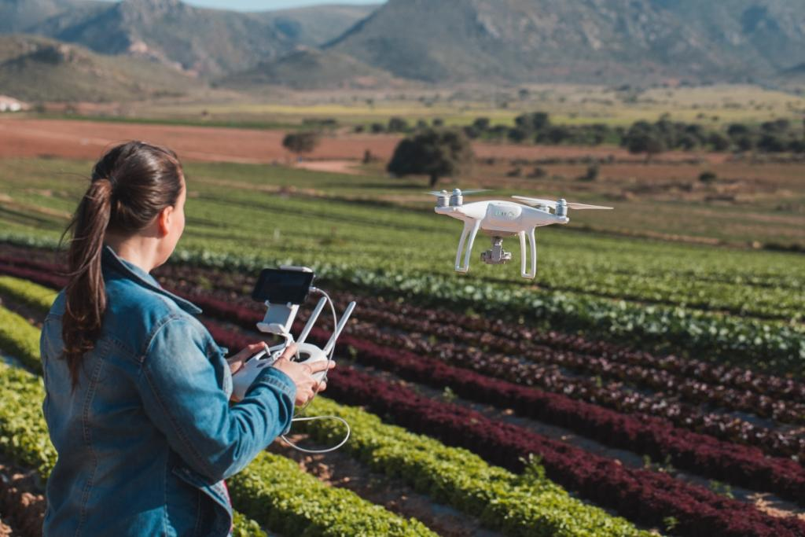
Aerial crop imaging
Aerial images taken with drones, satellites and planes can help farmers map their fields and use the land to its greatest potential.
Drones could perform crop monitoring, planting, and even spraying.

Slide 21
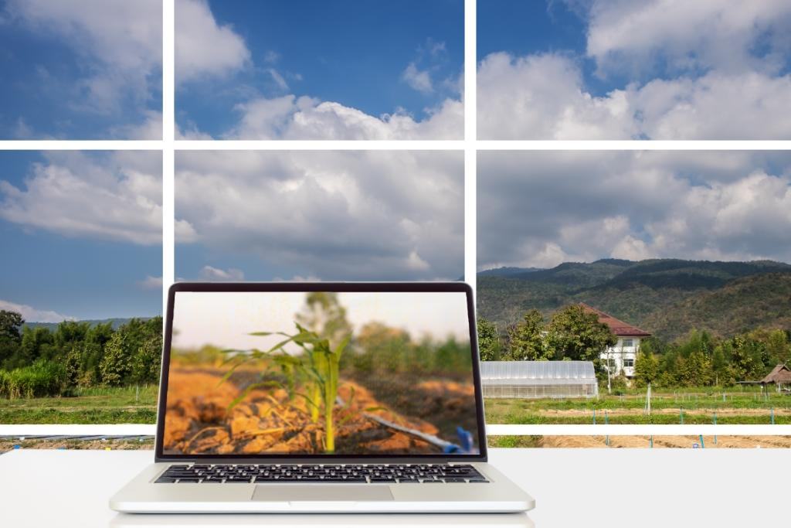
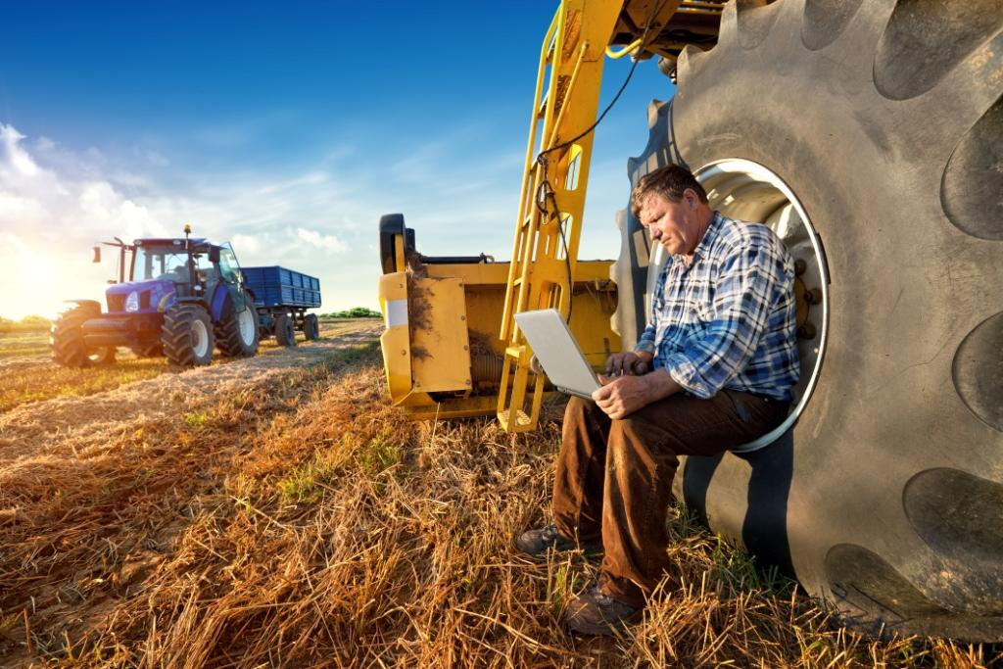
Agriculture data systems
Say good-bye to notebooks.
Farm data such as annual crop yield, market forecasts, soil nutrients, and weather can be collected and stored electronically to give farmers valuable information.

Slide 22
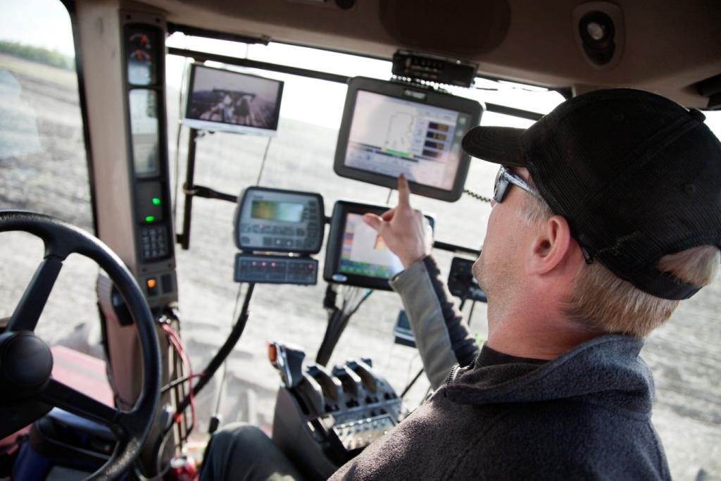
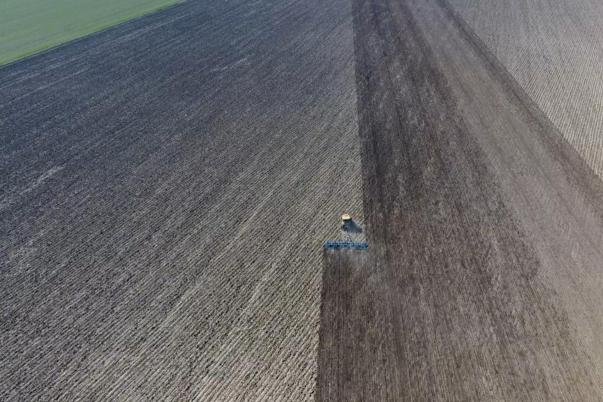
Global positioning systems
GPS-based applications are being used for farm planning, field mapping and more!
The farmer is always present, but the tractor can drive itself to ensure perfect rows, while the farmer can program the precise application of seed and fertilizer.

Slide 23
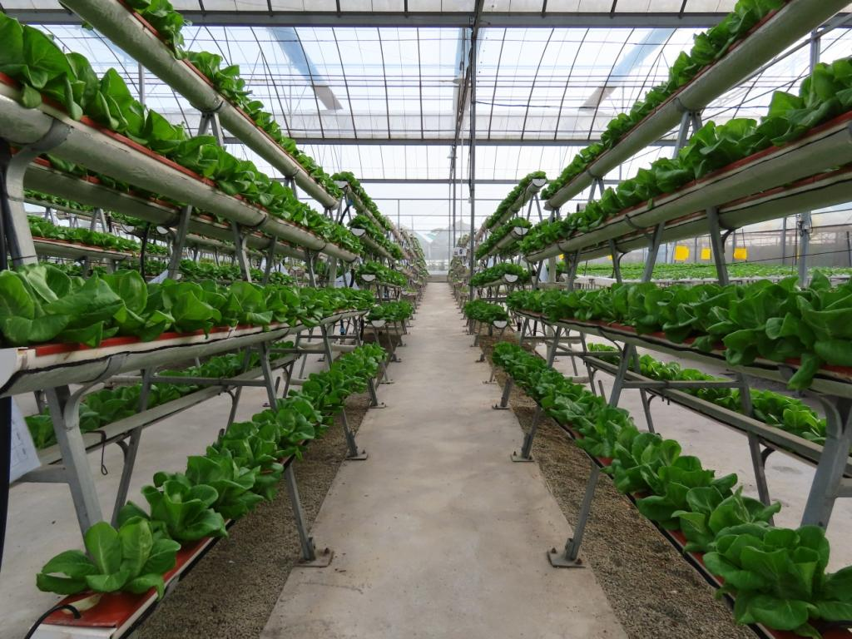
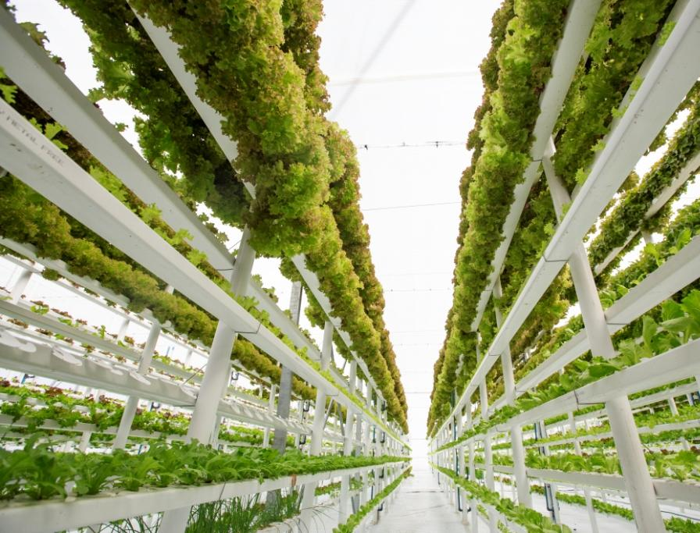
Vertical & indoor farming
Growing crops up, instead of out…
Now that’s a good idea!
Vegetables and fruits tend to work the best in vertical farming, and it’s ideal where land isn't available.
It can even help to re-purpose abandoned structures.

Slide 24
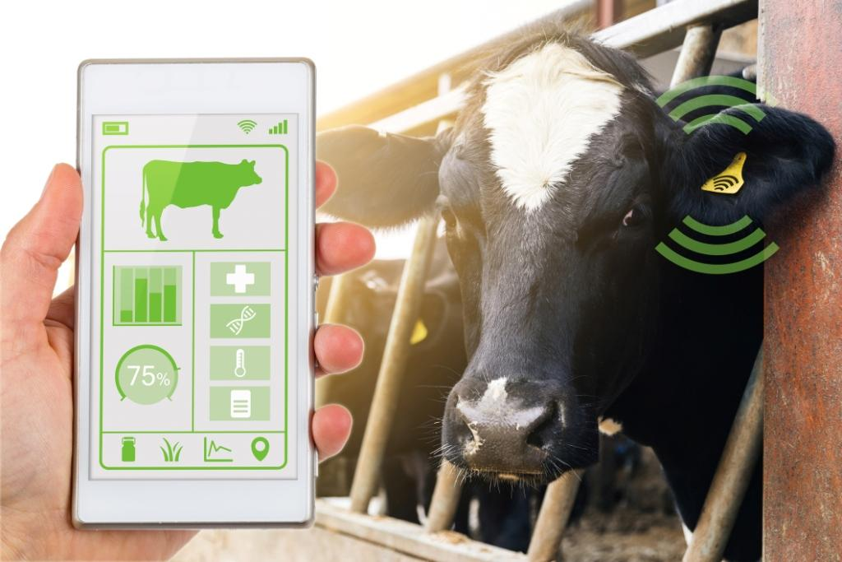
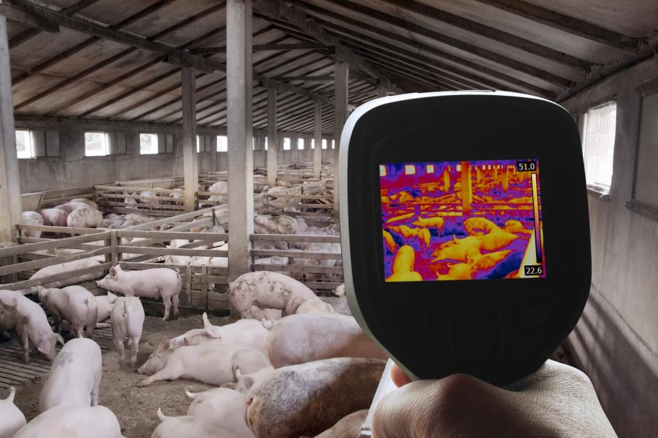
Livestock monitors
The livestock industry utilizes technology to ensure animal health, safety, and welfare.
Examples:
Smart collars are used like a personal fit bit, tracking daily activity, behavior and health.
Breath analysis allows farmers to evaluate potential health problems and diet.
Thermal imaging and 3D cameras analyze an animal’s body muscle and weight to advise the farmer when to sell their livestock.

Slide 25
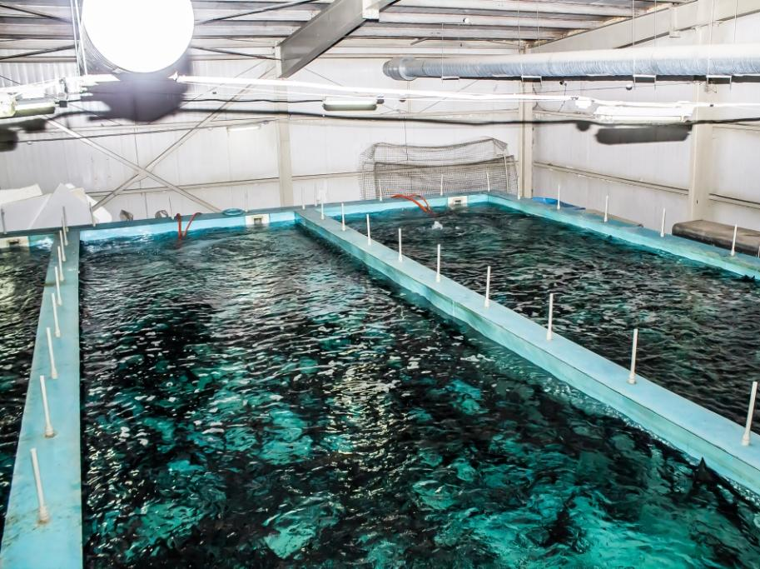
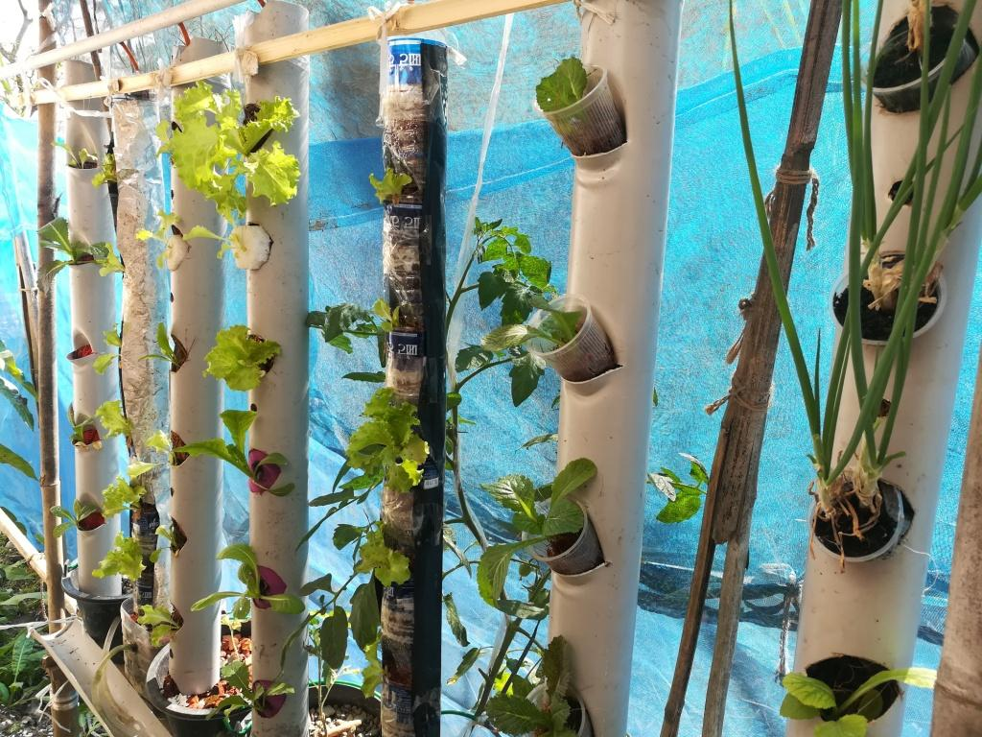
Fish farms & aquaponics
Specialized fish farms involve raising fish in tanks or enclosed ponds.
Aquaponic systems are a unique way to grow fish and plants symbiotically. Waste from the fish is cycled through the system, serving as a source of nutrients to grow the plants.

Slide 26
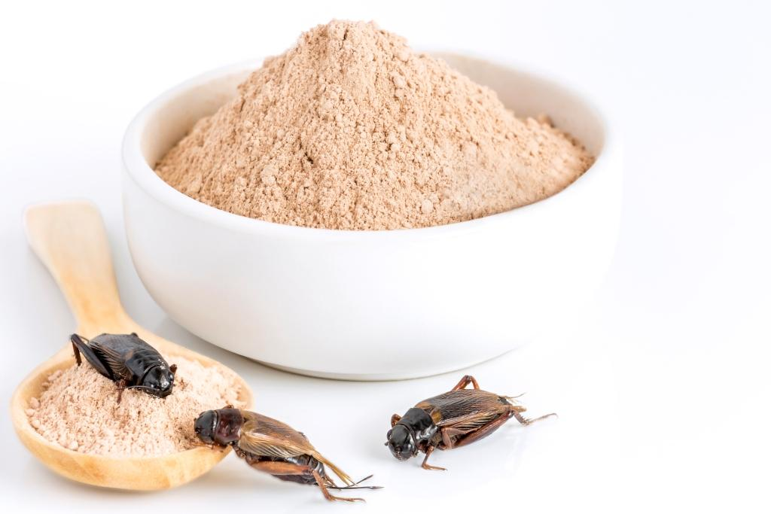
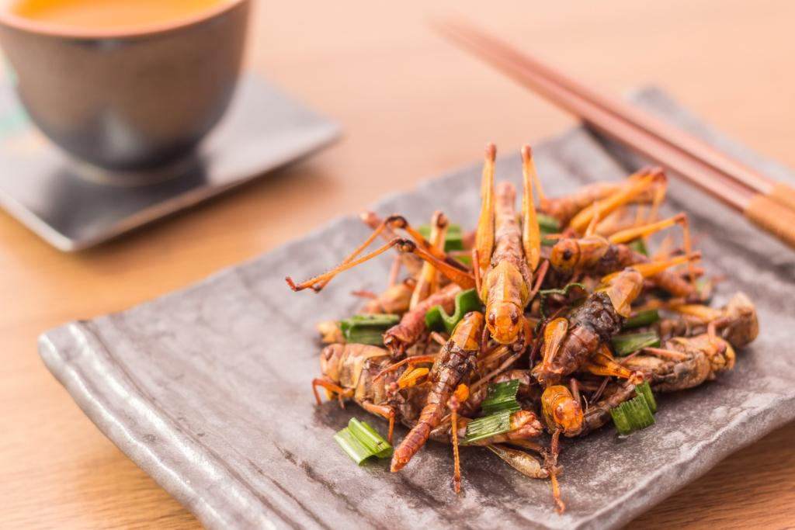
Insect PROTEIN
Meat, milk, and eggs are common sources of protein in our diet.
But, what about bugs as as source of protein?
Insects are affordable and require fewer natural resources.
Would you eat them?

Slide 27
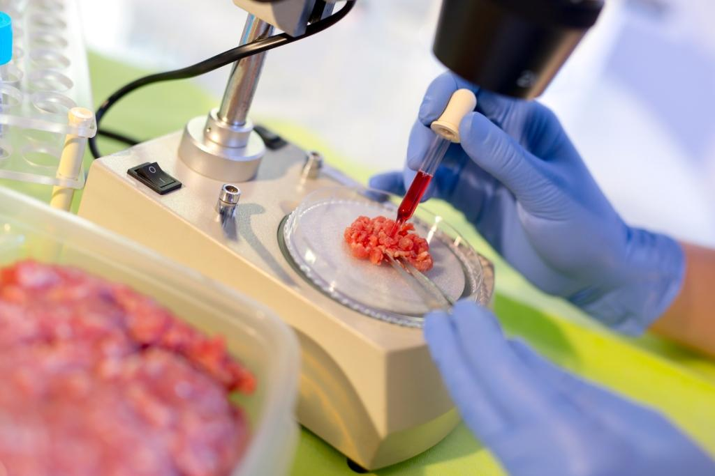
Cultured meat
Another alternative protein source is cultured meat. It isn’t “meat” in the traditional sense - as it doesn’t come from processing an animal.
It is formed in a lab using animal cells. Tissues are engineered to form a meat alternative.

Slide 28
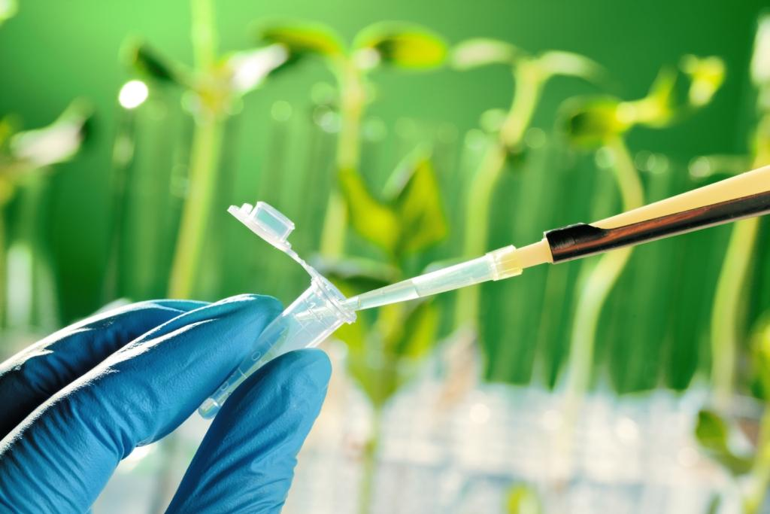
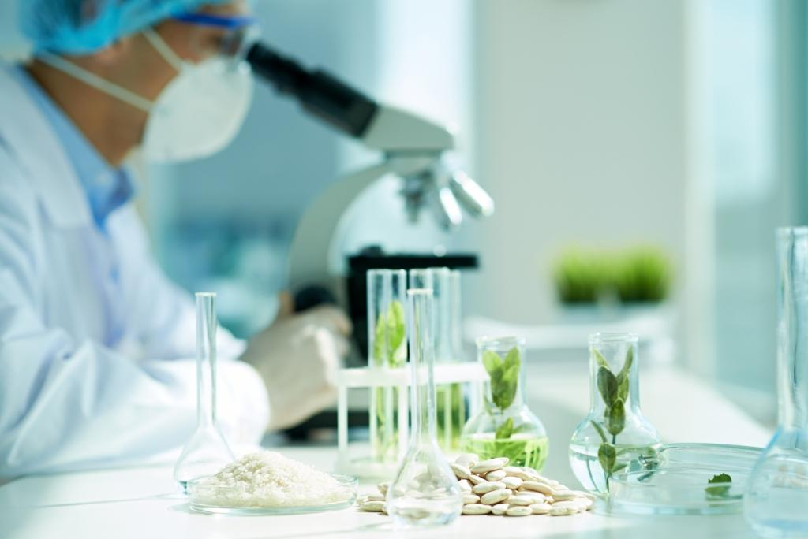
new seed varieties
Genetically modified organisms (GMOs) and CRISPR technology edit genes in plants to overcome a challenge, such as a disease.
A lot of time and money is required to produce a GMO plant. It takes approximately 13 years to research and ensure its safety – and can cost around $136 million dollars.

