Slide 1
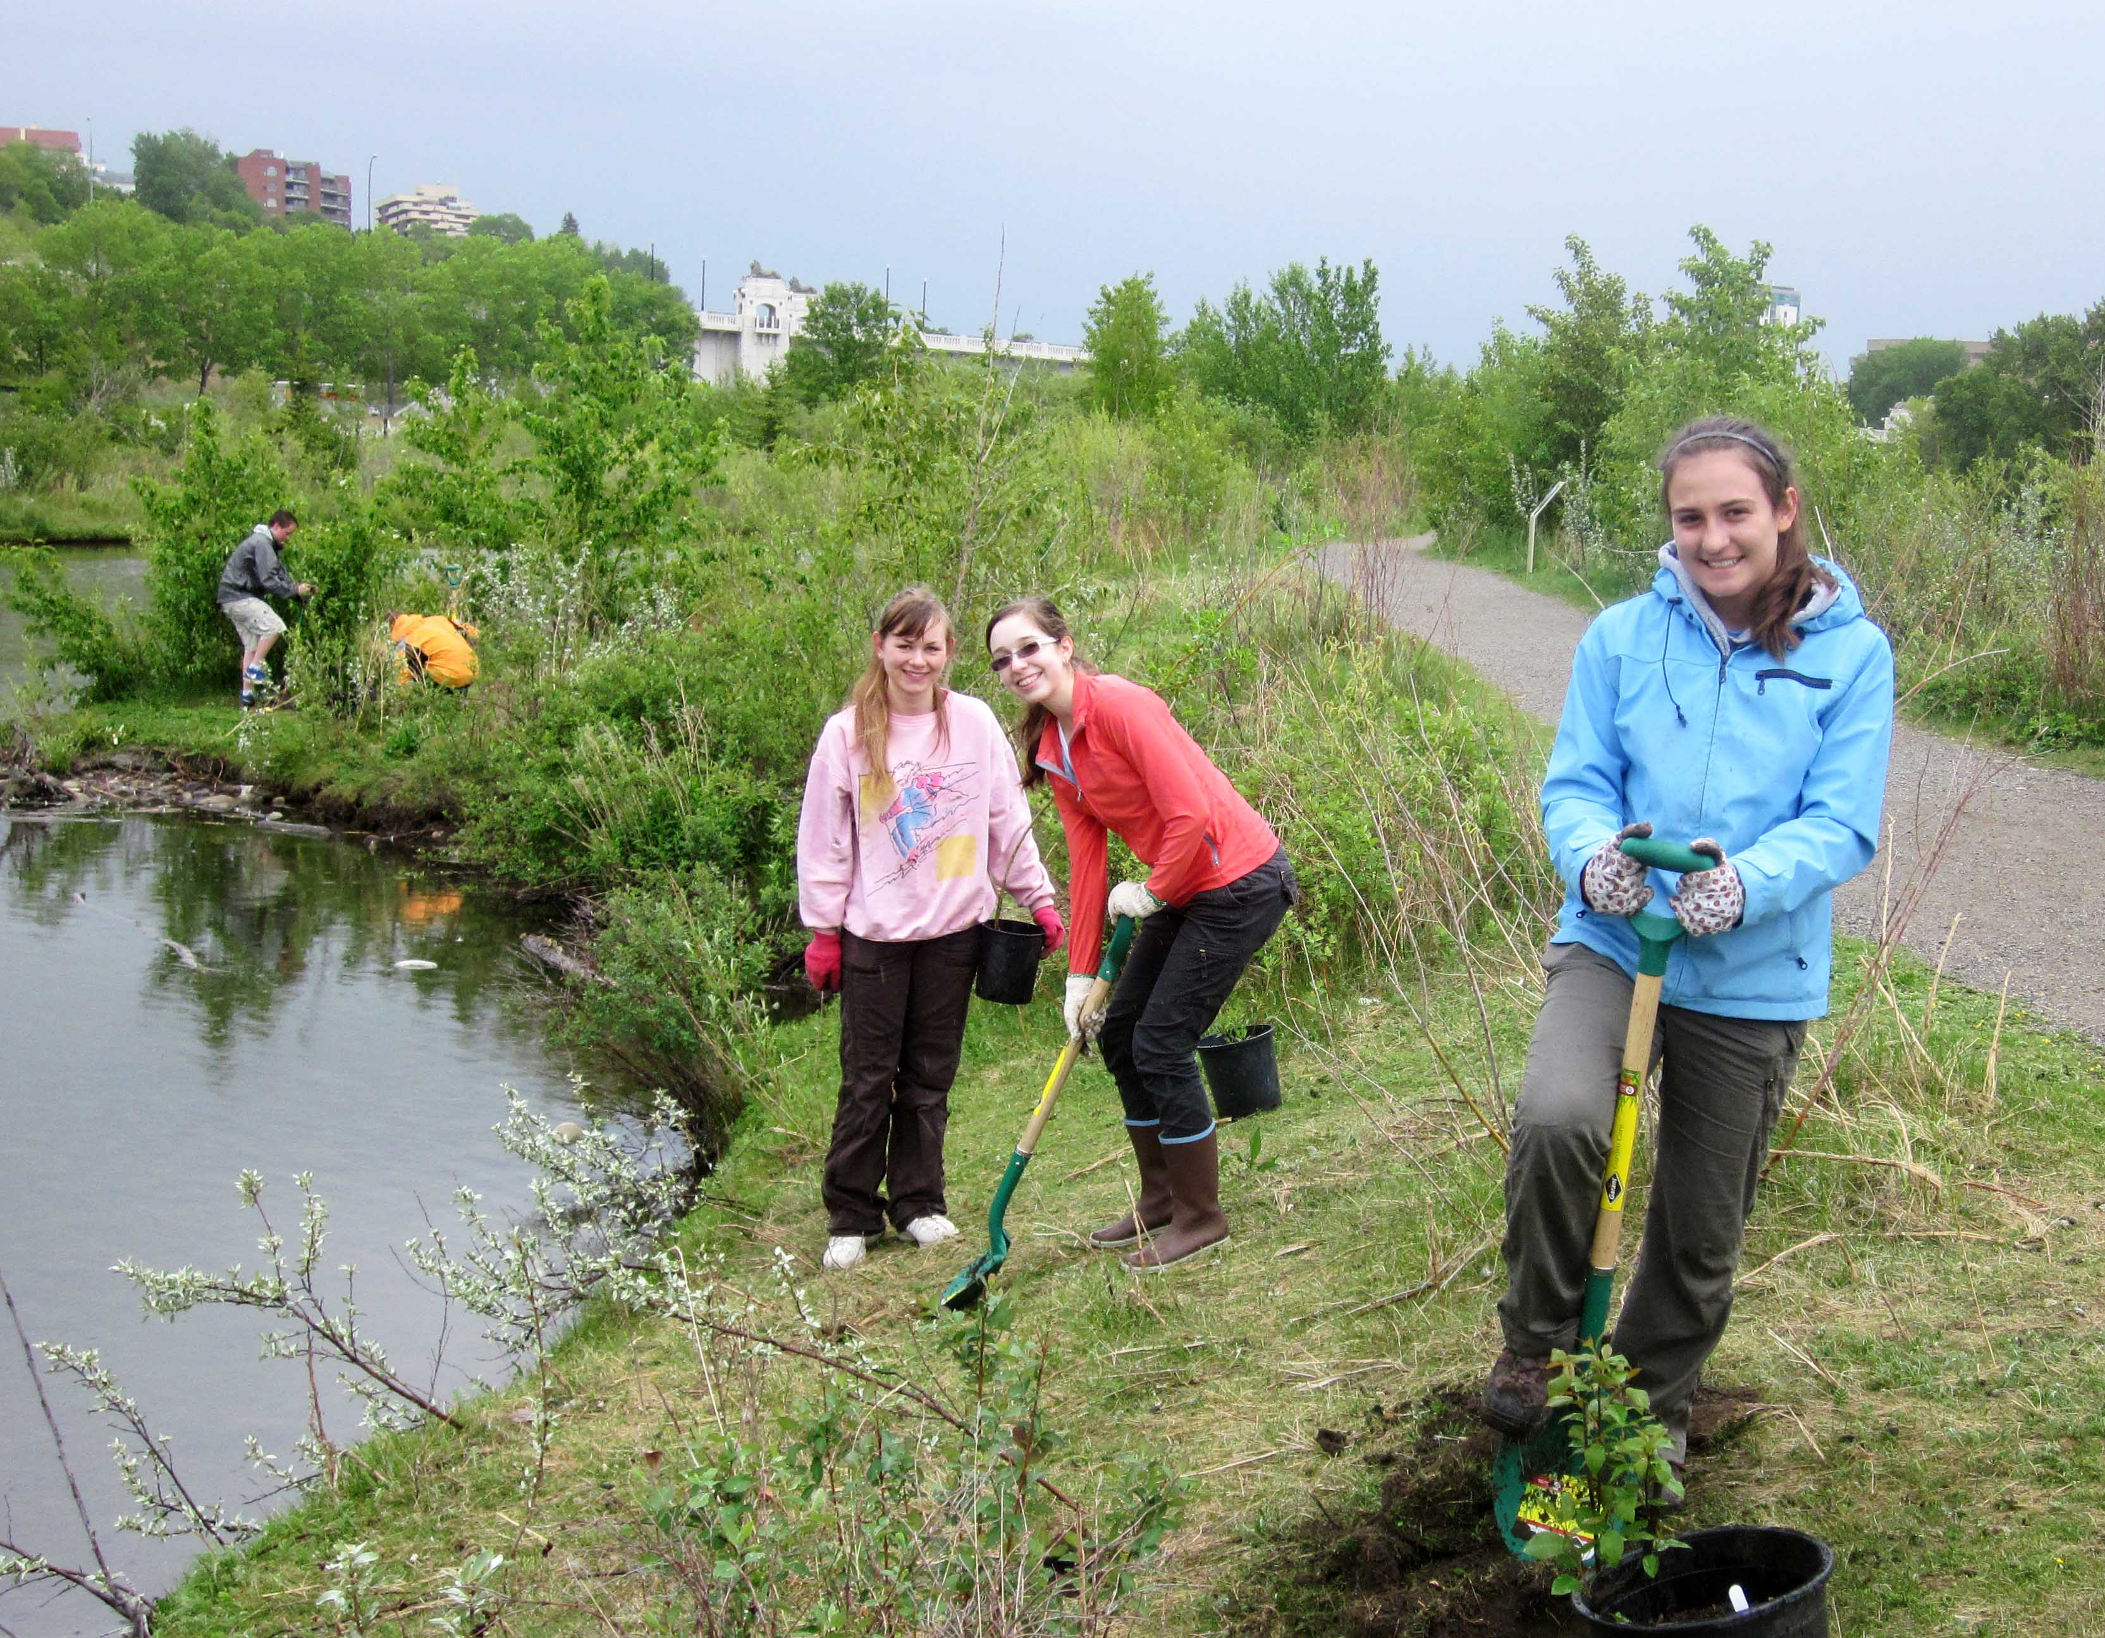
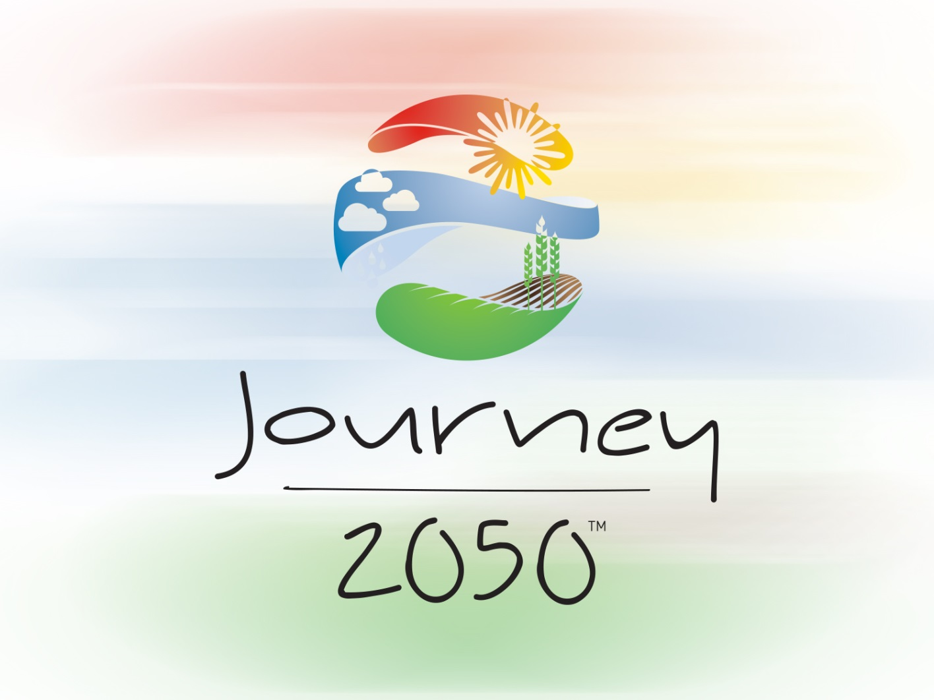
Summary:
Project-Based Learning
V8.0
Notes:
Time
60-90 minutes
Activity Expectations
Students will be able to:
Answer the question, “How will we sustainably feed nearly 10 billion people by the year 2050?”;
Describe the United Nations Sustainable Development Goals (SDGs) and the contribution we can each make; and
Implement a solution to take action to address world food sustainability.
Materials
Summary PowerPoint
Journey 2050 Project-Based Learning (PBL) Student Workbook
More information on PBL: https://pblworks.org
Key Terms
Refer to the Glossary of Key Terms handout for any words the students need to revisit.

Slide 2

brainstorm
“How will we sustainably feed
nearly 10 billion people by the year 2050?”
Notes:
In groups of three or four, write down as many Best Management Practices and NEW IDEAS as you can think of to answer the question: “How will we sustainably feed nearly 10 billion people by the year 2050?” Think of realistic solutions happening right now and also think outside the box!
[If you want to discuss other interesting agricultural innovations and practices that improve sustainability, here are three in each country]
Canada
4R Nutrient Stewardship – is a global program that ensures farmers apply the right source of nutrients, at the right rate, time and place specific to their farm to improve their economic, social and environmental performance.
Global Positioning Systems (GPS) – machinery is guided by satellites to precisely place nutrients, seed and crop protection products at variable rates to match the soil’s productivity.
Wetland Restoration – brings back the kidneys of the environment, wetlands that filter excess nutrients and help reduce water levels during floods.
Africa
Cell Phone Towers - increase communication and result in improved market access, education and local jobs.
Improved Grain Storage – reduces spoilage and allows grain to be sold at a premium.
School Meal Program – nourishes children resulting in improved learning outcomes and school attendance.
India
Remote Control Drip Irrigation – reduces evaporation and improves water utilization by the crop; using a cell phone to turn the water on and off conserves water and energy.
New Seed Varieties – increase yield, crop quality and resistance to drought, insects and disease.
Marketing Cooperative – helps producers collectively sell crops, rather than individually, to increase market access and prices.

Slide 3
What do you think?
What are the
challenges & opportunities
for each idea proposed?
Notes:
Think of realistic solutions happening right now and also think outside the box!
Pick one person in each group to share at least two ideas.
Ask students to debate, “Will these technologies and more answer the question: How will we sustainably feed nearly 10 billion people by the year 2050? What are the challenges and opportunities for each?”

Slide 4
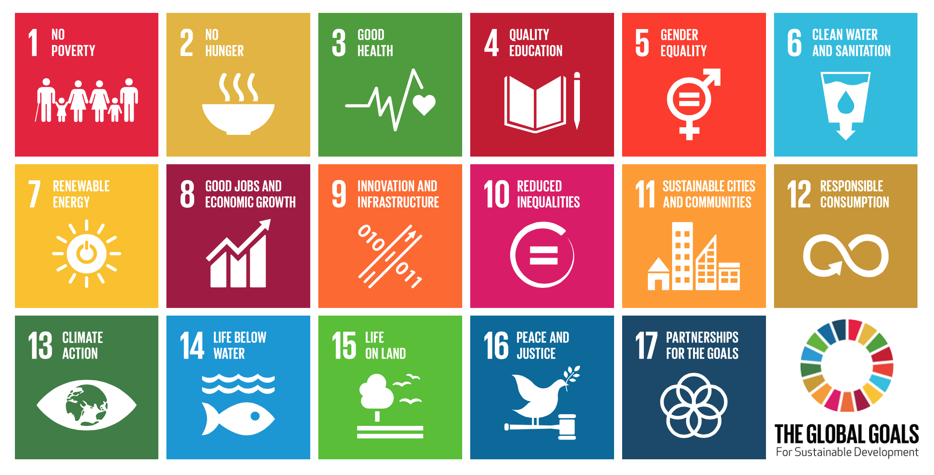
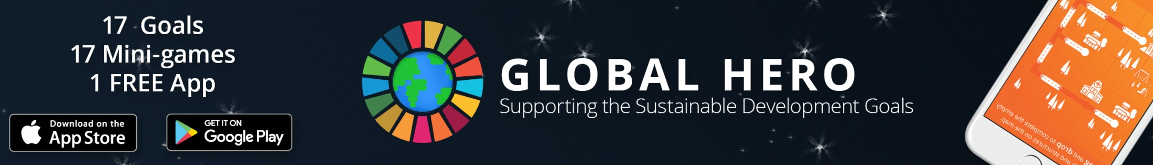
Do your ideas advance any of the United nations sustainable development goals?
Notes:
Review the United Nations Sustainable Development Goals (SDGs) (https://sustainabledevelopment.un.org/).
Optional: If possible, ask students to download the Sustainable Development Goals In Action app (https://sdgsinaction.com/) instructing them to explore the 17 goals using the app as they consider what they could do to help achieve one of the goals. The app provides explanatory videos, key facts and figures, as well as suggestions for achieving specific goals.
Optional: Students could also download a free app called, Global Hero (http://www.journey2050.com/download-global-hero-app/). Global Hero allows users to compete in 17 mini-games that showcase each goal at a high level. It’s a fun way to learn about each goal.

Slide 5
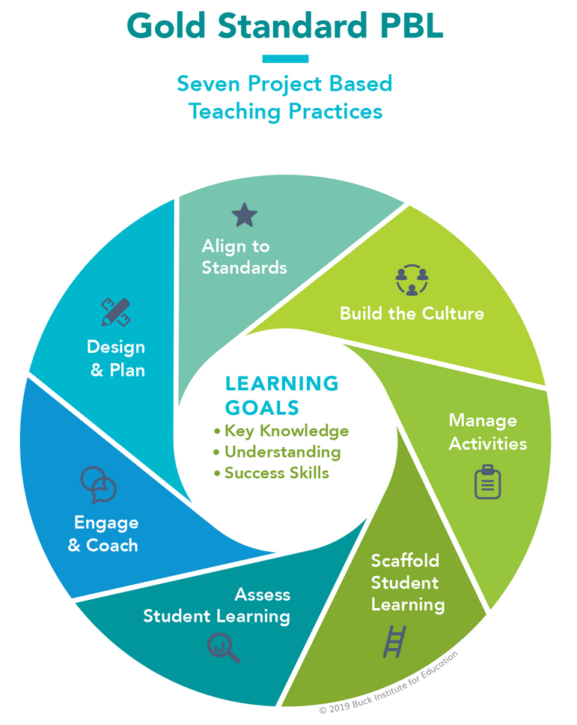
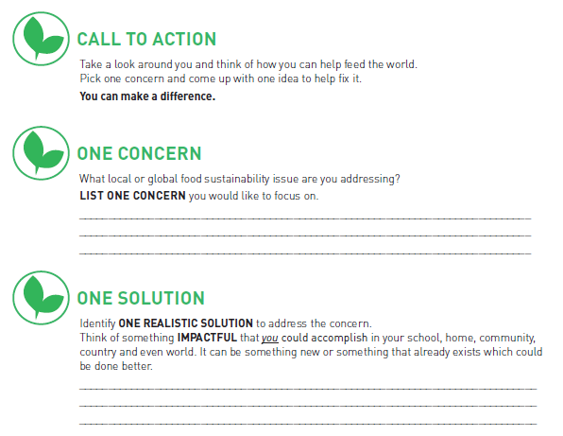
Take action:
Project-based learning
Notes:
Give each student one copy of the Journey 2050 Project-Based Learning Student Workbook. Students may complete the project as individuals or in groups. Explain that they will be developing an actionable project that supports sustainable agriculture.
Review the Journey 2050 Service Learning Lessons in Level 1-6. Some ideas provided include projects to reduce food waste; building a school or community garden; reducing water use; supporting local growers; creating green space; or hosting an agriculture career fair. Students may consider volunteering to help a charity in need, making changes at home to be more sustainable, fundraising for charities contributing to sustainability and educating others about the challenges we face in feeding the world.
Form teams around one or more SDG goals where students think they have a plan for making a difference. Teams should use the Journey 2050 Project-Based Learning Student Workbook to guide their project planning.
From this point forward this activity should follow the Project-Based Learning (PBL) approach. If you are new to PBL or need a refresher visit, https://pblworks.org. These five steps are part of the PBL Planner and help to guide the process:
Project Overview: Key features of your project
Learning Goals: Standards, success skills, literacy skills, rubrics
Project Milestones: Significant steps in the project
Project Calendar: Day-by-day activities in the project
Lesson Planner: Supporting resource with guidance on planning daily lessons to meet the needs of all learners
Image courtesy of: https://pblworks.org

Slide 6
Share your ideas
Notes:
If you implement a project to improve world food sustainability please let us know.
E-mail programs@naitco.org.
All of the ideas are reviewed, and the top ones are shared with the public. By sharing our ideas and making action plans, we can help sustainable agriculture reach the goal of feeding the world.

Slide 7
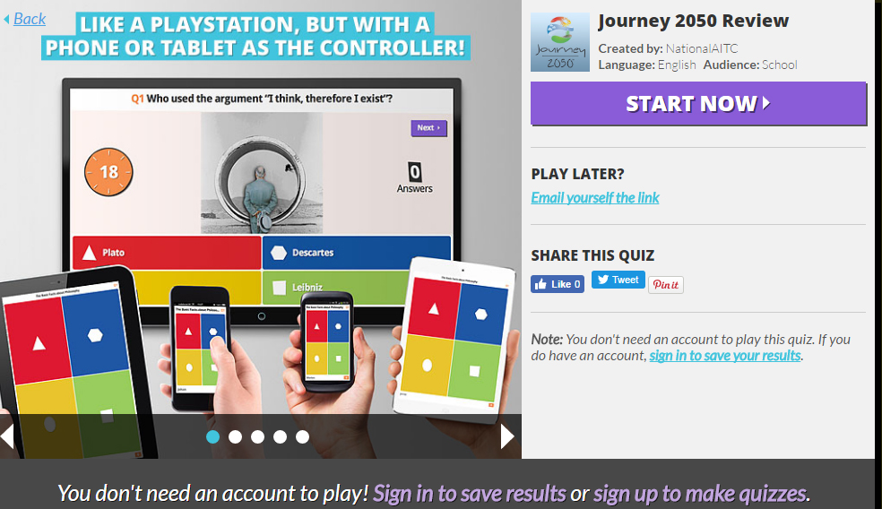
Test your knowledge
Review the concepts from Levels 1-7
Journey 2050 Kahoot!
Notes:
Review as a class what has been learned throughout the Journey 2050 program: Levels 1-7. Use the Journey 2050 Kahoot! as a formative assessment.
https://play.kahoot.it/#/k/69ea672b-8be0-4144-8504-8232d9dce211

Slide 8



Wrap up
The Sustainable Development Goals are interconnected and drive the sustainability of our communities and our world.
You have the power to make a difference in feeding a growing population.
Spread the word! How do we sustainably feed nearly 10 billion people by the year 2050? #journey2050 #feedingtheworldresponsibly
Notes:
The Sustainable Development Goals are interconnected and drive the sustainability of our communities and our world.
Youth have the power to make a difference in feeding a growing population.
Tweet this: How do we sustainably feed nearly 10 billion people by the year 2050? #journey2050 #feedingtheworldresponsibly
Emphasize to students they can make a difference in sustainability – not only in agriculture but across all sectors!
Students could consider: volunteering to help a charity in need, making changes at home to be more sustainable, fundraising for charities contributing to sustainability and educating others about the challenges we face in feeding the world.
Chance to Win:
A component of Journey 2050 is to inspire and encourage participants to get involved in sustainable initiatives.
Classrooms that participate in the Online Experience and complete the follow-up survey sent in December of each year will be entered for a chance to win $100 donation credit to donate to a charity that contributes to sustainability!
Field trip and classrooms who receive the 2-hour Guest Speaker presentation may also receive a donation credit, but it’s based on first come, first served. The Program Coordinator will notify all winning schools and provide instructions to claim the prize at that time.
This is a unique opportunity for the participants to think as global citizens and give back to those who work hard to improve social, economic and environmental performance.

Slide 9
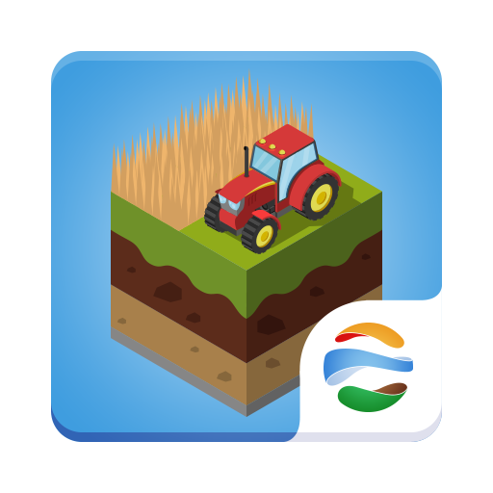

Journey expansion
SCHOOL EDITION: JOURNEY 2050
HOME EDITION: FARMERS 2050
Notes:
The Journey 2050 game is available in the iOS, Android and Windows Stores; however, it wasn’t intended for public use. It has timers to make sure the students all start and stop roughly at the same time, and it has a limited number of commodities simply because there isn’t enough time in the program to incorporate everything in agriculture.
Students who want to play at home are encouraged to download: FARMERS 2050

Slide 10
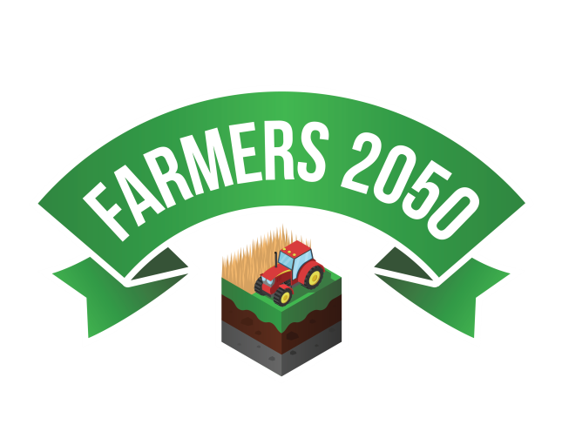


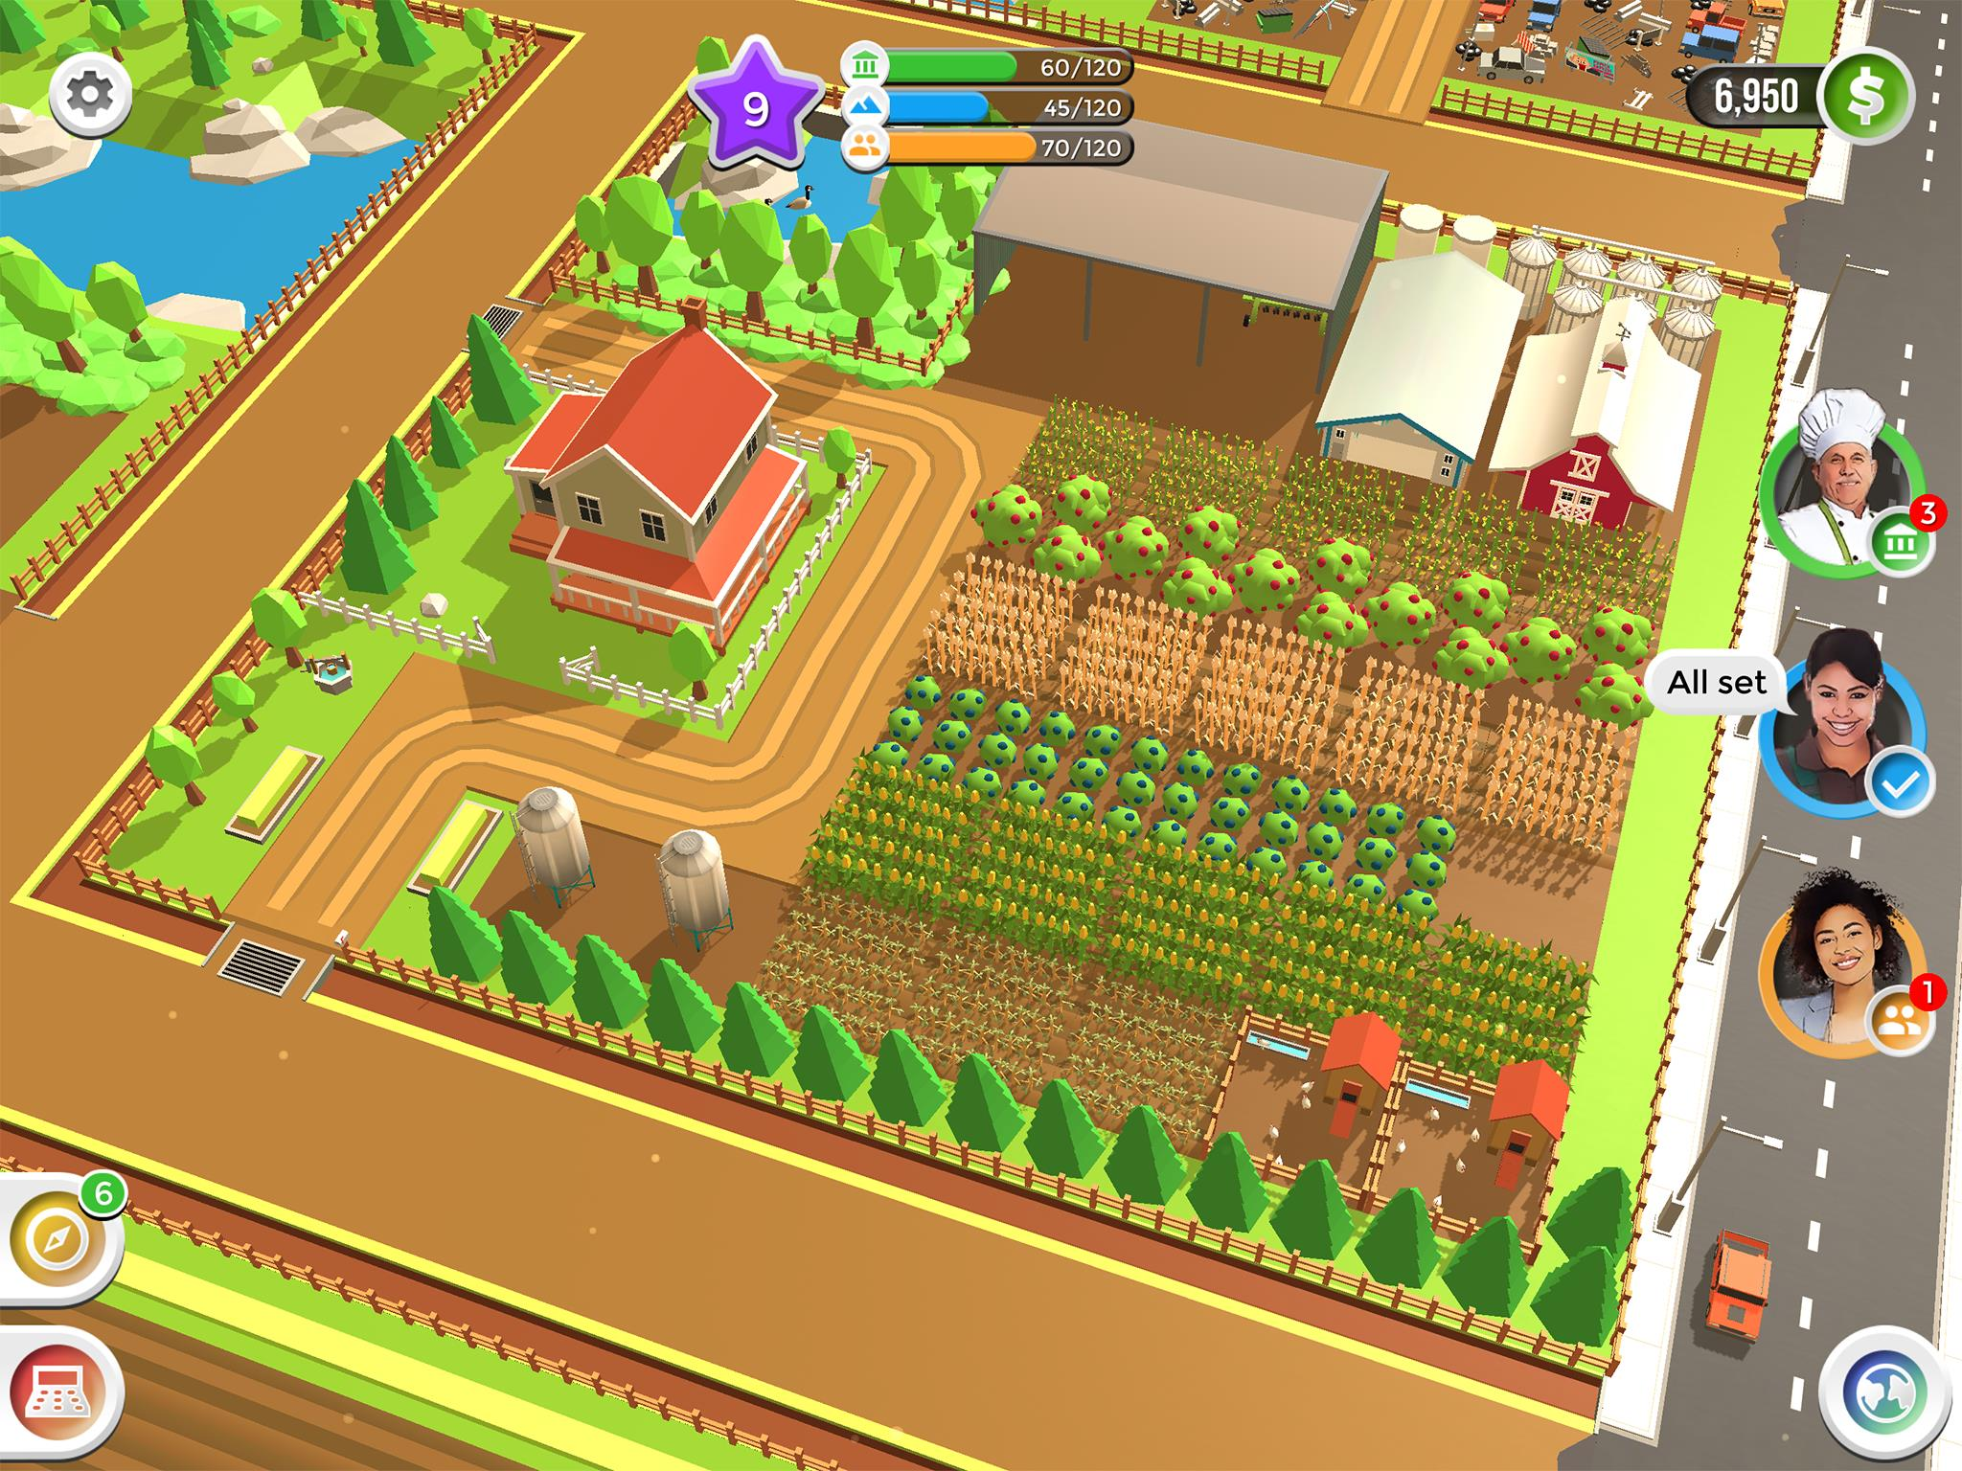
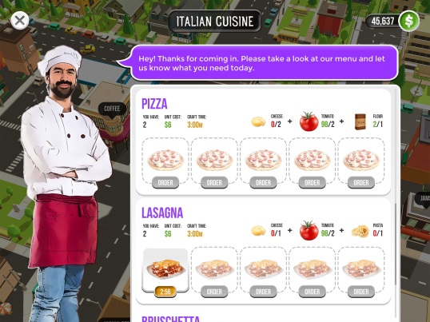
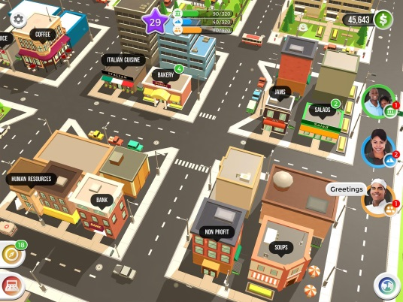
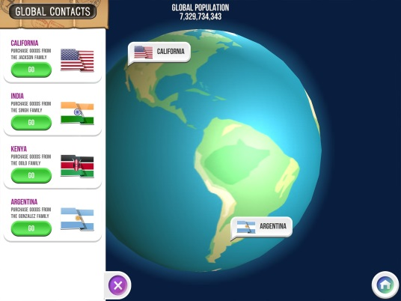


ONE FARM. NO TIMERS.
MORE CROPS, ANIMALS & CRAFTING.
CRAFT
SELL
TRADE
GROW CROPS
RAISE ANIMALS
FREE. NO ADS or IN-APP PURCHASES
Notes:
FARMERS 2050 is an animated farming game. Droughts occur, mortgage payments come due, and farm chores never stop. Students will discover what it really takes to feed the world.
Players will have one farm, instead of three, to grow crops, raise animals, and craft goods to sell in your local community all the while managing the three pillars of sustainability: environment, economic and social. Sound familiar!
Along the way, real farmers from across the world will show students what they are doing on their farms.
Farmers is FREE to play and there are no advertisements or in-app purchases.
It is available on iOS and Android devices.
Learn more at www.Farmers2050.com
30 Second Preview: https://youtu.be/dWxNwQKhbJg

Slide 11
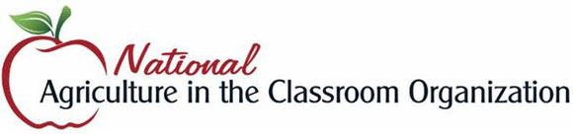

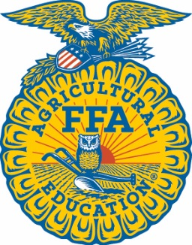







Brought to you in collaboration
www.Journey2050.com
Notes:
Brought to you by community partners around the world.

Slide 12

Questions?
Programs@naitco.org
Notes:
Thank you for participating in the Journey 2050 program.

