Slide 1



Online Experience
www.Journey2050.com
Journey2050@nutrien.com

Slide 2
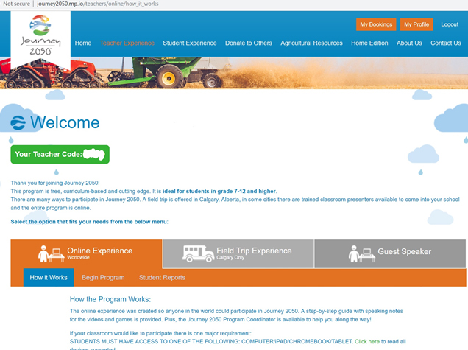
After registering
Notes:
Once you have registered at www.journey2050.com, sign into your account.
This is the home screen where you can access the curriculum, resources and select different options in the program.
Lets go over the 3 main tabs you see on the home screen: Online Experience, Field Trip and Guest Speaker
Online Experience is where you will spend most of your time. This tab is home to the main portions of the curriculum. You will find every level and its accompanying resources listed section by section. Each level has a complete lesson plan, PowerPoint, video and additional resources. Level 1-6 has a game level incorporated using the Journey 2050 gaming platform. Level 7 is a research-based project and the Summary lesson is a Project-Based Learning experience.
Field Trip Experience is an opportunity for students in or near Calgary, Alberta, Caanda to visit the Journey 2050 classroom at the Calgary Stampede. In areas where it is offered the tab will be orange signifying the option is available to teachers.
Guest Speaker Experience is a specialized opportunity based on the territory. In areas where it is offered the tab will be orange signifying the option is available to teachers. A teacher can request a Guest Speaker to come to the classroom to do a 2 hour presentation covering level 1, 2 and 6 with the class.
Everything is provided!
This program was designed by teachers, non-profits and industry experts to ensure it is science-based, realistic and engaging.

Slide 3
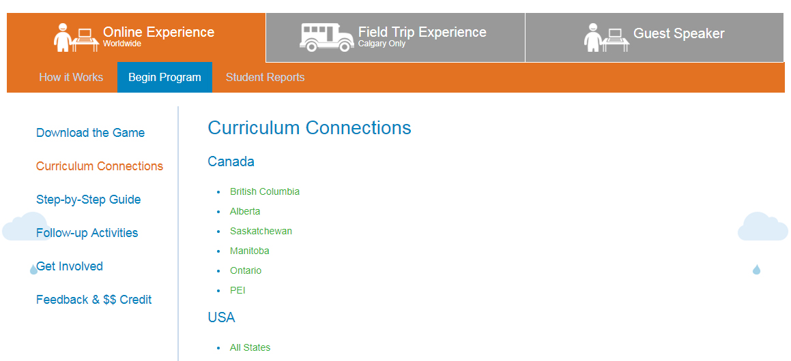
Step-by-step guide
Notes:
Journey 2050 was written with teachers to ensure it fits curriculum. Connections between grade 7-12 are provided under Online Experience/Begin Program
If you want a more detailed link to curriculum please let us know. We are confident this program will fit directly into your school curriculum.

Slide 4
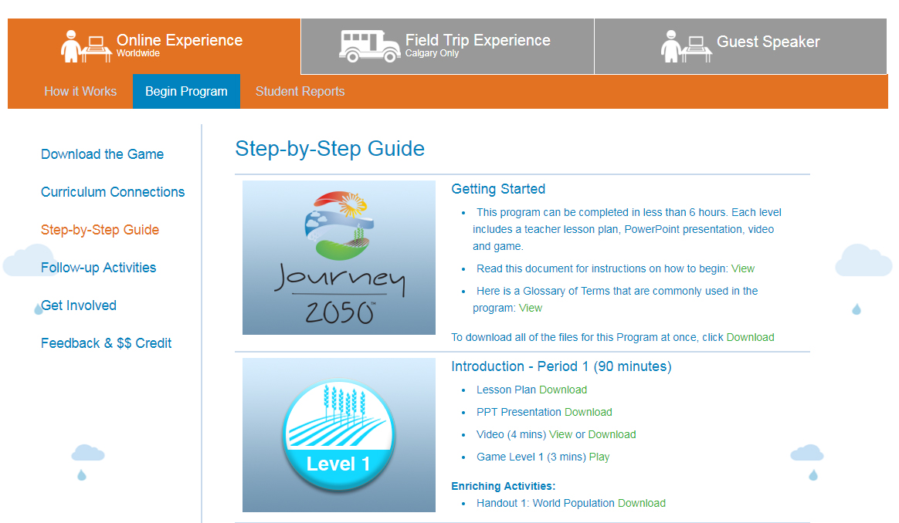
Step-by-step guide
Notes:
7 Levels + Summary
Core topics include:
1. Sustainable agriculture and food waste
2. Plant health and soil nutrients
3. Water and conservation
4. Economies
5a. Land-use and population density
5b. OPTIONAL Q&A showcasing cultures around the world
6. Agriculture careers
7. Technology and innovations
Summary: Project-Based Learning
You can pick and choose the levels you want to teach; however, the program was intended for Level 1-4 to be taught in order.
Each level includes a lesson plan, PPT, video and game/activity. Plus, enriching activities to learn more.
There are suggested action projects for most levels to help set the students up for building and implementing a project at the end of the program.

Slide 5
Teacher code: reports
Notes:
Each teacher is assigned an individual teacher code. This code skips the videos (it assumes you will play them at the front of the class for everyone) and it generates a report after each game. Students should use the same device the entire time they play through Journey 2050 to ensure their scores are recorded properly.
Note:
It takes 24 hours for the report to generate and the device must be connected to wifi.
Level 1-4 is considered one game. Students virtually farm and each level rolls into the next.

Slide 6
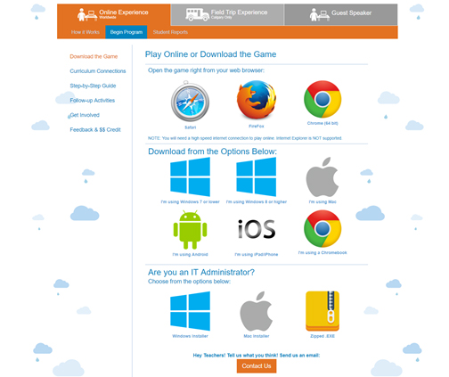
Download the games
Notes:
Every student needs a device to play the game portion of the program.
If you have a computer lab with wifi then students can play online using Safari, FireFox or Chrome browsers.
Alternatively, if you are concerned your school wifi will not support the students all playing online at once a great solution is to download the Zip Folder. This will download the game directly onto the computer so you will not need wifi. (Quick tip, save the ZIP folder onto a USB and it will make it quicker to load it onto each computer in the lab).
Note: Old browsers such as IE8 don’t work
If your classroom has tablets the game is available as a FREE download in iOS, Google Play and Windows Store.

Slide 7
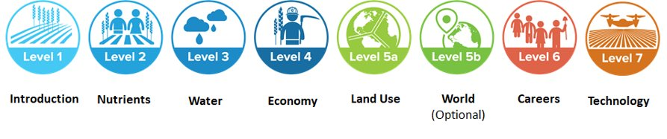
games
Game: Level 1-6
Notes:
Open the game either through internet browser or downloaded file – home screen of game
Remember, level 1-4 is considered one game. Students virtually farm and each level rolls into the next so ensure the students use the same device to play all levels or the report will not function correctly. Alternatively, just have the students write down their ‘sustainability barrel score’.
There is no virtual game for level 7

Slide 8
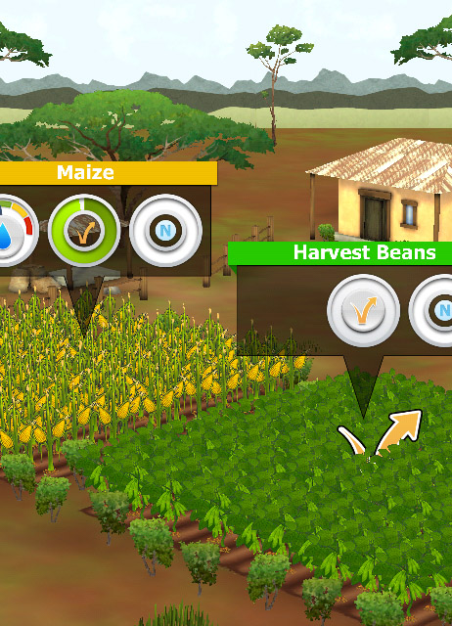
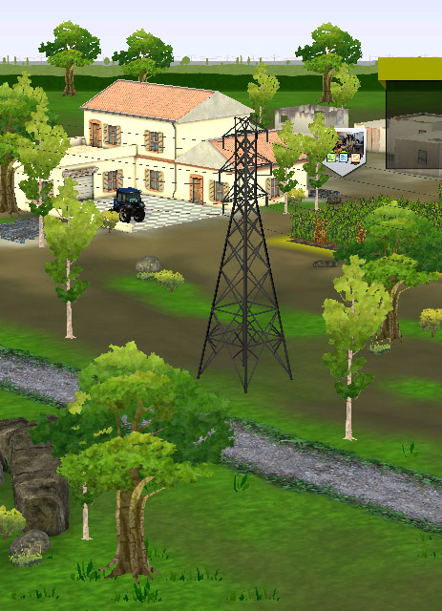
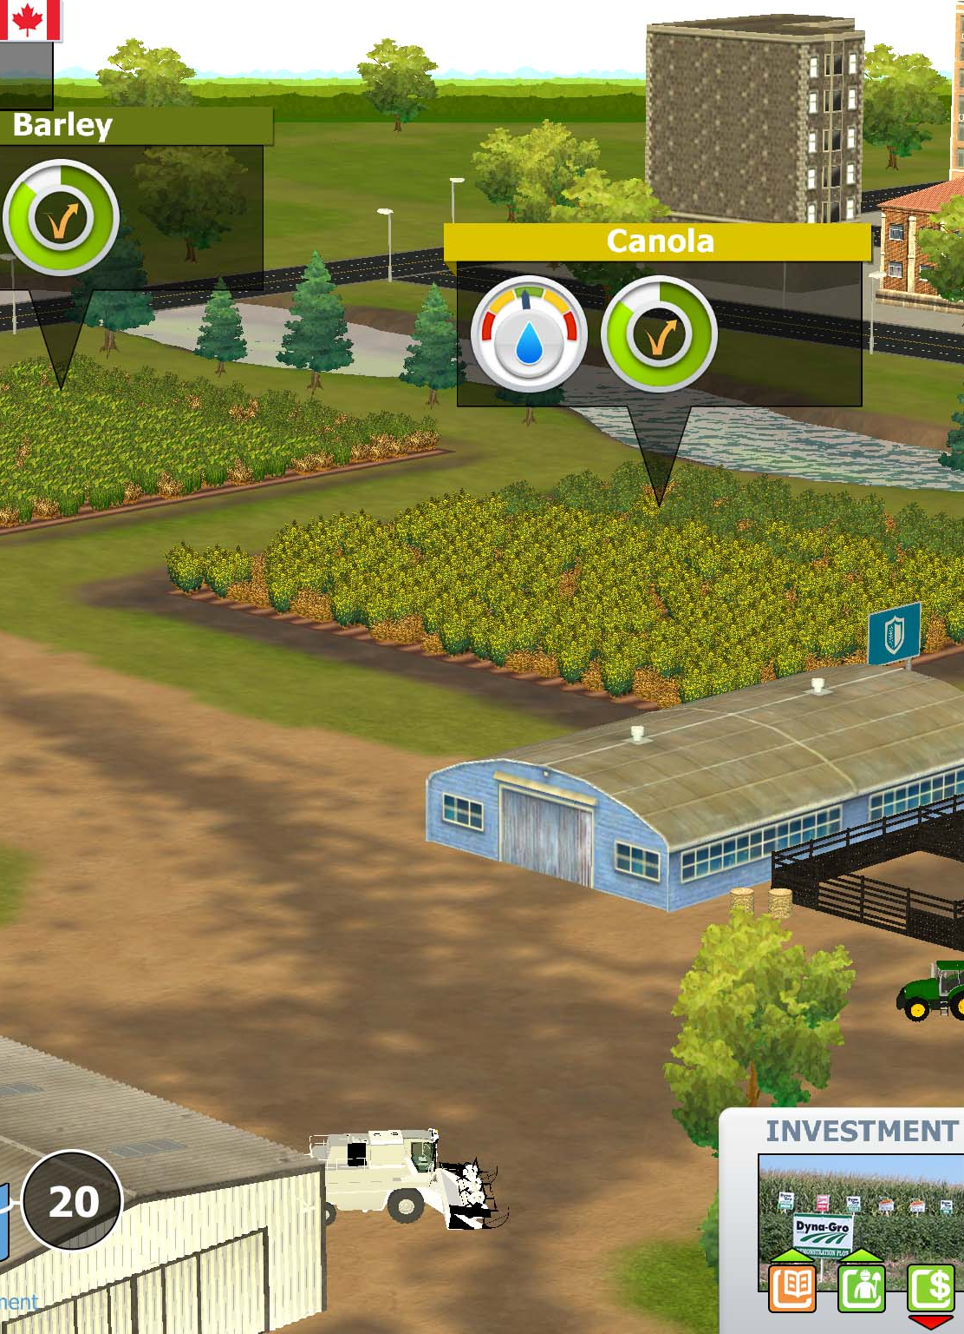
Virtual farm game: Real farm families
KENYA
INDIA
CANADA
Notes:
Students will experience life on the farm in 3 countries – Kenya, India and Canada.
Each country has specific crops, challenges and farming practices that are based on the real-farm families lives.
Each level in the game get’s harder with more challenges that the students have to respond to (for example in level 3: water hail occurs; in level 4: economies they must harvest and choose who to sell their crop to)
Levels are timed to provide students with the same opportunity and fit class timeframe.
Level 1 is a demonstration of the game. It takes 5 minutes to complete.
Level 2-4: Students farm in each country for 5 minutes (total is 15 mins per level).
Reports are provided for the teacher to help evaluate student comprehension but the virtual farm game is unique in that Level 1-4 must be completed at once or on the same device by the same student to generate a report as it is considered one game.

Slide 9
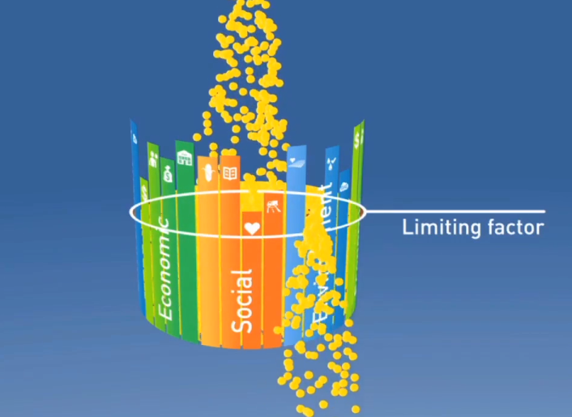
Virtual farm game:
Sustainability barrel IS THE SCORE
A community is only as successful as the least developed factor.
We must continually try to improve the weakest one.
ECONOMIC FACTORS:
profits, jobs,
incomes, community
SOCIAL FACTORS:
food, education,
health, infrastructure
ENVIRONMENTAL FACTORS:
soil health, habitats,
water, green house gases
Notes:
FAST REVIEW
I would like to introduce you to a unique way to remember sustainability.
Picture a “sustainability barrel”. The pieces that make up the barrel are made up of 3 different factors: – Economic, Social, and Environmental. These three different things are key parts of sustainability. In our Journey to 2050, we will be looking at some of these different elements individually and discovering how they are important to sustainability.
For example, in order to be able to grow enough food to feed the world sustainably, we have to make sure that the soil stays healthy, that we have enough water to grow the food, and that we don’t destroy natural habitats in doing so. In growing the food we want the farmer to make a profit, so that he and his children can be educated and benefit the community.
A community is only as successful as the least developed sustainability factor. We call this our ‘limiting factor’ - We must continually improve the weakest part of our sustainability – whether it is education or soil health – they all impact our ability to feed the world.
In the Sustainability Farming Game, the sustainability barrel is what we use to keep score. Our score will only be as high as our limiting factor, so we have to pay attention to everything, and be careful with the choices we make if we want to farm sustainably. Students will see their barrel begin to reflect their choices as they play
Sustainability varies across the globe with each factor facing different opportunities and challenges.

Slide 10
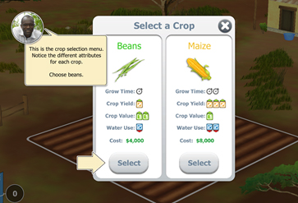
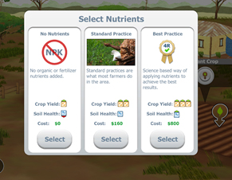
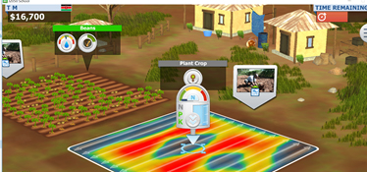
Virtual farm game: CROP NUTRIENTS
1
2
3
Notes:
1. Select crop
2. In level 2, 3, 4 students can choose which form of nutrients they want to apply to their field.
3. If they choose Best Practice a map appears where the nutrients need to be applied (yellow and red). If students over apply the nutrients or apply the nutrients in an area that does not need it their sustainability barrel will decrease (money and environmental score will decrease).

Slide 11
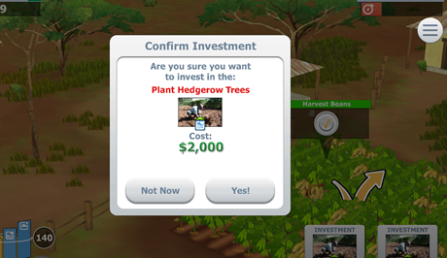
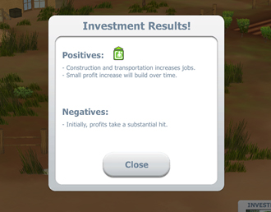
Virtual farm game:
Community investments
Realistic investments to each country
Ripple effect of each choice
Notes:
Students have the opportunity to make community investments through the game.
These choices are realistic based on the country and type of farm.
Each investment has a positive and negative result when either made or passed on. This showcases the power of the ripple effect of our choices we make - that there is always an impact made on the community, economy and environment. Students will see the results of their choices illustrated in the sustainability barrel throughout the game.

Slide 12
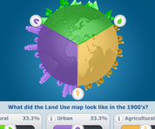
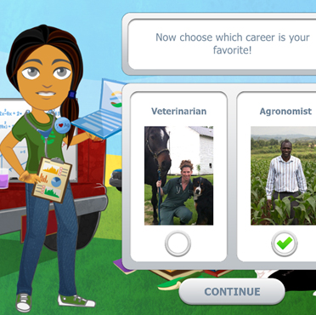
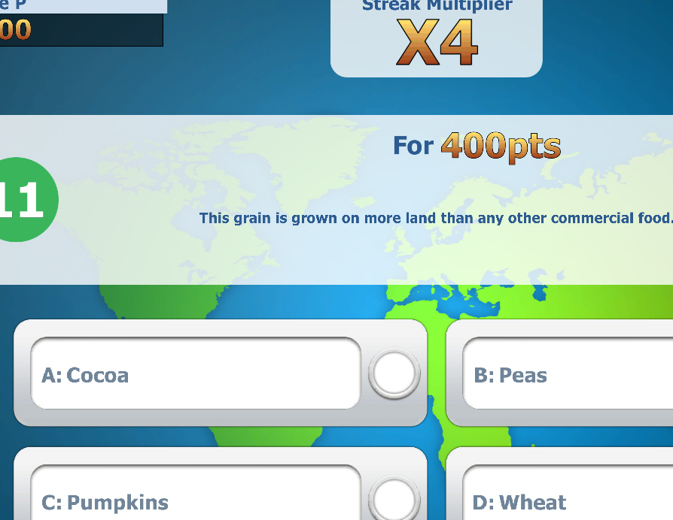
Level 5a, 5b, 6
5A
6
5B
Notes:
5a. This is a land-use game where students explore best management practices for agriculture, urban and recreational areas.
5b. OPTIONAL This is a Q&A game showcasing cultures around the world.
6. Agriculture careers are featured in this avatar game. The people showcased at the end of the game are real and their stories are true reflections of their career paths.

Slide 13
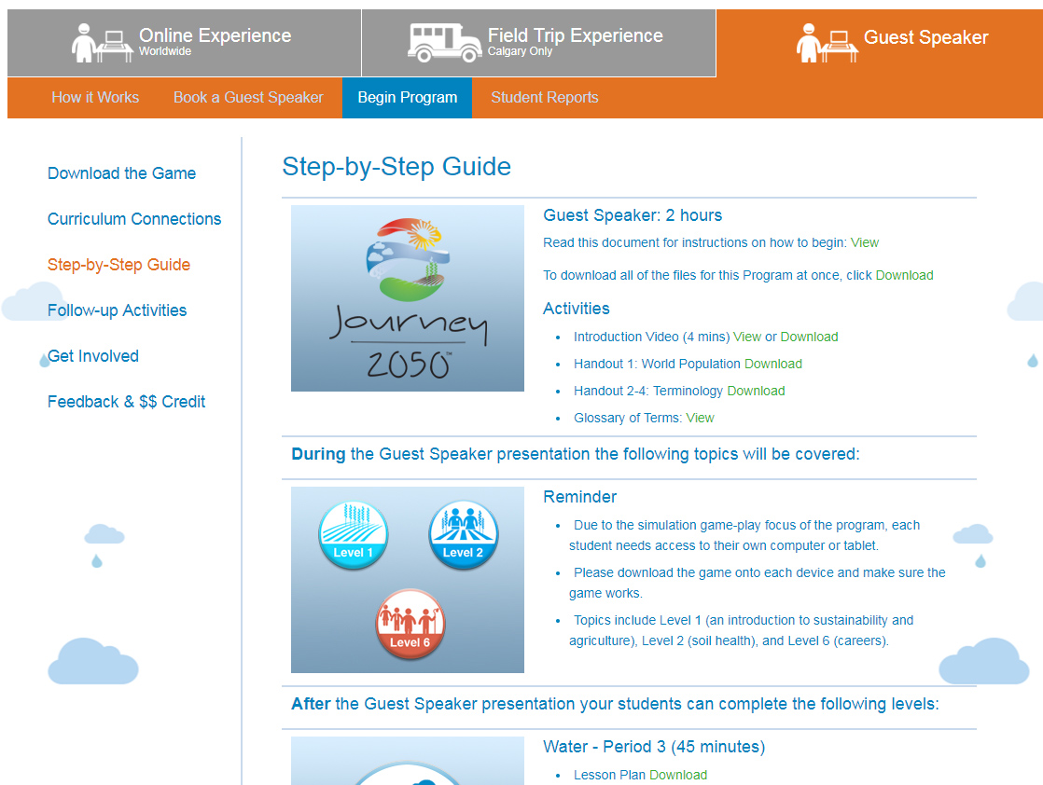
GUEST SPEAKER PRESENTATION
Notes:
This Experience is set-up the same as the Online Experience except a Guest Speaker comes into your classroom and delivers 2-hours out of the 7-hour experience. Afterwards, you can deliver the rest of the lessons.

Slide 14
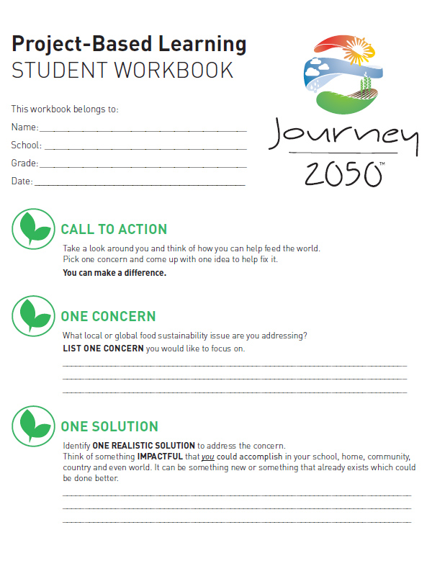

Take action
Summary Lesson
Notes:
The Program Summary has a Project Based Learning focus. This level was designed to provide students with the opportunity to create a personally meaningful project to address the issue of food security and sustainability.

Slide 15



Social activation
$100
Donation
Credit
Notes:
A component of Journey 2050 is to inspire and encourage participants to get involved in sustainable initiatives.
Classrooms that participate in the Online Experience and complete the follow-up survey will be entered for a chance to win $100 donation credit to donate to a charity that contributes to sustainability!
Field trip and classrooms who receive the 2 hour Guest Speaker presentation may also receive a donation credit based on first come, first serve. https://journey2050.benevity.org/community/redeem-a-giftcard
This is a unique opportunity for the participants to think as global citizens and give back to those who work hard to improve social, economic and environmental performance.

Slide 16

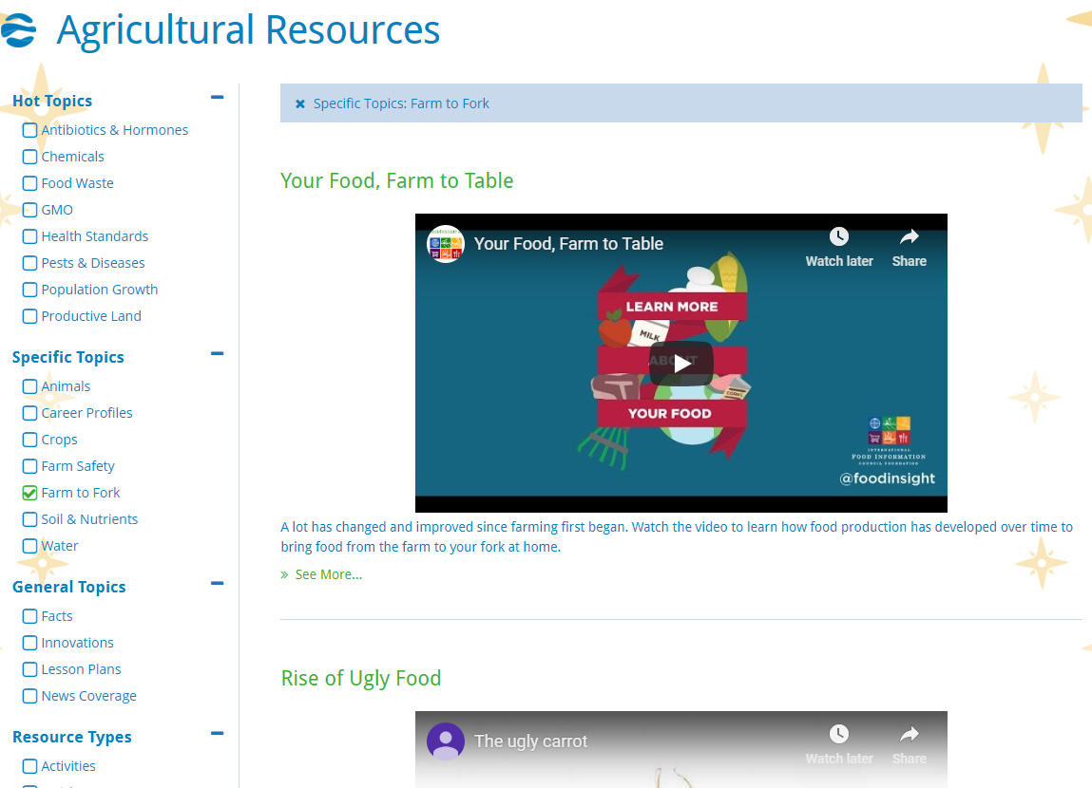
Agricultural resources
Notes:
Free videos, activities, fact sheets and more are available under the Agricultural Resources section of the website.
If your students have questions about agriculture please contact us. We have a network of industry experts ready to answer!

Slide 17
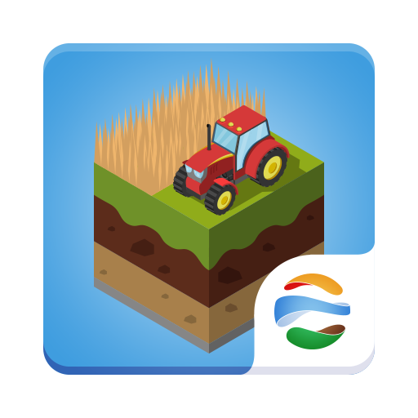

expansion
SCHOOL EDITION: JOURNEY 2050
HOME EDITION: FARMERS 2050
Notes:
The Journey 2050 game is available in the iOS, Android and Windows Stores; however, it wasn’t intended for public use. It has timers to make sure everyone starts and stops roughly at the same time, and it has less commodities simply because there isn’t enough time in the program to incorporate everything in agriculture.
Students who want to play at home are encouraged to download: Farmers 2050

Slide 18



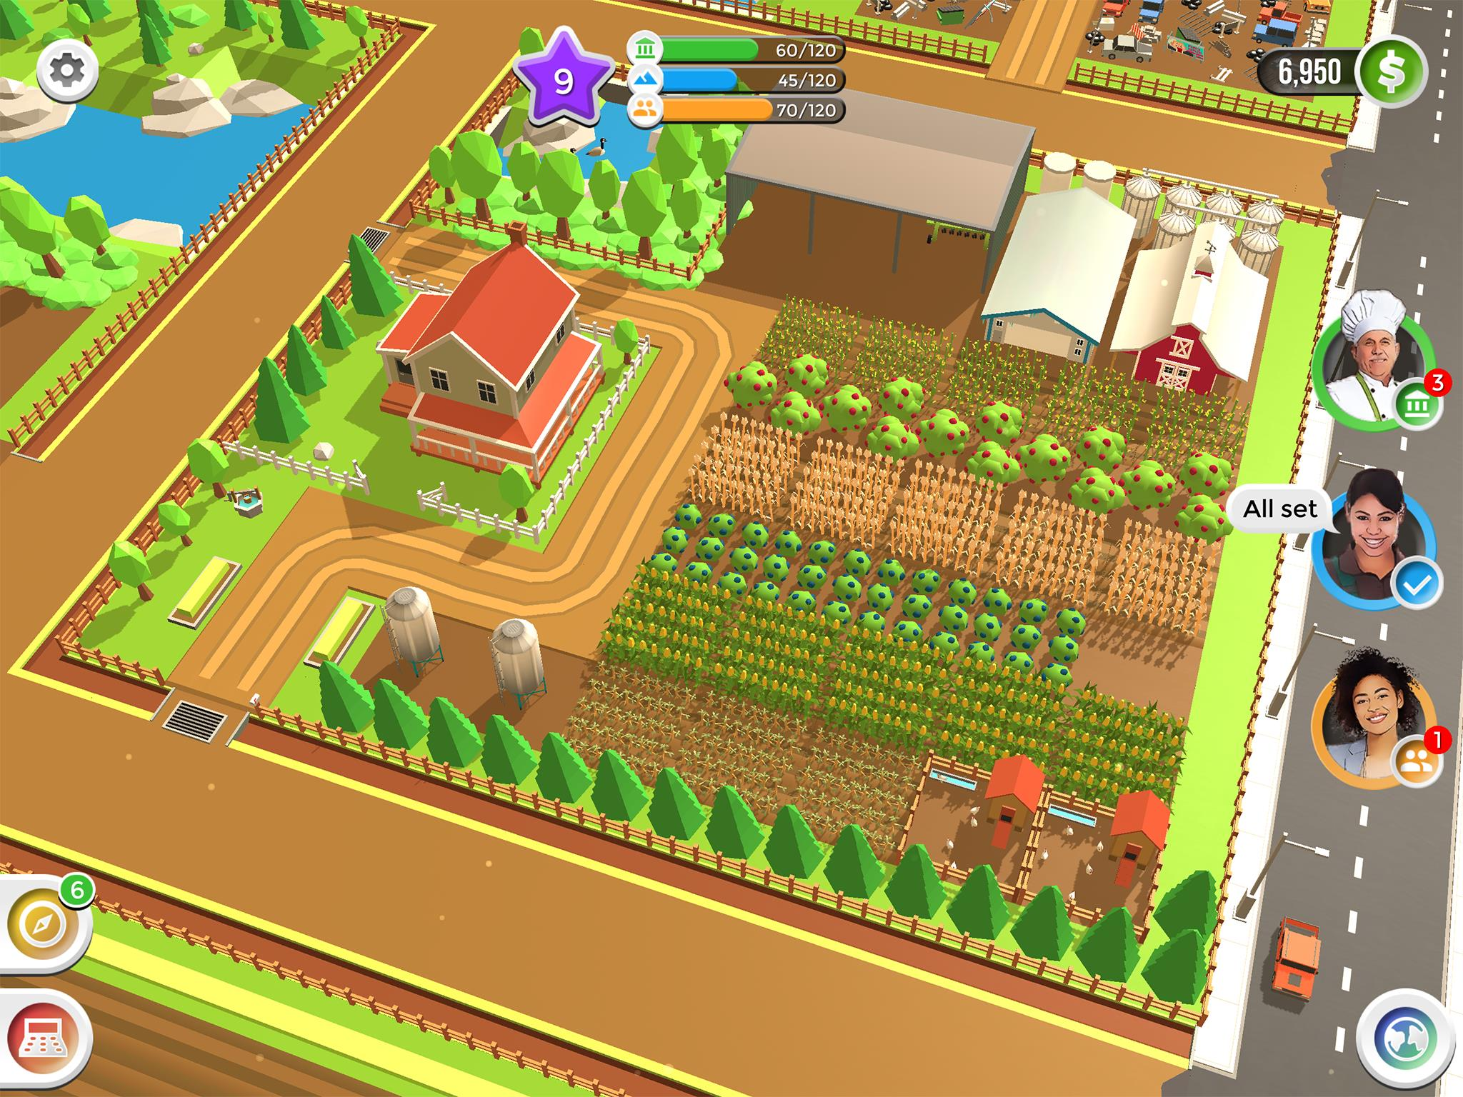
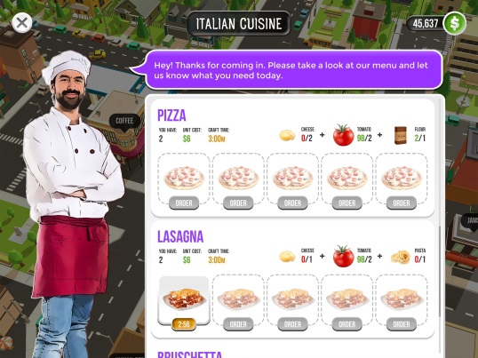
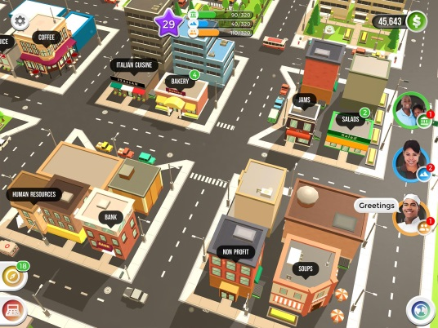
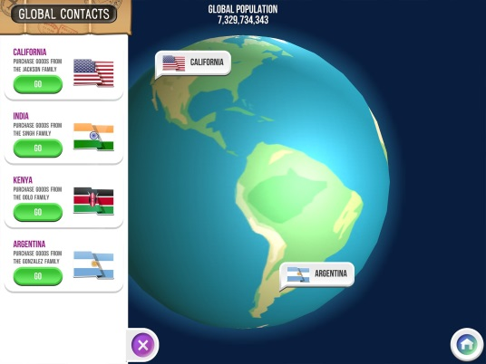


ONE FARM. NO TIMERS.
MORE CROPS, ANIMALS & CRAFTING.
CRAFT
SELL
TRADE
GROW CROPS
RAISE ANIMALS
FREE. NO ADS or IN-APP PURCHASES
Notes:
FARMERS 2050 is an animated farming game. Droughts occur, mortgage payments come due, and farm chores never stop. Students will discover what it really takes to feed the world.
Players will have one farm, instead of three, to grow crops, raise animals, and craft goods to sell in your local community all the while managing the three pillars of sustainability: environment, economic and social. Sound familiar!
Along the way, real farmers from across the world will show students what they are doing on their farms.
Farmers is FREE to play and there are no advertisements or in-app purchases.
It is available on iOS and Android devices.
Learn more at www.Farmers2050.com
30 Second Preview: https://youtu.be/dWxNwQKhbJg

Slide 19



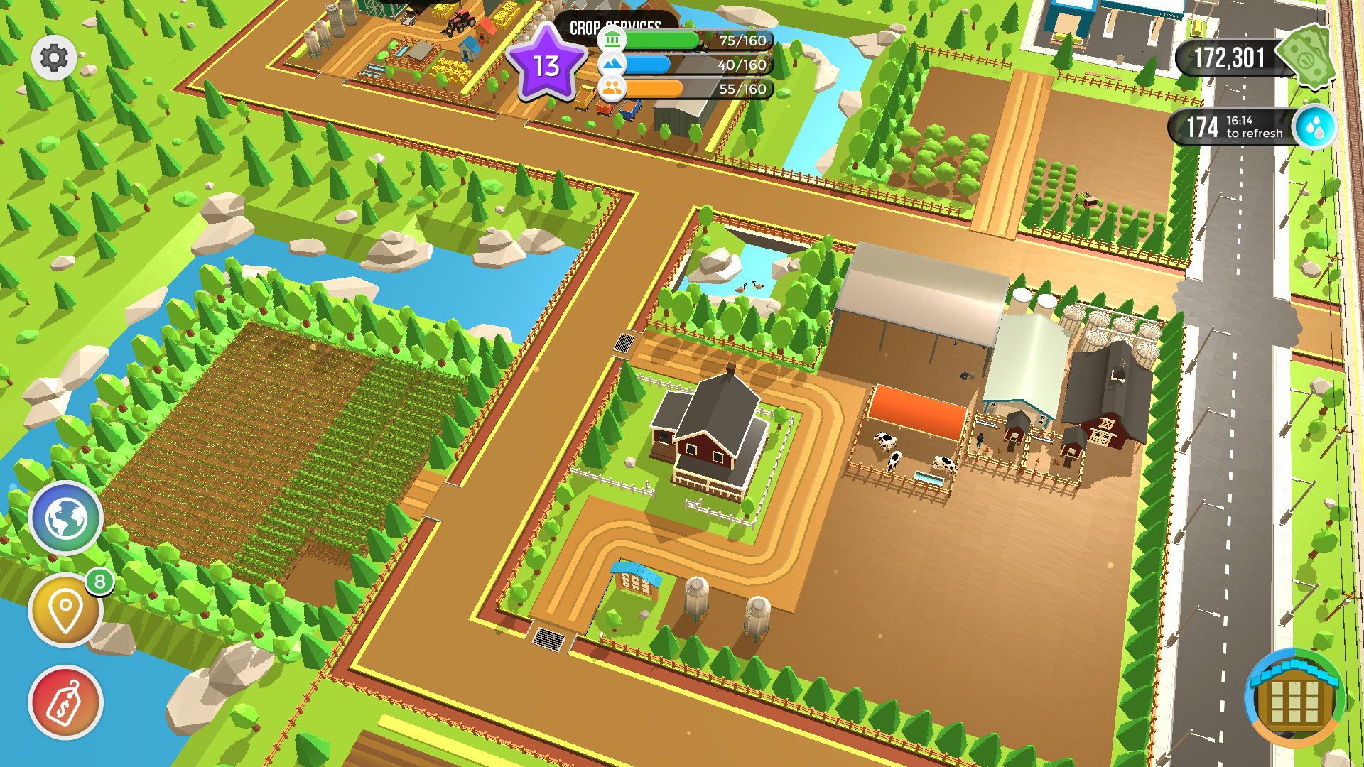
EXAMPLE: Global Event + SDG Goal + Donation
Droughts in Australia were featured in Global Events
Teams virtually grew crops for livestock to donate to those in need
Supported awareness of Sustainable Development Goals
Showcased $100,000 donation made by Nutrien to support Australian ranchers
Notes:
One of the best parts of Farmers 2050 is that we tied Global Events based on Real Life to the Sustainable Development Goals (SDGs). Players have to work together to address a challenge. Every so often charitable donations are highlighted that support the global challenges in real-life!
Examples:
No hunger
Good health
Quality education
Clean water and sanitation
Clean energy
Good jobs and economic growth
(Note this is an example of a donation that would have happened regardless of the game-play. The cool part of the game is that it allows for real-life events and donations to be featured to showcase improvements being made on the ground to help the SDGs.)
Backgrounder:
Sdg = SUSTAINABLE DEVELOPMENT GOAL
The United Nations launched the SDGs in 2015 – there are 17 goals the world must work together to address such as Zero Hunger, Clean Water, Responsible Consumption and Production etc.
https://www.un.org/sustainabledevelopment/sustainable-development-goals/

Slide 20










Brought to you in collaboration
www.Journey2050.com
Notes:
Brought to you by community partners around the world.
A few of thesemay be present in your area, we ask that you please check with the orization you are near if they have a role with Journey 2050 in the community already to collabaorate rather than work against eachother.

Slide 21

Questions?
Journey2050@nutrien.com
Notes:
Thank you for participating in the Journey 2050 program.

