Slide 1
Do people waste food?
Notes:
Option to teach as an independent lesson another day: Slides 21-25

Slide 2
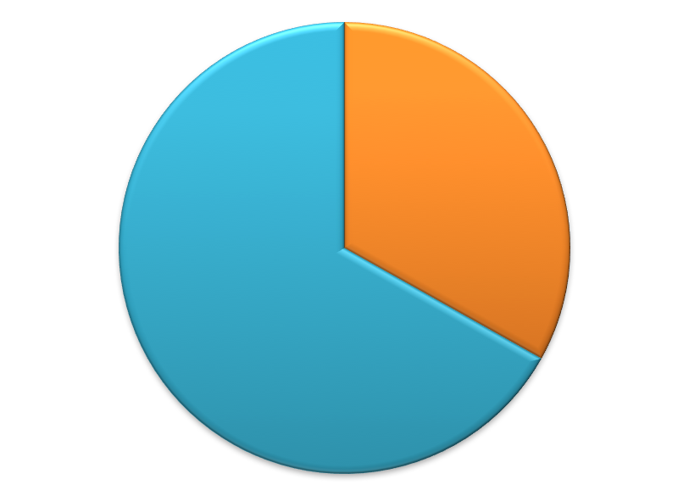
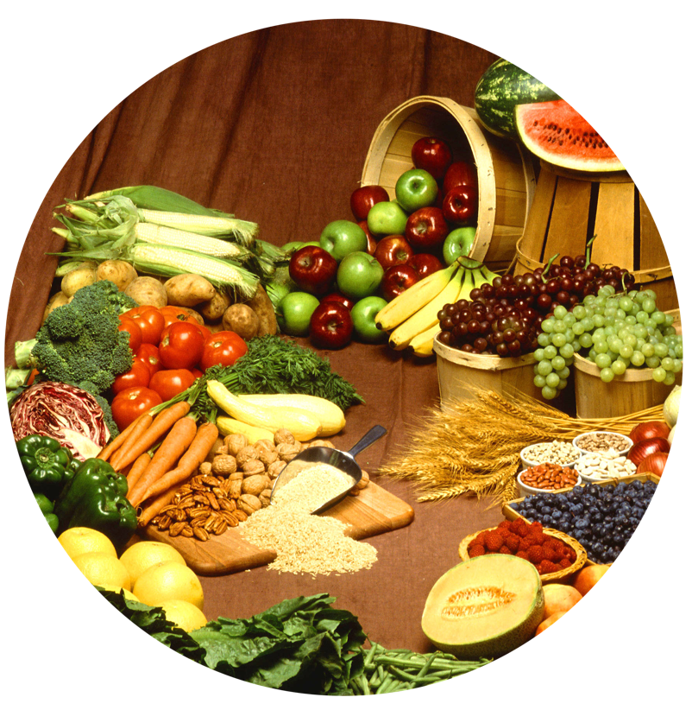
Food security risk
There are an estimated 1.4 billion people living in extreme poverty and around 870 million people that are hungry, malnourished and food insecure (have difficulty acquiring food).
Developed countries food is thrown out and overconsumed
Developing countries food is lost to unreliable storage and transportation.
Of all the food produced on our planet…
1/3 of our total food supply is wasted
Hunger is often caused by food waste and inequality of distribution, not scarcity.
Notes:
Take some time with your students to discuss the risks of food security. There are food security risks in all parts of the world, and unfortunately there is one prominent threat that we all contribute to: food waste. Unfortunately, about one-third of our current global food supply is wasted. There are an estimated 1.4 billion people living in extreme poverty, and about 870 million people that are hungry, malnourished and food insecure (have difficulty acquiring food). In developed countries food is thrown out and overconsumed, and in developing countries food is lost to unreliable storage and transportation.
Hunger is often caused by food waste and inequality of distribution, not scarcity.
Ask your students this question, “How often do you throw food out and what else could you do with that uneaten food?” Discuss ways the students can reduce their personal food waste, such as making or ordering only what you NEED to eat, composting, saving food for leftovers to eat later, etc.
Sustainable agriculture is critical in the global effort to eradicate hunger and poverty, and reducing waste can improve the sustainability of agriculture.

Slide 3
How does food waste impact sustainability & hunger?
Watch The Ugly Carrot Video
Have you ever seen a carrot or other similarly misshaped produce item at a grocery store?
If you did see this carrot (or another similar produce item), would you buy it?
Why or why not?
Would you pay the same price as if it was perfectly shaped?
Notes:
Play the video clip, The Ugly Carrot (https://www.youtube.com/watch?v=EswyKGgk_Dc). Then ask the following questions:
Have you ever seen a carrot or other similarly misshaped produce item at a grocery store?
If you did see this carrot (or another similarly misshaped produce item), would you buy it? Why or why not? Would you pay the same price as if it was perfectly shaped?

Slide 4
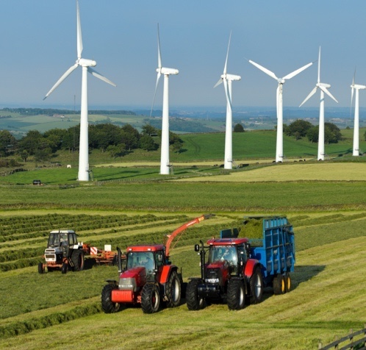
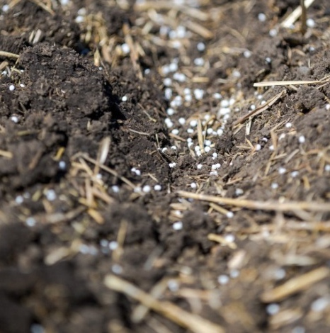
How does food waste impact sustainability & hunger?
An estimated 1.3 billion tons of food never reaches a table.
What does it cost our environment to produce the food that we throw away?
Water
Fuel & Energy
Land & Soil
Soil Nutrients
Notes:
Ask students, “How does food waste impact sustainability and hunger?”
Students will likely associate food waste with hunger and recognize the moral, economic and social implications. Provide guiding questions to help students also recognize the impact to our environment and natural resources that food waste has.
Ask, “Besides the food itself, what else is wasted?”

Slide 5
BRAINSTORM CHALLENGES
When a country is hungry…
When a country has an overabundance of food...
Malnutrition and health care risks
Violence and thievery
Vulnerability to markets and storage
Decline in education attendance
Political distress and corruption
Decline in infrastructure, investment in technology and innovation
Risk of unsustainable practices across industries
Quality food is thrown out
Obesity - Increasing calorie-intake (eating more per meal)
Rise in Western-style diets and desire for food from other places (increased markets, infrastructure)
Shift to more urban population which can result in disconnect with life on the farm
Consumer demands and perspectives influence food value chain (genetically modified, organic, free range vs barn raised animals, herbicides, pesticides, food labels, country of origin traceability, animal care, food preparation, sanitation, packaging, preservatives...)
Notes:
On the board, brainstorm potential challenges that could arise when the people of country are hungry (malnutrition and health care risks, violence and thievery, vulnerability to markets and storage, decline in education attendance, political distress/corruption, decline in infrastructure, decline in investment in technology and innovation and risk of unsustainable practices across industries). On the board, brainstorm potential challenges that could arise when a country has an overabundance of cheap food (quality food is thrown out, obesity, increasing calorie-intake (eating more per meal), rise in Western-style diets, desire for food from other places (increased markets, infrastructure), shift to more urban population which can result in disconnect with life on the farm, consumer demands and perspectives influence food value chain (genetically modified foods, organic, free range animals, herbicides, pesticides, food labels, country of origin traceability, animal care, food preparation, sanitation, packaging, preservatives, etc.).
Optional questions for higher grades: How can governments be involved in food security? (Governments can provide regulations, policies, education programs, low interest loans, investment in research and development, and share practices with other countries.) What happens when there is corruption in government or a huge gap between the rich and poor?

Slide 6
Wrap-Up
Over one-third of our food is wasted in both developing and developed countries.
Hunger is often caused by food waste and inequality of distribution, not scarcity.
Food waste decreases sustainability due to the inefficient use of natural resources, such as arable land, soil nutrients, water and energy.
Food waste can negatively affect our quality of life and create undesirable outcomes in a country.

