Slide 1

ONLINE EXPERIENCE

Slide 2
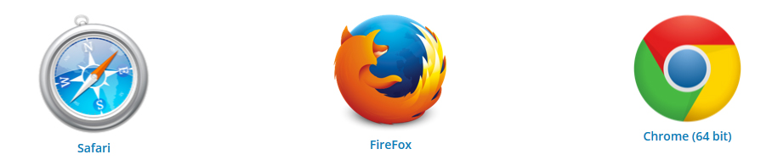
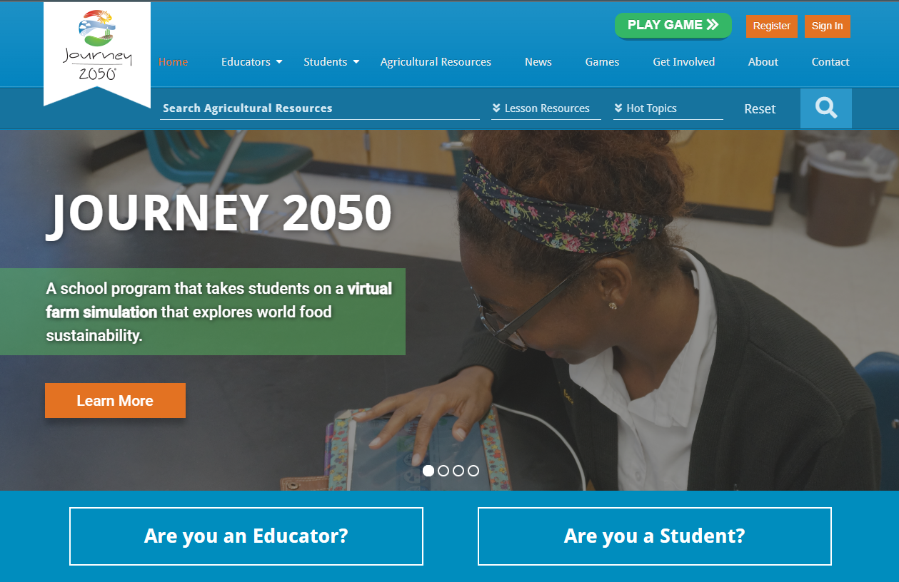
Website Overview
Notes:
www.journey2050.com
The entire program is available by going to www.journey2050.com
The game and website only work in Google Chrome, Firefox and Safari browsers. Old browsers like IE8 do not work.
Teachers first step is to register for the program. Once you have registered you can sign in to access the curriculum and program options.
Students can use the button to easily access the game and start playing if you are planning to have them play through the browser.

Slide 3
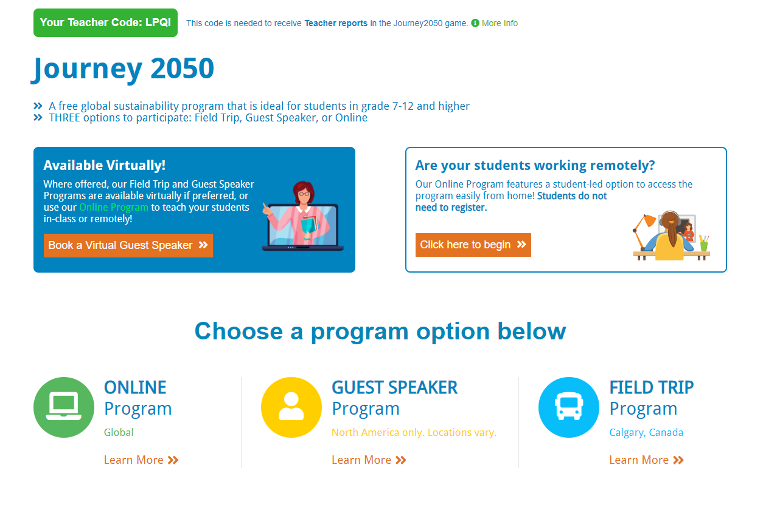
Notes:
From the landing page you can choose which program option you want to participate in.
Students must enter your teacher code (seen in the green box on the top left of the screen) for you to receive teacher reports (see slide 6 for more information on reports).

Slide 4
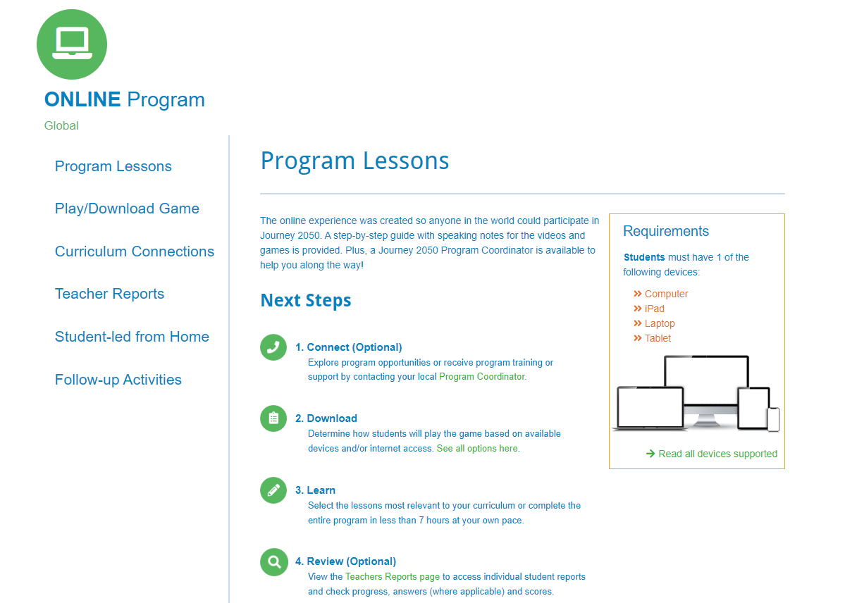
Notes:
Run through side-bar items:
Program Lessons - All program resources are found here (example on next slide)
Play/Download Game – Provides all options available for downloading/playing
Curriculum connections - Powered by EdGate (also available on the website under the Educators tab)
Teacher reports – This is where you access your reports if students are using your teacher code
Self-guided experience – Guides you through delivering the program if students are working in a self-led environment (ie: remote) or with a substitute.
Follow-up activities - for your classrooms continued learning about sustainability
Each program option also outlines a step-by-step guide for delivery. You can see the online program guide on this screen under Next Steps. The program content can be found directly below.

Slide 5
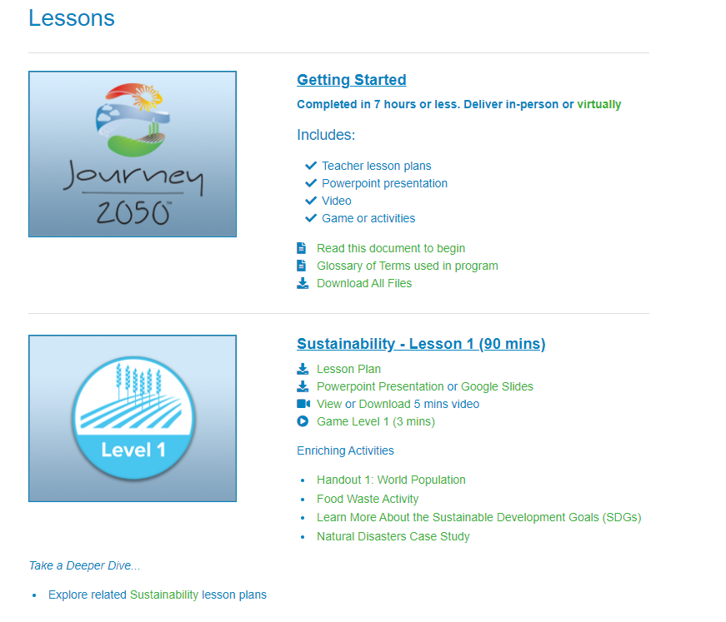
Notes:
You can download all files you will need for program delivery if desired under the "Getting Started" tab or go through each lesson individually.

Slide 6
Teacher reports
Teacher reports are an optional resource to track students’ progress in the game and are meant to be used as a completion/grading tool or discussion resource.
Your 4-digit teacher code must be used to generate teacher reports.
Reports are currently generated after each section of the game. You can expect to receive a cumulative report after levels 4 (farming), 5b (geography) and 6 (careers). Reports will be named by the section completed and student number.
Students must have internet connection to generate reports. Reports may take up to 24 hours to generate in the teacher's account.
We do not collect any personal identifiable information (PII) on students. Educators will be responsible for numbering students outside of the system before playing the game if you want to generate teacher reports.
For more information on student PII and see examples of the reports: https://www.journey2050.com/educators/student-privacy-faq/
Student steps:
  When students go to play the game, they will be prompted to enter your teacher code to generate teacher reports (this is optional).
  If they enter your teacher code, they will then be prompted to enter a student number provided by you.
  If you are not using your teacher code for reports, students will not need to enter a number and will go directly to gameplay.
Notes:
Teacher reports track students’ progress in the game and are meant to be used as a completion/grading tool or discussion resource.
Your teacher code (see slide 3 for location) must be used to generate teacher reports. Reports are currently generated after each section of the game. You can expect to receive a cumulative report after levels 4 (farming), 5b (geography) and 6 (careers). If students are logging out between the farming levels (1-4), no problem! A report will still generate after level 4 but the score will be lower as it won’t be cumulative. Students must have internet connection to generate reports. Reports may take up to 24 hours to generate in the teacher's account.
Student privacy and confidentiality are important, and to limit risk to the students and schools using our program around the world, we do not collect any personal identifiable information (PII) on students.
What this means is that educators will be responsible for numbering students outside of the system before playing the game if you want to generate teacher reports.
When students go to play the game, they will be prompted to enter your teacher code to generate teacher reports (optional).
If they enter your teacher code, they will then be prompted to enter a student number provided by you.
For your teacher reports, they will show as the section completed and the student number, ie) Student 1, Student 2, etc. (based on the numbers you provided) in your teacher account.
If you are not using your teacher code for reports, students will not need to enter a number and will go directly to gameplay.
https://app.journey2050.com/teacher/online/reports/

Slide 7
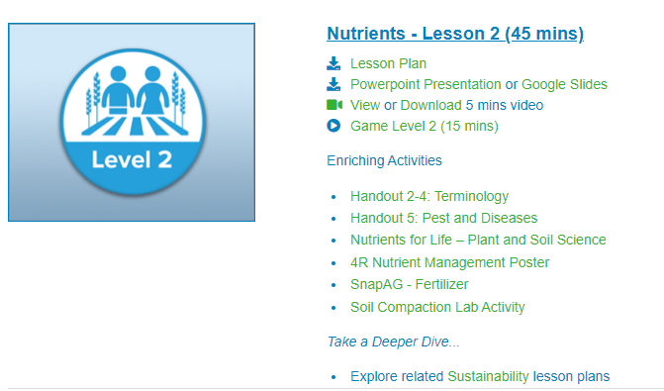
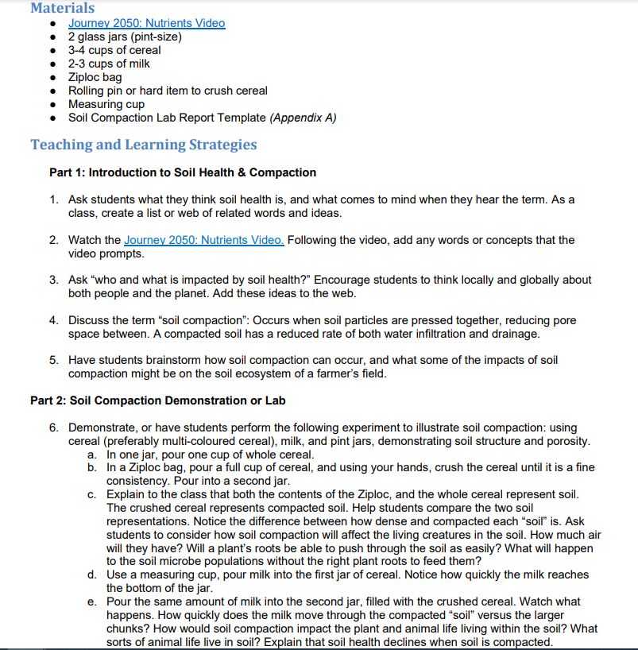
Enriching Activities and "Deep Dives"
Notes:
These activities are optional and provided in addition to the core curriculum. Many of the activity topics actually came directly from teacher feedback surveys about what topics teachers and students wanted to learn more about.
So what’s the difference? Deep Dives are full, curriculum-linked lesson plans. These are comprehensive and provide the deepest dive (if you will) on key topics. Enriching activities are just that - optional and in many cases hands-on - activities or related resources like websites or one-page snap-sheets that explore related topics and/or solidify key Journey 2050 outcomes. All of these activities were created by or in collaboration with our Journey 2050 program partners.
Topics include:
Food waste
Ag Economics
Animals in Ag
Soil Health
Water
Urban Agriculture
Natural Disasters & Sustainability
the Sustainable Development Goals (or SDGs)

Slide 8
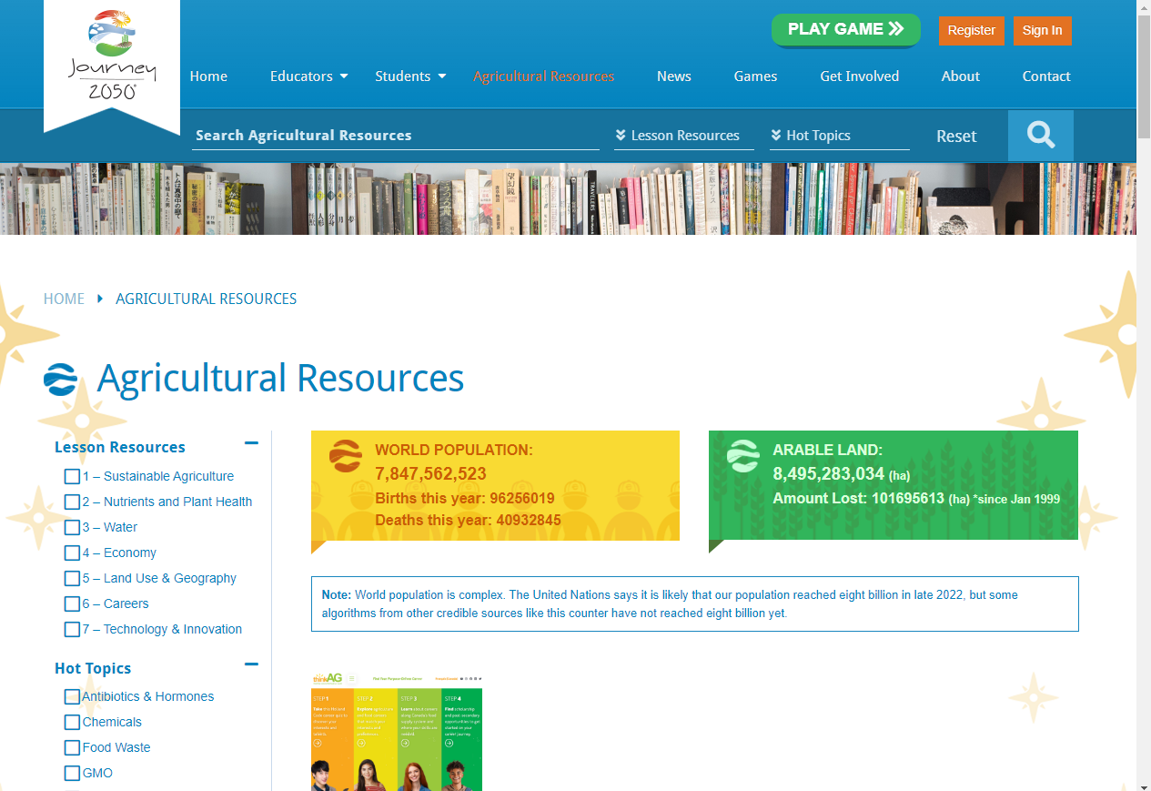
Additional Aggie Resources
Notes:
Found on the program website – search for agricultural resources by Journey 2050 lesson topic, hot topic (ie: GMOs), or resource type (video, website, etc.)

Slide 9
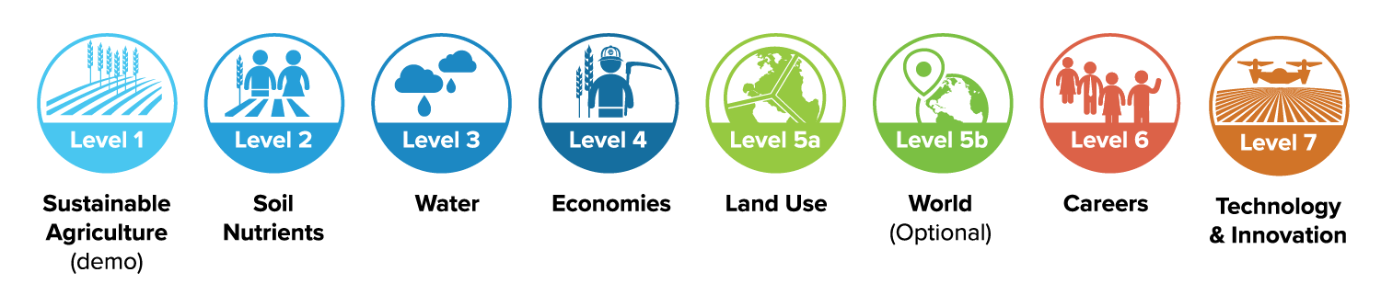


Program Outline
GAME: Levels 1-6
Notes:
Core topics include:
Level 1: introduction, sustainable agriculture, food waste
Level 2: best management practices, soil health and nutrients
Level 3: water and conservation
Level 4: economic influence, trading goods
Level 5: geography, cultural influences
Level 6: agricultural careers
Level 7: technology and innovative solutions
The levels are color coded to help explain the game connections. 1-4 is actually one game, so students only have 1 score based on completion of those levels
Each level progressed to the next
Level 5 and 5b are independent games
Level 6 is a career avatar game, and the last level of the game.
Level 7 – showcases new technology and innovations being used in agriculture . Features an activity instead of a game.
Students do not need to register but they will need their own device to play. Students can download the game on the App Store, Google Play or play online at www.Journey2050.com

Slide 10
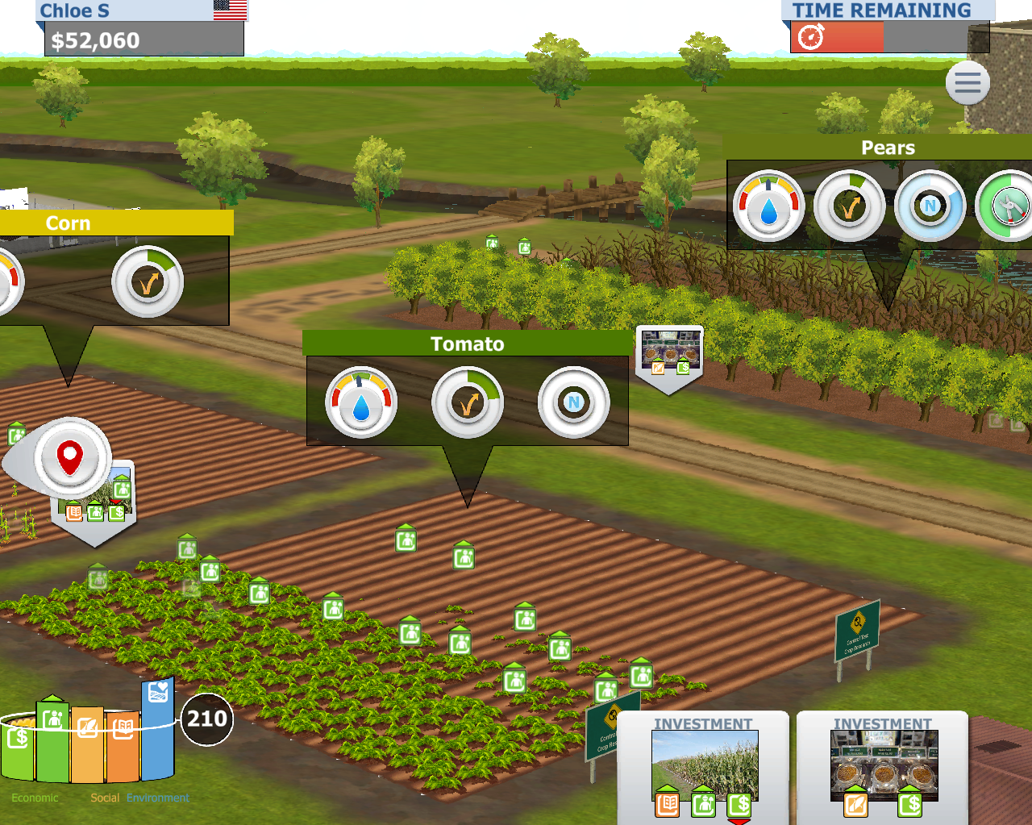
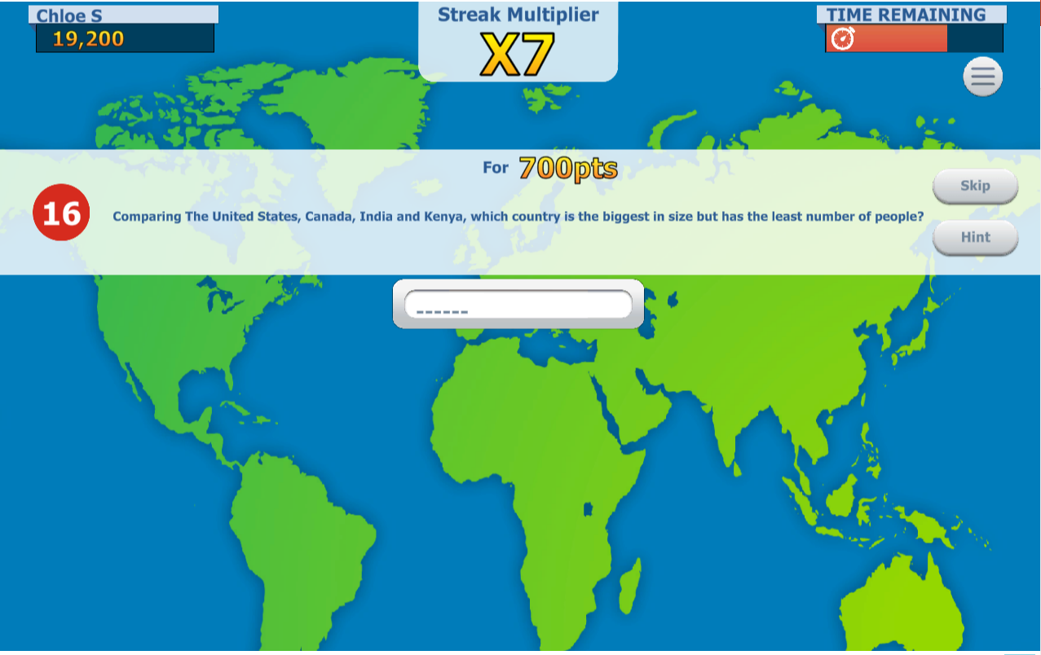
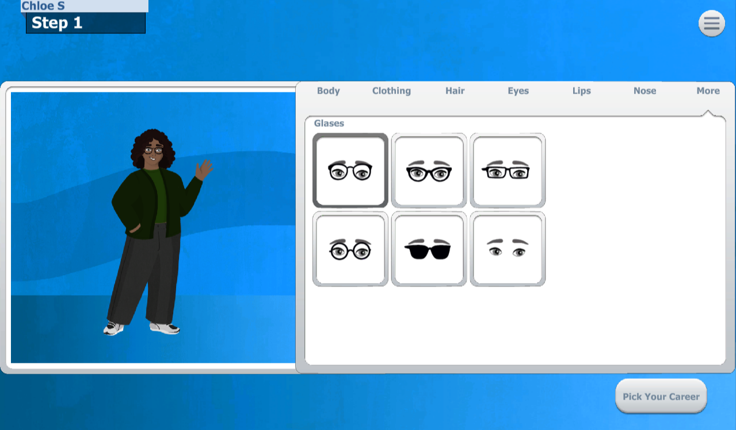
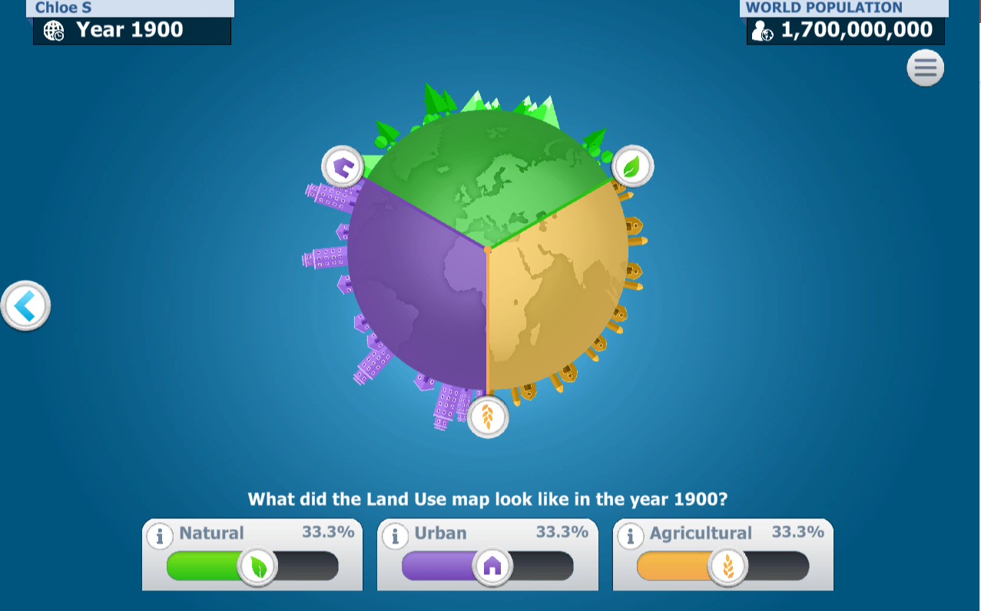
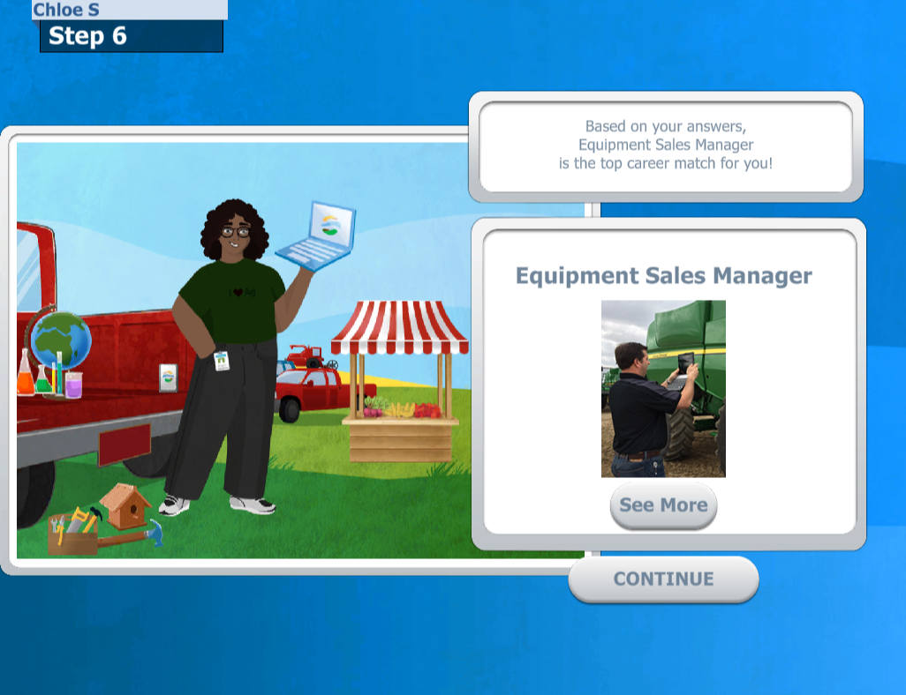

Game levels
Levels 1-4: sustainability farming game
Levels 5a & 5b: Land use and geography games
Level 6: avatar builder
and career quiz
Notes:
Quick snapshot of all the game levels in the program

Slide 11
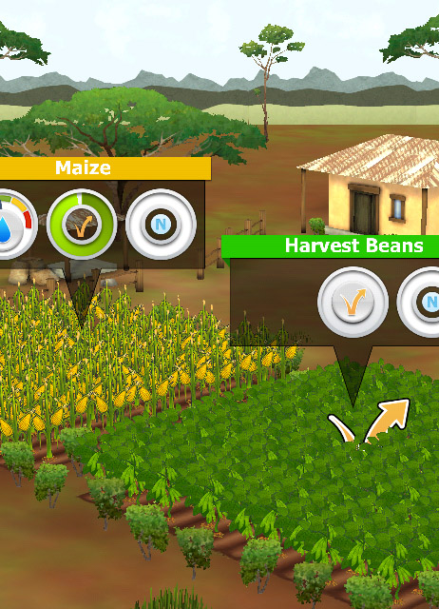
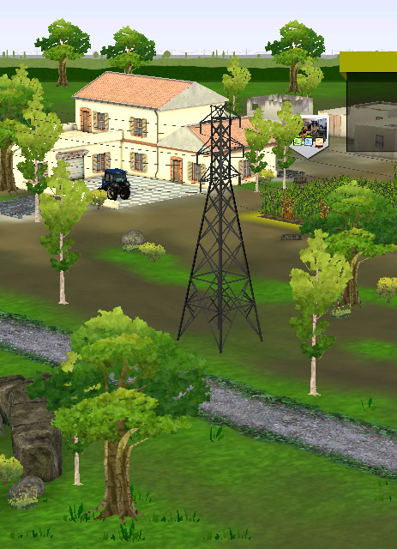
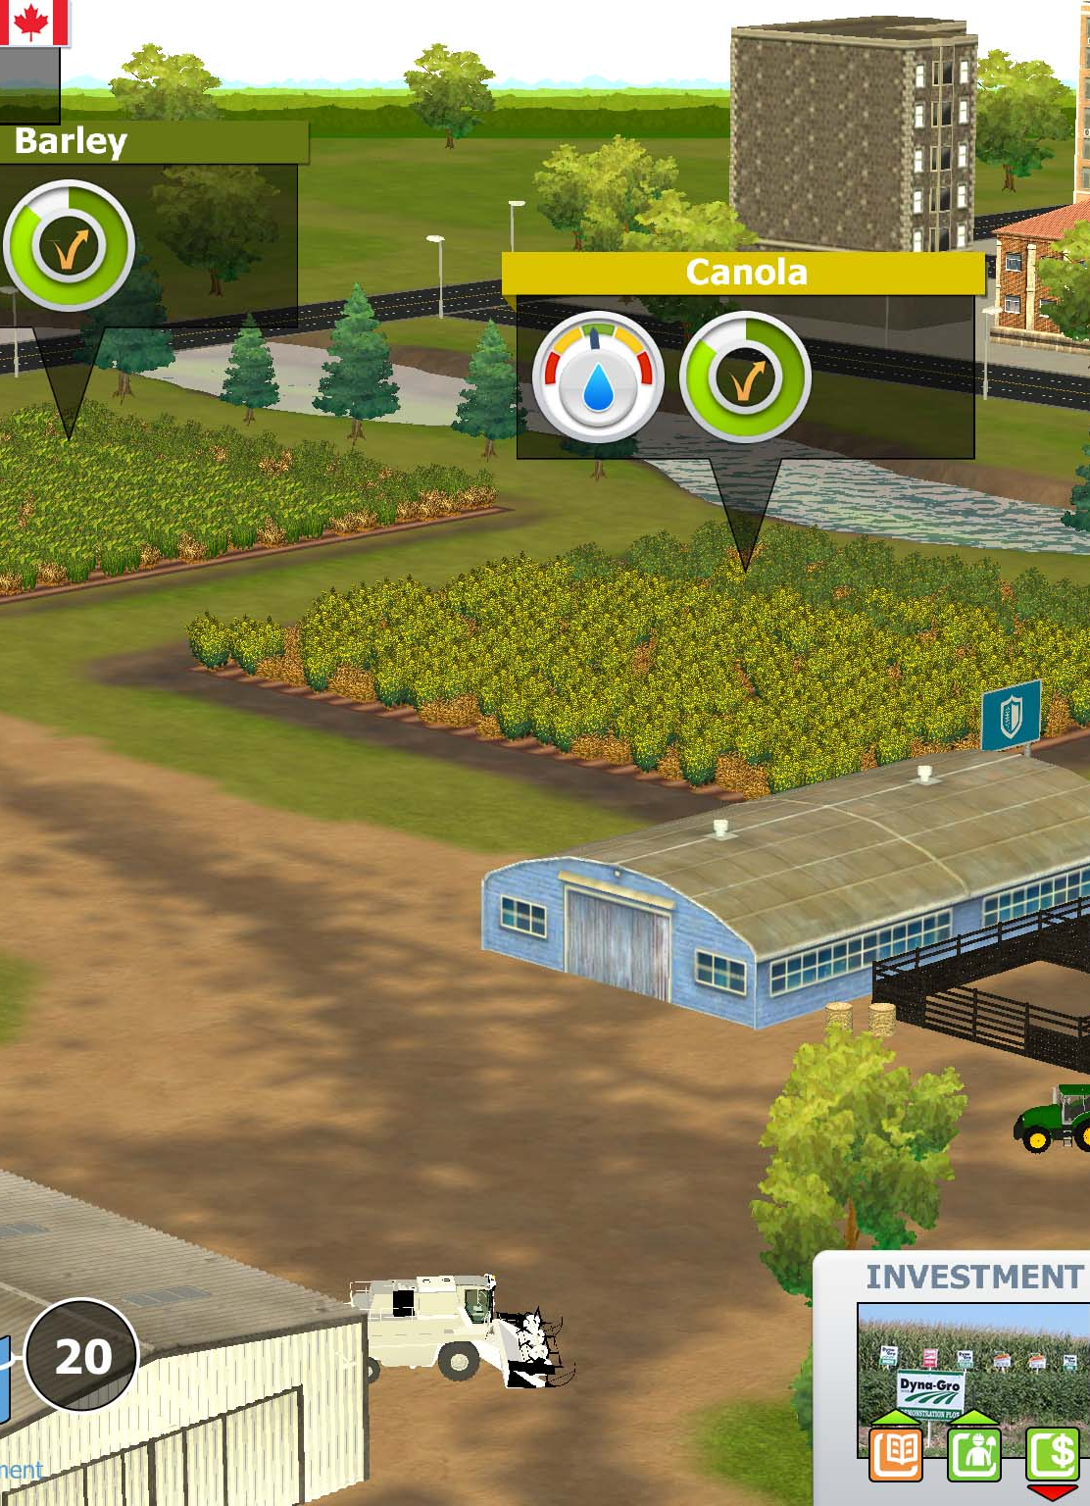
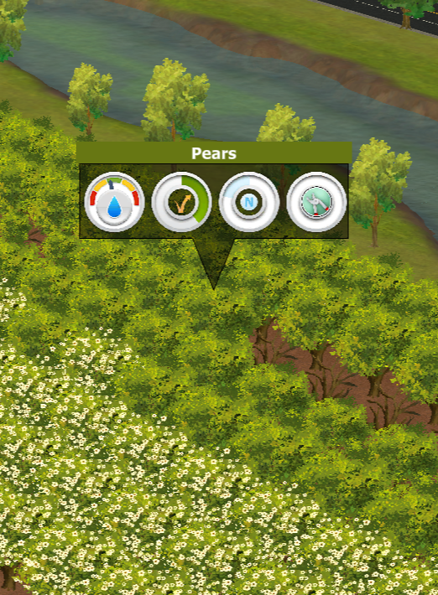
Virtual Farm Game: Real Farm Families
KENYA
INDIA
CANADA
UNITED STATES
Notes:
Students will experience life on the farm in 3 countries – Kenya, India and Canada or the United States. Once a student chooses their preferred country between Canada and the United States, they will farm in that country for the remainder of the farm game.
Each country has specific crops, challenges and farming practices that are based on the real-farm families lives.
Each level in the game gets harder with more challenges that the students have to respond to (for example in level 3: water hail occurs; in level 4: economies they must harvest and choose who to sell their crop to)
Levels are timed to provide students with the same opportunity and fit class timeframe.
Level 1 is a demonstration of the game. It takes 5 minutes to complete.
Level 2-4: Students farm in each country for 5 minutes (total is 15 mins per level).
Reports are provided for the teacher to help evaluate student comprehension but the virtual farm game is unique in that Level 1-4 must be completed at once or on the same device by the same student to generate a report as it is considered one game.

Slide 12
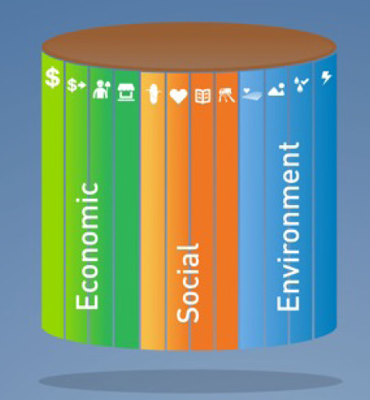
Sustainability Barrel is the Score
ECONOMIC FACTORS:
profits, jobs, incomes, community
SOCIAL FACTORS:
food, education, health, infrastructure
ENVIRONMENTAL FACTORS:
soil health, habitats, water, greenhouse gases
Notes:
I would like to introduce you to a unique way to remember sustainability.
Picture a “sustainability barrel”. The pieces that make up the barrel are made up of 3 different factors: – Economic, Social, and Environmental. These three different things are key parts of sustainability. In our Journey to 2050 through this program, we will be looking at some of these different elements individually and discovering how they are important to sustainability.
For example, in order to be able to grow enough food to feed the world sustainably, we have to make sure that the soil stays healthy, that we have enough water to grow the food, that we don’t destroy habitats and that farmers are able to earn a profit.

Slide 13
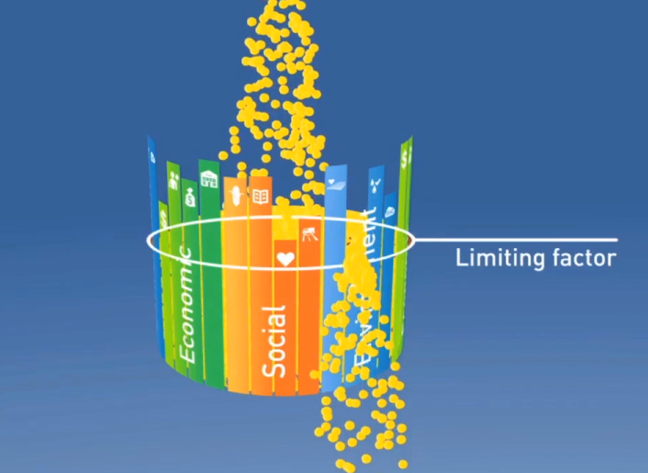
Sustainability Barrel is the Score
A community is only as successful as the least developed factor.
We must continually try to improve the weakest one.
Notes:
A community is only as successful as the least developed sustainability factor. We call this our ‘limiting factor’ - We must continually improve the weakest part of our sustainability – whether it is education or soil health – they all impact our ability to feed the world.
In the Sustainability Farming Game, the sustainability barrel is what we use to keep score. Our score will only be as high as our limiting factor, so we have to pay attention to everything, and be careful with the choices we make if we want to farm sustainably. Students will see their barrel begin to reflect their choices as they play.
Highest score possible is 1,000 points!
Sustainability varies across the globe with each factor facing different opportunities and challenges.

Slide 14
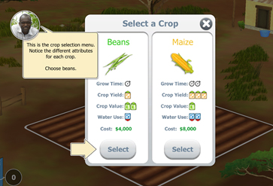
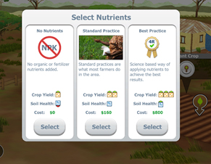
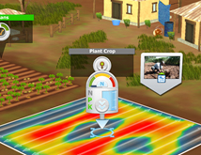
Crop Nutrients
1
2
3
Notes:
1. Select crop
2. In level 2, 3, 4 students can choose which form of nutrients they want to apply to their field.
3. If they choose Best Practice a map appears where the nutrients need to be applied (yellow and red). If students over apply the nutrients or apply the nutrients in an area that does not need it their sustainability barrel will decrease (money and environmental score will decrease).

Slide 15
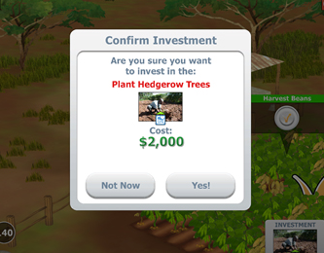
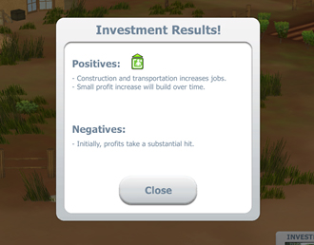
Community Investments
Realistic investments to each country
Ripple effect of each choice
Notes:
Students have the opportunity to make community investments through the game.
These choices are realistic based on the country and type of farm.
Each investment has a positive and negative result when either made or passed on. This showcases the power of the ripple effect of our choices we make - that there is always an impact made on the community, economy and environment. Students will see the results of their choices illustrated in the sustainability barrel throughout the game.

Slide 16
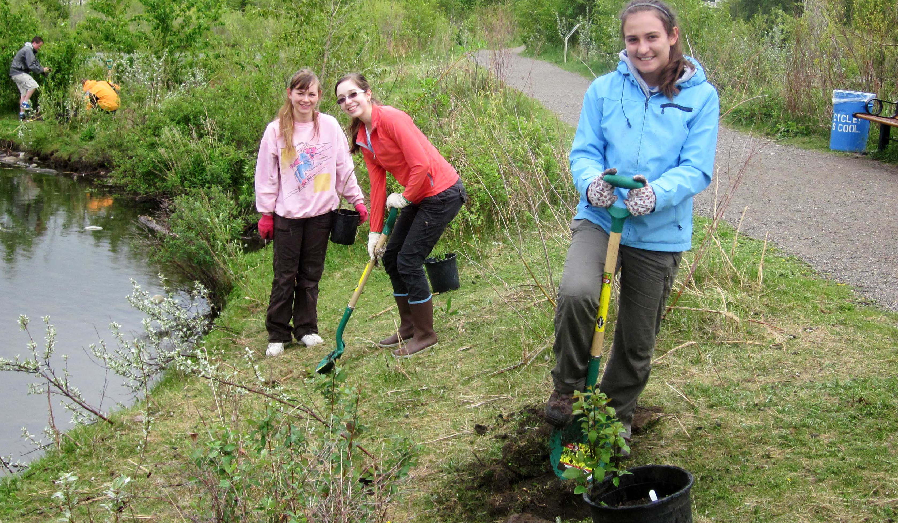

Summary
Project-Based Learning
Notes:
Students will answer the question, “How will we sustainably feed nearly 10 billion people by the year 2050?” by developing and potentially implementing a solution to take action to address world food sustainability.

Slide 17
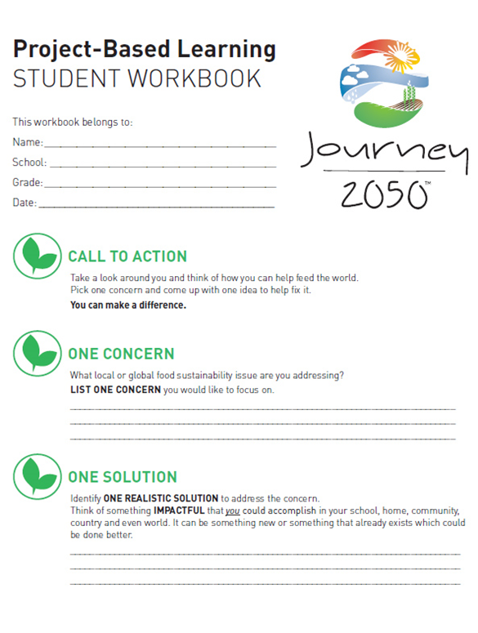

Take Action
Notes:
The Action level is the program summary, centered around project-based learning.
This level is designed to give students the opportunity to develop a personally meaningful project using the knowledge they acquired through Journey 2050 to support sustainability in their local community.

Slide 18
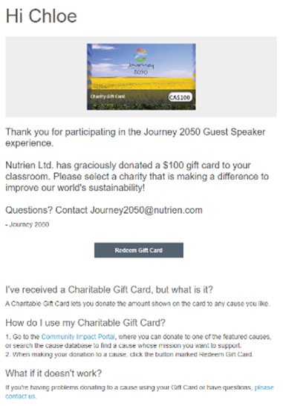
Win $$$ to donate!
Classrooms who participate in the Journey 2050 program and fill out a feedback survey are entered to win a $100 credit to donate
Recipients receive the gift card via email and can redeem the gift card through the Community Impact Portal by searching for and selecting the nonprofit they are most passionate about
The survey is available through program partners or available on the website under the Get Involved tab
Notes:
Classrooms who complete the Journey 2050 program (Online, Guest Speaker, and Field Trip classrooms are eligible) and fill out a feedback survey are entered to win a $100 credit to donate to a not-for-profit organization that is contributing to sustainability as a real-world application and extension of the Journey 2050 program.
You can see an example of the charitable gift card on the screen. Recipients receive the gift card via email and can redeem the gift card through the Community Impact Portal by searching for and selecting the nonprofit they are most passionate about.
It’s a meaningful way for students to give back to communities and make a real-life difference. The survey is available through program partners or available on the website under the Get Involved tab.

Slide 19
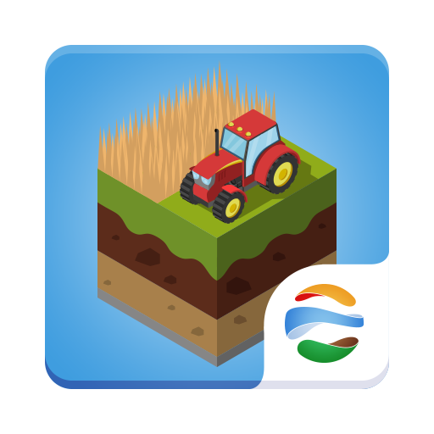

Journey expansion
SCHOOL EDITION: JOURNEY 2050
HOME EDITION: FARMERS 2050
Notes:
The Journey 2050 game is available for Android and iOS devices; however, it wasn’t intended for public use. It has timers to make sure the students all start and stop roughly at the same time, and it has a limited number of commodities simply because there isn’t enough time in the program to incorporate everything in agriculture.
Students who want to play at home are encouraged to download: FARMERS 2050

Slide 20



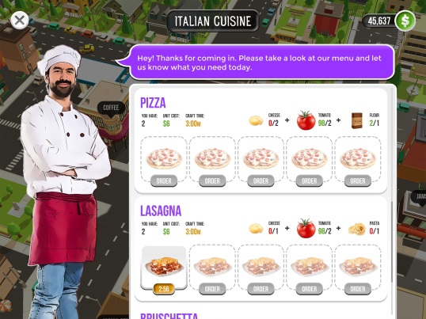
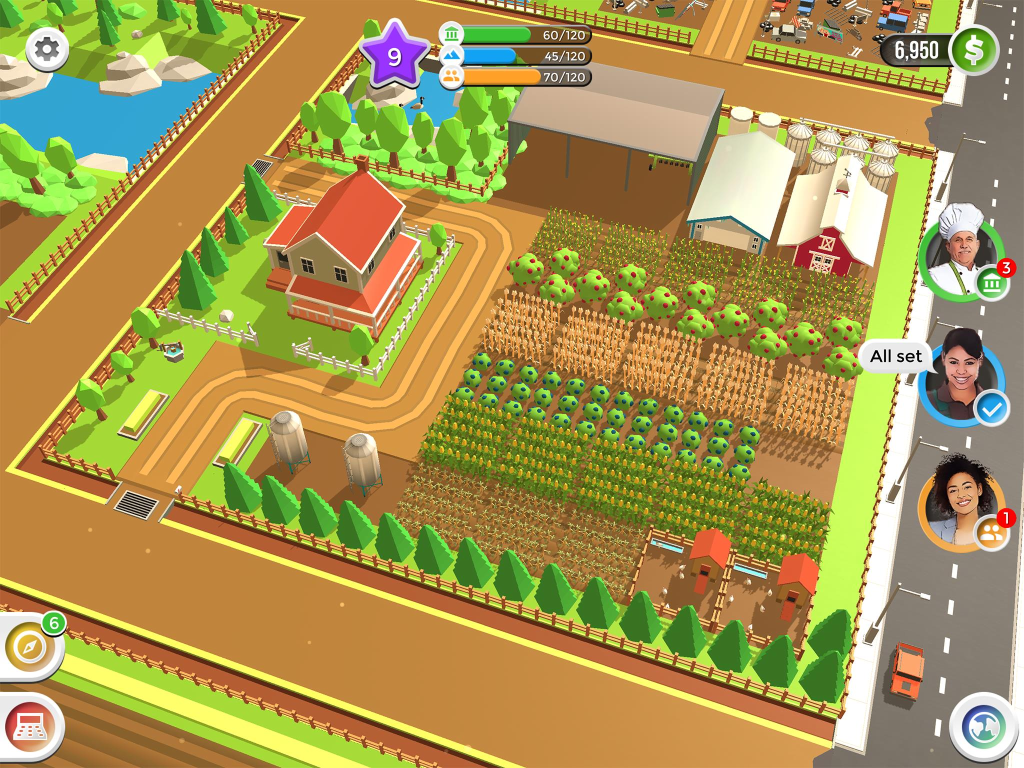
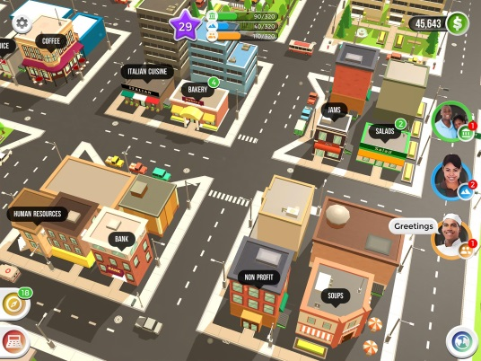
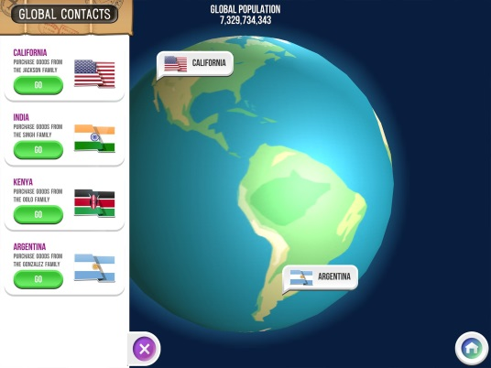
ONE FARM. NO TIMERS.
MORE CROPS, ANIMALS & CRAFTING.
CRAFT
SELL
TRADE
GROW CROPS
RAISE ANIMALS
FREE. NO ADS or IN-APP PURCHASES
Notes:
FARMERS 2050 is an animated farming game. Droughts occur, mortgage payments come due, and farm chores never stop. Students will discover what it really takes to feed the world.
Players will have one farm, instead of three, to grow crops, raise animals, and craft goods to sell in your local community all the while managing the three pillars of sustainability: environment, economic and social. Sound familiar!
Along the way, real farmers from across the world will show students what they are doing on their farms.
Farmers is FREE to play and there are no advertisements or in-app purchases.
It is available on iOS and Android devices.
Learn more at www.Farmers2050.com
30 Second Preview: https://youtu.be/dWxNwQKhbJg

Slide 21
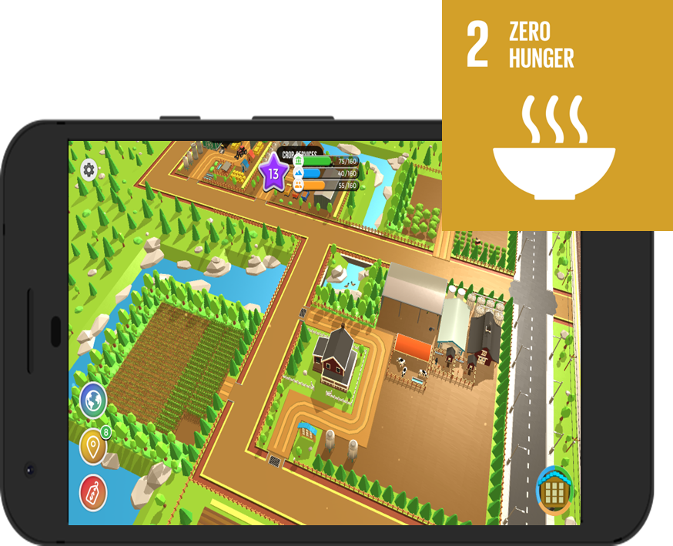
EXAMPLE: Global Event + SDG Goal + Donation
Droughts in Australia were featured in Global Events
Teams virtually grew crops for livestock to donate to those in need
Supported awareness of Sustainable Development Goals
Showcased $100,000 donation made by Nutrien to support Australian ranchers
Notes:
One of the best parts of Farmers 2050 is that we tied Global Events based on Real Life to the Sustainable Development Goals (SDGs). Players have to work together to address a challenge. Every so often charitable donations are highlighted that support the global challenges in real-life!
Examples:
No hunger
Good health
Quality education
Clean water and sanitation
Clean energy
Good jobs and economic growth
(Note this is an example of a donation that would have happened regardless of the game-play. The cool part of the game is that it allows for real-life events and donations to be featured to showcase improvements being made on the ground to help the SDGs.)
Backgrounder:
Sdg = SUSTAINABLE DEVELOPMENT GOAL
The United Nations launched the SDGs in 2015 – there are 17 goals the world must work together to address such as Zero Hunger, Clean Water, Responsible Consumption and Production etc.
https://www.un.org/sustainabledevelopment/sustainable-development-goals

Slide 22









Brought to you in collaboration
www.Journey2050.com
Notes:
These programs are brought to you by community partners around the world. National program partners are listed on the screen but this includes many regional (state or provincial) partners as well.

Slide 23
Questions?
Journey2050@nutrien.com
Notes:
Thank you for participating in the Journey 2050 program.

